Slide 1

After Massage School
Steps for getting Nationally Certified and/or Licensed

Slide 2
National Certification
TLC’s NCBTMB school code: 022140-00.

Slide 3
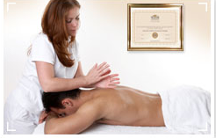
National certification
NCBTMB’s licensure through certification program makes it possible for practitioners to achieve the highest standard in the field – national certification. Plus, it provides many benefits along the way:
  State Licensure – 38 States use NCBTMB exams as part of their licensure process, including the District of Columbia
  Career Support – National online Find a Practitioner resource so potential clients can locate national board certified professionals
  Acceptance by Healthcare community – establishes practitioners as healthcare providers on par with other professional requiring certification

Slide 4
National certification exams
NCETM – the National Exam for Therapeutic Massage
NCETMB – the National Exam for Therapeutic Massage & Bodywork
Content Outline:
  16% General Knowledge of the Body Systems
  19% Detailed knowledge of Anatomy, Physiology, & Kinesiology
  13% Pathology
  16% Therapeutic Massage Assessment
  24% Therapeutic Massage Application
  12% Professional Standards, Ethics, Business & Legal Practices
Content Outline:
  16 % General Knowledge of the Body System
  19% Detailed knowledge of Anatomy, Physiology, & Kinesiology
  13% Pathology
  18 % Massage & Bodywork Assessment
  22% Therapeutic Massage & Bodywork Application
  12% Professional Standards, Ethics, Business & Legal Practices

Slide 5

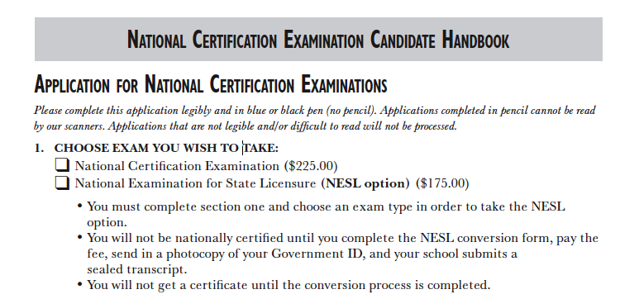
The certification process
HOW TO APPLY
  Go to NCBTMB’s website: http://www.ncbtmb.org/.
  Download their application
  Fill out application
  Pay $225 fee
  You can either fill the application out online and send in additional info, or send in the application and corresponding info
  Please note: You can not apply for National Certification without your official transcript

Slide 6
Additional info you need to send in if you applied online
If you are submitting your application online, you can mail additional
info to:
NCBTMB
Eligibility Department, Online Applications
  1901 S. Meyers Road
  Suite 240
  Oakbrook Terrace, IL 60181
Transcript
(students can request a sealed copy of their transcript to send in with the application, or your student admin. can send a copy of your transcript to NCBTMB)
Official Score Report Request Form
STATEMENT OF UNDERSTANDING

Slide 7
The national certification exams - miscellaneous facts
It will take 3 -4 weeks to process an application.
After your application is processed applicants will either receive an Authorization to Test (ATT), a letter of Incomplete Application or a Denial letter.
NCBTMB contracts with Person VUE, an independent testing company, to administer the National Certification Exams.

Slide 8
The national certification exams miscellaneous facts
Each exam consists of 160 multiple choice questions.
You will receive notification of having either passed or failed the exam as soon as you have completed it.
TLC’s NCBTMB school code: 022140-00.
Transcripts need to be sent directly from the school at which you received your training.

Slide 9
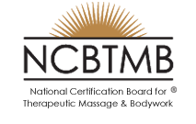

If you are not interested in becoming nationally certified, but still want to take one of the national certification exams for state licensure
OR if you want to take your exam but don’t have your transcript yet, then you can go through the National Examination for State Licensing (NESL) process
TLC’s NCBTMB school code: 022140-00.

Slide 10
the National Examination for State Licensing (Nesl) process
Each exam is available under the National Examination for State Licensing option:
  NCETMB
  NCETM
This option costs $175 for each exam.
With the NESL option:
  You can test prior to having satisfied the 500-hour requirement.
  You can test prior to graduating from a massage therapy program.
  You can convert to national certification within 2 years of passing the exam under the NESL option.

Slide 11
Portfolio review process
If you do not have 500 hours of training from one massage therapy education institution, and you want to be Nationally Certified, then you will have to go through the Portfolio Review Process.
For all information regarding this process please refer to the National Certification Portfolio Review Handbook. (It can be downloaded off http://www.ncbtmb.org)
TLC’s NCBTMB school code: 022140-00.

Slide 12
Important Info to know
Being Nationally Certified does not make you eligible for practicing Massage in Texas (or any other state).
Taking one of the NCBTMB’s exam is only apart of the licensure process.
In order to practice massage in Texas, you must get Licensed by the Texas Department of State Health Services.

Slide 13
Massage & bodywork licensing examination
(MBLEx)
Developed & Administered by the Federation of State Massage Therapy Boards

Slide 14

MBLEx
The examination was developed by the FSMTB, reflects entry level practice (rather than theory) and consists of 125 multiple choice items. The exam costs $195.
33 States recognize the MBLEx
The FSMTB has established two avenues of eligibility to take the MBLEx.
  The first is for individuals who apply directly to the FSMTB.
  The second is for those who apply directly through a State Licensing Board (The Texas Department of State Health Services does not allow this).

Slide 15

MBLEx –
Application Requirements
Verify that you have reviewed the content outline and have education and training in the content subject areas;
Acknowledge and agree in writing to abide by FSMTB policies; and
Pay the required fee.

Slide 16
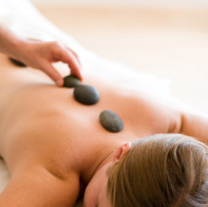
Content Outline
14% - Anatomy & Physiology
11% - Kinesiology
13% - Pathology, Contraindications, Areas of Caution, Special Populations
17% - Benefits & Physiological effects of techniques that manipulate soft tissue
17% client assessment, reassessment & treatment planning
5% - Overview of Massage & Bodywork History/Culture & Modalities
13% - Ethics, Boundaries, Laws, Regulations
10% - Guidelines for professional practice
Looking for a more specific content outline - http://www.fsmtb.org/siteMap.html (download “MBLEx Content Outline” )

Slide 17
MBLEx – miscellaneous facts
The FSMTB examination is administered year-round at test sites across the US.
Once you are approved to test, you will receive a Notice to Schedule that you must use to register for the test date and test site of your choice.
After you schedule your examination you will receive specific info in the mail about the date, time, and location of the test you are registered to take.

Slide 18
MBLEx – miscellaneous facts
A tutorial is available at http://www.pearsonvue.com/fsmtb for candidates to learn to navigate the test on computer and to familiarize themselves with the computer based testing experience.
Candidates will receive their official Score Report at the test center, upon competing the examination.

Slide 19
Which Exam should you take?

Slide 20
Comparison between ncetmb and MBLEx
NCETMB
MBLEx
25 questions on Body Systems
42 questions on Anatomy, Physiology & Kinesiology
18 questions on Pathology
30 on Massage & Bodywork Assessment
35 questions on Massage & Bodywork Application
10 question of Professional Massage Standards, Ethics, Business & Legal Practices
18 questions on Anatomy & Physiology
14 questions on Kinesiology
16 questions on Pathology
21 questions on Benefits & Physiological Effects
21 questions on Client Assessment & Treatment
6 on History/Culture
16 on Ethics, Boundaries & Laws
13 questions on Business & Professional Practices

Slide 21
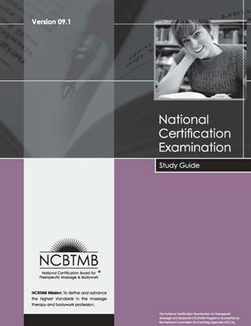
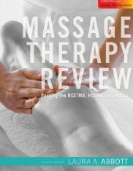
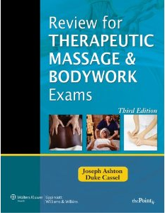
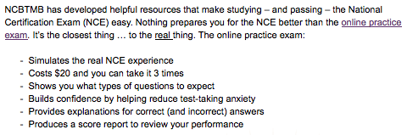
How to study for the exams
Massage-exam.com OR massagetherapyexam.com

Slide 22
STATE LICENSURE
How to get licensed after you have taken the MBLEx and/or one or the National Certification Exams

Slide 23

Reporting MBLEx scores to licensing boards
When you apply for the MBLEx, there will be a spot on the application to indicate where you want your exam score sent.
However, if you forget to specify where to send your score you may request your exam results to be reported to a State Licensing Agency by completing the MBLEx Mobility Form, and mailing or faxing it, along with the appropriate fee, to FSMTB.

Slide 24
Reporting your national certification exam score to licensing boards
If your state requires that you send them an official copy of your score, you will need to complete the Official Score Report Request Form, contained in the candidate handbook (Texas requires an official report).
After exam is taken, official score report requests must be made in writing by the candidate and submitted directly to the testing company (Pearson VUE).
Each report is $15.

Slide 25
requirements to get licensed in the state of Texas
Read the Massage Therapy Act (Texas Occupations Code, Chapter 455) and the rules relating to massage therapy license (25 Texas Administrative Code, (TAC) Chapter 140) before completing the application.
Answer all questions on the application completely (submit application online or by mail).
Attach the application fee of $117.
Attach an official transcript or notarized copy of your transcript.
Attach a copy of your social security card.
Attach proof of jurisprudence exam $ 35 (for all applications postmarked on or after 6/1/09). http://www.dshs.state.tx.us/massage/mt_jurisprudence.shtm
Attach required documents for questions 14-15 (if you answered yes).

Slide 26
Department of State Health Services Contact information
ADDRESS:
  Texas Department of State Health Services
Massage Therapy Licensing Program
P O Box 12197
Austin, TX 78711-2197
512-834-6616
massage@dshs.state.tx.us
Website: http://www.dshs.state.tx.us/massage/

Slide 27
Physical Address
If you would like to physically take your application to DSHS, here is their physical address:
8407 Wall Street,
Austin, TX 78754
Exchange Building

Slide 28


Want to be licensed in a state other than Texas?
To locate the state requirements and contact info, go to www.amtamassage.org and click on the link “Legislation and Regulation.” Then go to the “State Licensing” link and then to “State Massage Laws and Practice Requirements.”
Notes:
Other “than”

Slide 29

Resources
Updated: June 2011
The Lauterstein-Conway Massage Therapy School - http://www.tlcschool.com/
The Federation of State Massage Therapy Boards - http://www.fsmtb.org/licensing.html
The Department of State Health Services - http://www.dshs.state.tx.us/massage/default.shtm
The National Certification Board for Therapeutic Massage & Bodywork - http://www.ncbtmb.org/

