Slide 1
After Massage School
Steps for getting Licensed

Slide 2
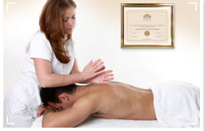
Licensing:
Students can take either the Licensure Exam or the MBLEx Exam as part of their requirements to obtain a Massage Therapy license in the state of Texas.
NCBTMB (Licensure Exam) and the FSMTB (MBLEx Exam) makes it possible for practitioners to secure state licensure in massage therapy. It also provides many benefits along the way:
State Licensure – 38 States use the Licensure Exams and 40 states use the MBLEx Exams as part of their licensure process, both include the District of Columbia.
Career Support – National online Find a Practitioner resource so potential clients can locate national board certified professionals
Acceptance by Healthcare community – establishes practitioners as healthcare providers on par with other professional requiring certification

Slide 3
MBLEx Massage & bodywork licensing examination
Developed & Administered by the Federation of State Massage Therapy Boards

Slide 4
MBLEx
The examination was developed by the FSMTB, reflects entry level practice (rather than theory) and consists of 125 multiple choice items. The exam costs $195.
40 States recognize the MBLEx
The FSMTB has established two avenues of eligibility to take the MBLEx.
The first is for individuals who apply directly to the FSMTB.
The second is for those who apply directly through a State Licensing Board (The Texas Department of State Health Services does not allow this).
The FSMTB examination is administered year-round at test sites across the US.
Once you are approved to test, you will receive a Notice to Schedule that you must use to register for the test date and test site of your choice.
After you schedule your examination you will receive specific info in the mail about the date, time, and location of the test you are registered to take the exam.

Slide 5
The MBLEx Process
HOW TO APPLY:
There are TWO possible ways that you can apply to take the MBLEx. The following information gives an overview of the basic requirements:
1. Steps
•Submit an MBLEx Application Form
•Verify that you have reviewed the Examination Content Outline and have education and training in the content subject areas
•Acknowledge and agree in writing to abide by FSMTB policies
•Pay the required fee - $195.00
2. Steps
•Be approved by the State Licensing Board or Agency
•Acknowledge and agree in writing to abide by FSMTB policies
•Pay the required fee - $195.00
You will receive notification of having either passed or failed the exam as soon as you have completed it

Slide 6
Licensure Exam National Certification Examination for Therapeutic Massage
Developed & Administered by the National Certification Board of Massage Therapy

Slide 7
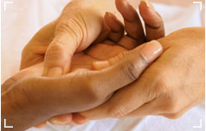
The Licensure Exam process
HOW TO APPLY
Go to NCBTMB’s website: http://www.ncbtmb.org/certificants/new-applicant-licensing-exam
Create an account using the Career Management System
Complete the online application
Submit payment: $225 fee with a valid American Express, MasterCard, or Visa credit card
Submit valid form of identification
Submit a copy of school transcript
Note: While the transcript is not required to take the exam, scores will not be released until a transcript is received.
You will receive notification of having either passed or failed the exam as soon as you have completed it.

Slide 8
Licensure Exam
The examination was developed by the NCBTMB, reflects entry level practice (rather than theory) and consists of 160 multiple choice items. The exam costs $225.00.
38 States recognize the MBLEx
The NCBTMB has established one avenue of eligibility to take the Licensure Exam.
Students must register and apply online to take the exam..
The NCBTMB examination is administered year-round at test sites across the US.
Once you are approved to test, you will receive a Notice to Schedule that you must use to register for the test date and test site of your choice.
After you schedule your examination you will receive specific info in the mail about the date, time, and location of the test you are registered to take

Slide 9
Exam Comparisons
NCBTMB – Licensure Exam
-160 Questions
-Students can retake up to 3 times before having to complete 100 additional hours of instruction
FSBMTB – MBLEx Exam
-125 Questions
- No limit to the amount of time students can retake the exam
Content Outline:
14 % Anatomy & Physiology
11% Kinesiology
13% Pathology, Contraindications & Special Populations
17% Benefits and Physiological Effects of Techniques that .Manipulate Soft Tissue
17% Client Assessment, Reassessment & Treatment Planning
5% Overview of Massage Bodywork/History/Culture/Modalities
13% Ethics, Boundaries & Laws
10% Guidelines for Professional Practice
Content Outline:
16% General Knowledge of the Body Systems
19% Detailed knowledge of Anatomy, Physiology, & Kinesiology
13% Pathology
18% Therapeutic Massage Assessment
22% Therapeutic Massage Application
12% Professional Standards, Ethics, Business & Legal Practices

Slide 10
Important Info to know
Taking one of the NCBTMB’s or the FSMTB’s exam is only a part of the licensure process.
In order to practice massage in Texas, you must get Licensed by the Texas Department of State Health Services. (See slide 31 for State Licensure information.

Slide 11
Portfolio review process
If you do not have 500 hours of training from one massage therapy education institution, and you want to be Nationally Certified, then you will have to go through the Portfolio Review Process.
For all information regarding this process please refer to the National Certification Portfolio Review Handbook. (It can be downloaded off http://www.ncbtmb.org)
TLC’s NCBTMB school code: 022140-00.

Slide 12
MBLEx – miscellaneous facts
A tutorial is available at http://www.pearsonvue.com/fsmtb for candidates to learn to navigate the test on computer and to familiarize themselves with the computer based testing experience.
Candidates will receive their official Score Report at the test center, upon competing the examination.

Slide 13
Which Exam should you take?

Slide 14
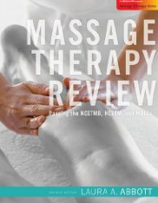
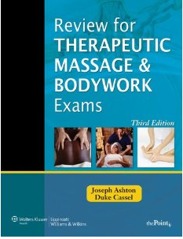
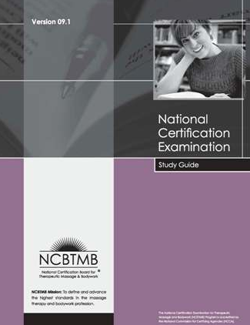
How to study for the exams
Massage-exam.com
Massageprep.com
Massagetherapyexam.com

Slide 15
STATE LICENSURE
How to get licensed after you have taken the MBLEx and/or the Licensure Exam.

Slide 16
Reporting MBLEx scores to licensing boards
When you apply for the MBLEx, there will be a spot on the application to indicate where you want your exam score sent.
However, if you forget to specify where to send your score you may request your exam results to be reported to a State Licensing Agency by completing the MBLEx Mobility Form, and mailing or faxing it, along with the appropriate fee, to FSMTB.

Slide 17
Reporting your Licensure exam score to licensing boards
If your state requires that you send them an official copy of your score, you will need to complete the Official Score Report Request Form, contained in the candidate handbook (Texas requires an official report).
After exam is taken, official score report requests must be made in writing by the candidate and submitted directly to the testing company (Pearson VUE).
Each report is $15.

Slide 18
requirements to get licensed in the state of Texas
Read the Massage Therapy Act (Texas Occupations Code, Chapter 455) and the rules relating to massage therapy license (25 Texas Administrative Code, (TAC) Chapter 140) before completing the application.
Answer all questions on the application completely (submit application online or by mail).
Attach the application fee of $117.
Attach an official transcript or notarized copy of your transcript.
Attach a copy of your social security card.
Attach proof of jurisprudence exam $ 35 (for all applications postmarked on or after 6/1/09). http://www.dshs.state.tx.us/massage/mt_jurisprudence.shtm
Attach required documents for questions 14-15 (if you answered yes).

Slide 19
Department of State Health Services Contact information
ADDRESS:
Texas Department of State Health Services
Massage Therapy Licensing Program
P O Box 12197
Austin, TX 78711-2197
512-834-6616
massage@dshs.state.tx.us
Website: http://www.dshs.state.tx.us/massage/

Slide 20
Physical Address
If you would like to physically take your application to DSHS, here is their physical address:
8407 Wall Street,
Austin, TX 78754
Exchange Building

Slide 21
Want to be licensed in a state other than Texas?
To locate the state requirements and contact info, go to www.amtamassage.org and click on the link “Legislation and Regulation.” Then go to the “State Licensing” link and then to “State Massage Laws and Practice Requirements.”
Notes:
Other “than”

Slide 22
Resources
Updated: January 2013
The Lauterstein-Conway Massage Therapy School - http://www.tlcschool.com/
The Federation of State Massage Therapy Boards - http://www.fsmtb.org/licensing.html
The Department of State Health Services - http://www.dshs.state.tx.us/massage/default.shtm
The National Certification Board for Therapeutic Massage & Bodywork - http://www.ncbtmb.org/

