Slide 1
After Massage School
Steps for getting Licensed

Slide 2
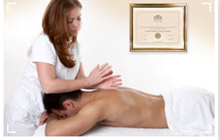
Licensing:
Students take the MBLEx Exam as part of their requirements to obtain a Massage Therapy license in the state of Texas.
The FSMTB (MBLEx Exam) makes it possible for practitioners to secure state licensure in massage therapy. It also provides many benefits along the way:
42 states use the MBLEx Exams as part of their licensure process, including the District of Columbia.
Career Support – National online Find a Practitioner resource so potential clients can locate national board certified professionals
Acceptance by Healthcare community – establishes practitioners as healthcare providers on par with other professional requiring certification

Slide 3
MBLEx Massage & bodywork licensing examination
Developed & Administered by the Federation of State Massage Therapy Boards

Slide 4
MBLEx
The examination was developed by the FSMTB, reflects entry level practice (rather than theory) and consists of 100 multiple choice items. The exam costs $195.
The FSMTB has established two avenues of eligibility to take the MBLEx.
The first is for individuals who apply directly to the FSMTB.
The second is for those who apply directly through a State Licensing Board (The Texas Department of State Health Services does not allow this).
The FSMTB examination is administered year-round at test sites across the US.
Once you are approved to test, you will receive a Notice to Schedule that you must use to register for the test date and test site of your choice.
After you schedule your examination you will receive specific info in the mail about the date, time, and location of the test you are registered to take the exam.

Slide 5
The MBLEx Process
HOW TO APPLY:
There are TWO possible ways that you can apply to take the MBLEx. The following information gives an overview of the basic requirements:
1. Steps
•Submit an MBLEx Application Form
•Verify that you have reviewed the Examination Content Outline and have education and training in the content subject areas
•Acknowledge and agree in writing to abide by FSMTB policies
•Pay the required fee - $195.00
2. Steps
•Be approved by the State Licensing Board or Agency
•Acknowledge and agree in writing to abide by FSMTB policies
•Pay the required fee - $195.00
You will receive notification of having either passed or failed the exam as soon as you have completed it

Slide 6
Important Info to know
Taking the FSMTB’s exam is only a part of the licensure process.
In order to practice massage in Texas, you must get Licensed by the Texas Department of State Health Services. (See slide 31 for State Licensure information.

Slide 7
Portfolio review process
If you do not have 500 hours of training from one massage therapy education institution, and you want to be Nationally Certified, then you will have to go through the Portfolio Review Process.
For all information regarding this process please refer to the National Certification Portfolio Review Handbook. (It can be downloaded off http://www.ncbtmb.org)
TLC’s NCBTMB school code: 022140-00.

Slide 8
MBLEx – miscellaneous facts
A tutorial is available at http://www.pearsonvue.com/fsmtb for candidates to learn to navigate the test on computer and to familiarize themselves with the computer based testing experience.
Candidates will receive their official Score Report at the test center, upon competing the examination.

Slide 9
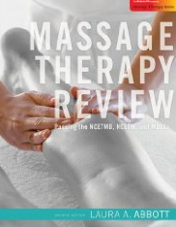
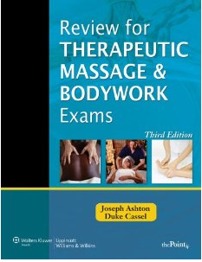
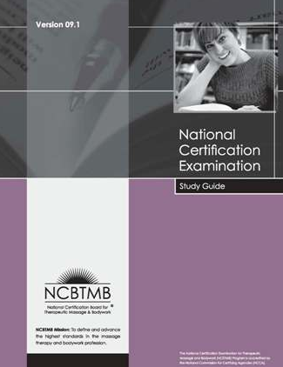
How to study for the exam
Massage-exam.com
Massageprep.com
Massagetherapyexam.com

Slide 10
STATE LICENSURE
How to get licensed after you have taken the MBLEx and/or the Licensure Exam.

Slide 11
Reporting MBLEx scores to licensing boards
When you apply for the MBLEx, there will be a spot on the application to indicate where you want your exam score sent. Also, keep your score sheet to give to the State with your licensing packet.
However, if you forget to specify where to send your score you may request your exam results to be reported to a State Licensing Agency by completing the MBLEx Mobility Form, and mailing or faxing it, along with the appropriate fee, to FSMTB.

Slide 12
Reporting your Licensure exam score to licensing boards
If your state requires that you send them an official copy of your score, you will need to complete the Official Score Report Request Form, contained in the candidate handbook (Texas requires an official report but you should get one copy as soon as you complete your exam).
After exam is taken, official score report requests must be made in writing by the candidate and submitted directly to the testing company (Pearson VUE).
Each report is $15.

Slide 13
requirements to get licensed in the state of Texas
Read the Massage Therapy Act (Texas Occupations Code, Chapter 455) and the rules relating to massage therapy license (25 Texas Administrative Code, (TAC) Chapter 140) before completing the application.
Answer all questions on the application completely. You must now apply online and make a username and password through the: Regulatory Services Online Licensing System
Pay the application fee of $117.
Collect the following documents to mail in or drop off at DSHS:
An official transcript or notarized copy of your transcript.
A copy of your social security card.
Proof of jurisprudence exam $ 35 (for all applications postmarked on or after 6/1/09). http://www.dshs.state.tx.us/massage/mt_jurisprudence.shtm
Attach required documents for questions 14-15 (if you answered yes).
MBLEx exam scores

Slide 14
Department of State Health Services Contact information
ADDRESS:
Texas Department of State Health Services
Massage Therapy Licensing Program
P O Box 12197
Austin, TX 78711-2197
512-834-6616
massage@dshs.state.tx.us
Website: http://www.dshs.state.tx.us/massage/

Slide 15
Physical Address
If you would like to physically take your application to DSHS, here is their physical address:
8407 Wall Street,
Austin, TX 78754
Exchange Building

Slide 16
Want to be licensed in a state other than Texas?
To locate the state requirements and contact info, go to www.amtamassage.org and click on the link “Legislation and Regulation.” Then go to the “State Licensing” link and then to “State Massage Laws and Practice Requirements.”
Notes:
Other “than”

Slide 17
Resources
Updated: December 2014
The Lauterstein-Conway Massage Therapy School - http://www.tlcschool.com/
The Federation of State Massage Therapy Boards - http://www.fsmtb.org/licensing.html
The Department of State Health Services - http://www.dshs.state.tx.us/massage/default.shtm
The National Certification Board for Therapeutic Massage & Bodywork - http://www.ncbtmb.org/

