Slide 1
Lesson Plan: Joints 1
5 minutes: Breath of Arrival and Attendance
10 minutes: Tibialis anterior and peroneus longus
40 minutes: Joints 1

Slide 2
Classroom Rules
Punctuality- everybody's time is precious:
Be ready to learn by 9:00, we'll have you out of here by 1:30
Tardiness: arriving late, late return after breaks, leaving early
The following are not allowed:
Bare feet
Side talking
Lying down
Inappropriate clothing
Food or drink except water
Phones in classrooms, clinic or bathrooms
You will receive one verbal warning, then you'll have to leave the room.

Slide 3
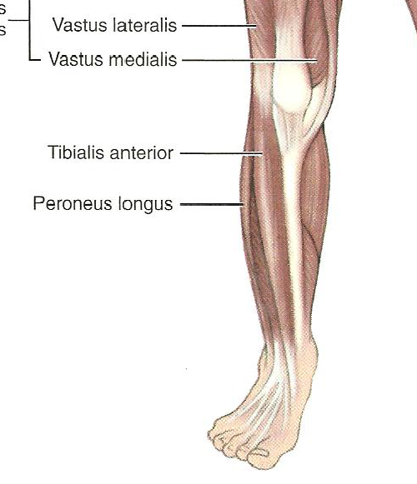
Tibialis Anterior and Peroneus Longus

Slide 4
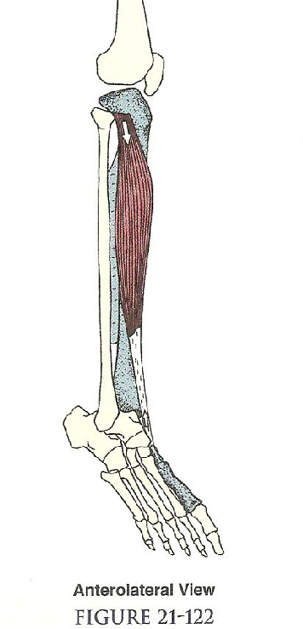
Tibialis Anterior
Origin:
Upper 2/3 of lateral tibia
Interosseous membrane
Insertion:
Base of 1st metatarsal
Medial cuneiform (plantar)
Actions:
Ankle dorsiflexion
Foot inversion

Slide 5
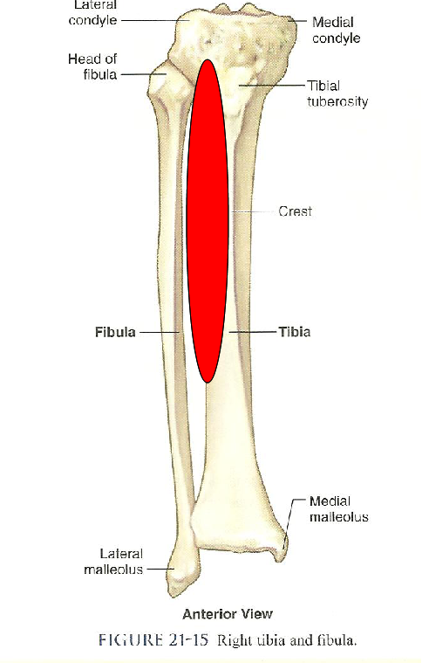
Tibialis Anterior
Origin:
Upper 2/3 of lateral tibia
Interosseous membrane
Insertion:
Base of 1st metatarsal
Medial cuneiform (plantar)
Actions:
Ankle dorsiflexion
Foot inversion

Slide 6
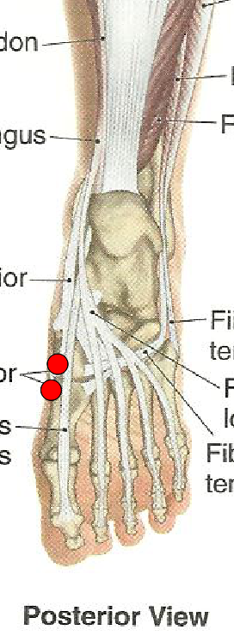
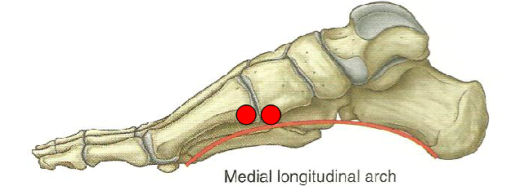
Tibialis Anterior
Origin:
Upper 2/3 of lateral tibia
Interosseous membrane
Insertion:
Base of 1st metatarsal
Medial cuneiform (plantar)
Actions:
Ankle dorsiflexion
Foot inversion

Slide 7
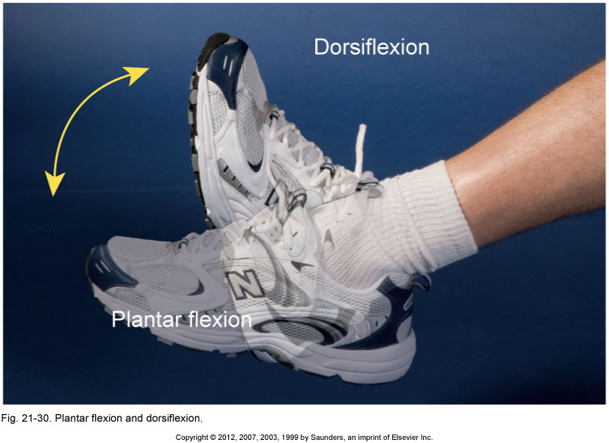
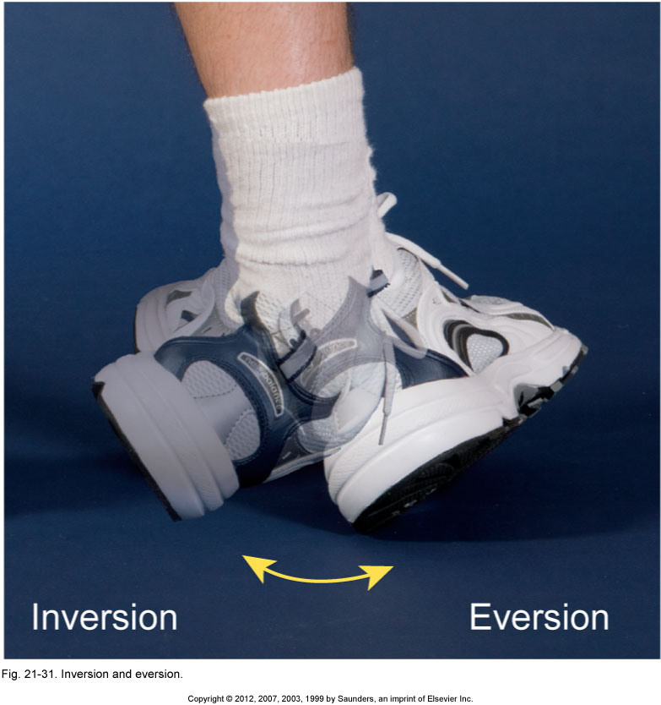
Tibialis Anterior
Origin:
Upper 2/3 of lateral tibia
Interosseous membrane
Insertion:
Base of 1st metatarsal
Medial cuneiform (plantar)
Actions:
Ankle dorsiflexion
Foot inversion

Slide 8
Peroneus Longus
Origin:
Proximal 2/3 of lateral fibula
Insertion:
Base of 1st metatarsal
Medial cuneiform (plantar)
Actions:
Ankle plantarflexion
Foot eversion

Slide 9
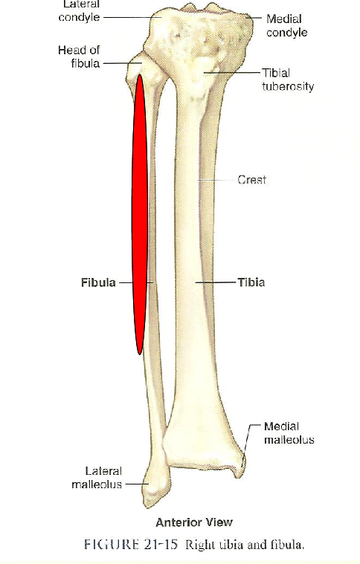
Peroneus Longus
Origin:
Proximal 2/3 of lateral fibula
Insertion:
Base of 1st metatarsal
Medial cuneiform (plantar)
Actions:
Ankle plantarflexion
Foot eversion

Slide 10
Peroneus Longus
Origin:
Proximal 2/3 of lateral fibula
Insertion:
Base of 1st metatarsal
Medial cuneiform (plantar)
Actions:
Ankle plantarflexion
Foot eversion

Slide 11
Peroneus Longus
Origin:
Proximal 2/3 of lateral fibula
Insertion:
Base of 1st metatarsal
Medial cuneiform (plantar)
Actions:
Ankle plantarflexion
Foot eversion

Slide 12
Tibialis Anterior and Peroneus Longus

Slide 13
Joints 1
“Opportunity is missed by most people because it is dressed in overalls and looks like work.”
–Thomas Edison

Slide 14
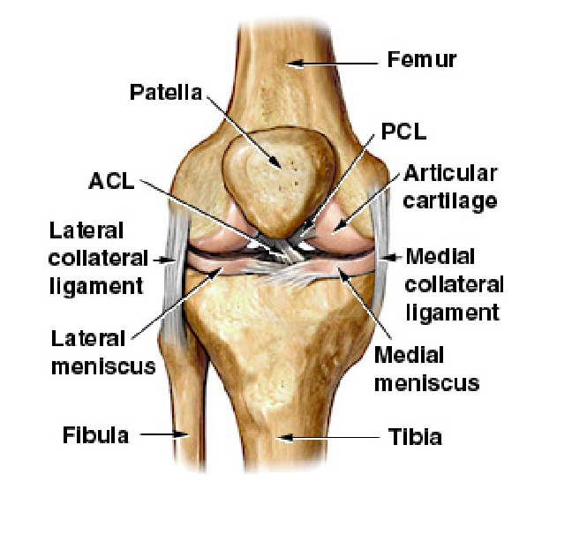
Joints
Joint (AKA: articulation or arthrosis) Where bones come together or join.

Slide 15
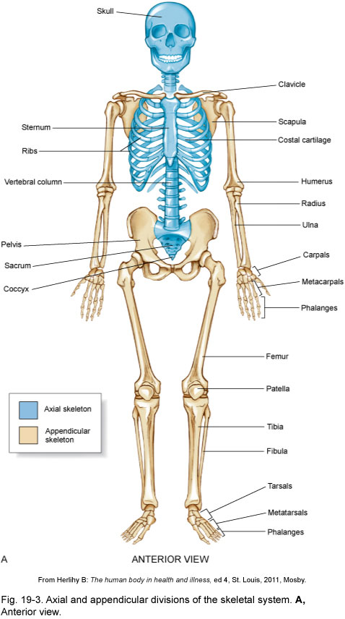
Joints
Physiology
Enable the body to move.
Bear the weight of the body.
Provide stability.

Slide 16
Structural and Functional Classification
Fibrous / Synarthrotic
Cartilaginous / Amphiarthrotic
Synovial / Diarthrotic

Slide 17
Structural and Functional Classification
Fibrous / Synarthrotic
Connected by dense fibrous connective tissue, consisting mainly of collagen.
Extremely limited movement.
Examples: cranial sutures, facial sutures, teeth, and tibiofibular joints

Slide 18
Structural and Functional Classification
Cartilaginous / Amphiarthrotic
Connected by cartilage .
Slightly movable .
Examples: costochondral joints, pubic symphysis, and intervertebral disk joints

Slide 19
Structural and Functional Classification
Synovial / Diathrotic
Contains a joint capsule that contains synovial fluid to nourish and lubricate the articulating surfaces.
Freely movable.
Examples: glenohumeral, iliofemoral . . . see Synovial Joints section for more examples

Slide 20
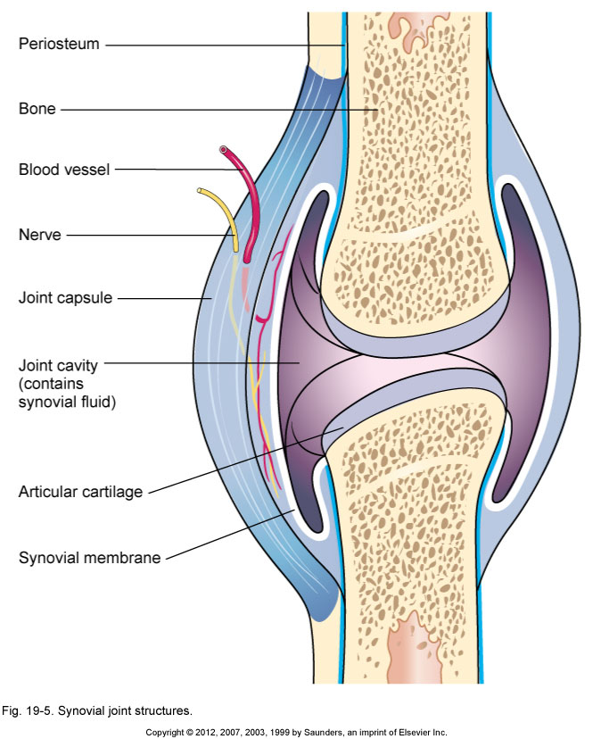
Synovial Joints
Articular cartilage
Joint capsule
Joint cavity
Synovial membrane
Synovial fluid
Synovial sheath
Bursa
Meniscus

Slide 21
Synovial Joints
Articular cartilage Hyaline cartilage covering an epiphysis.

Slide 22
Synovial Joints
Joint capsule Double-layered structure around a synovial joint. The outer layer is fibrous and forms ligaments, and the inner layer is the synovial membrane.

Slide 23
Synovial Joints
Joint cavity Space within a joint capsule. Lined with a synovial membrane.

Slide 24
Synovial Joints
Synovial membrane Membrane that lines cavities of freely moving joints, synovial sheaths, and bursae.

Slide 25
Synovial Joints
Synovial fluid Viscous fluid secreted by synovial membranes. Provides nutrition and lubrication.

Slide 26
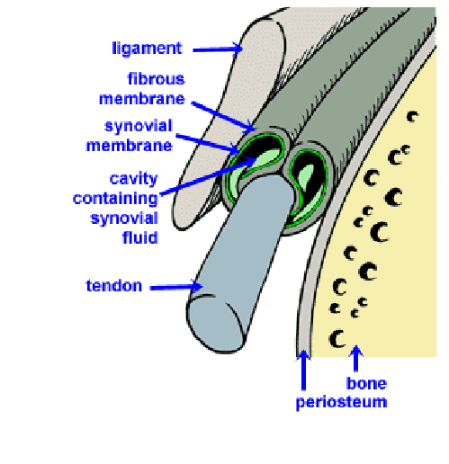
Synovial Joints
Synovial sheath Tube-like structure lined with synovial membrane that surrounds long tendons.

Slide 27
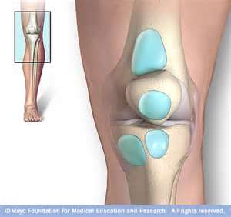
Synovial Joints
Bursa Collapsed sac-like structure with an interior lining of synovial , membrane. Contains synovial fluid. Plural is bursae.

Slide 28
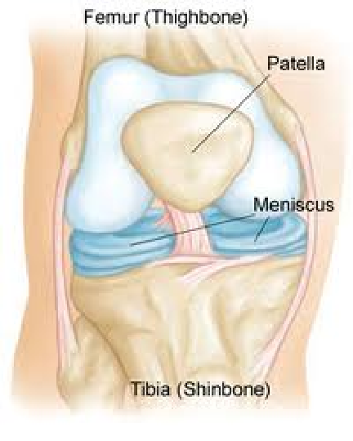
Synovial Joints
Meniscus Fibrocartilage pads found in select joints such as the knee and jaw. Helps the joint move smoothly and serves as a shock absorber. Plural is menisci.

Slide 29
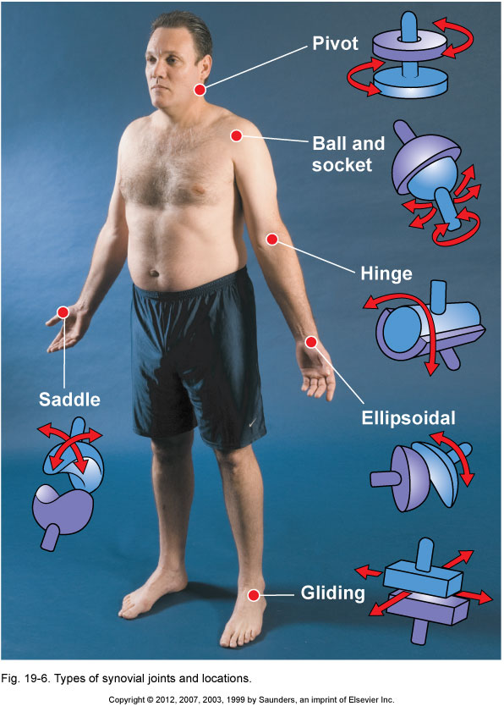
Types of Synovial Joints
Hinge
Pivot
Ellipsoidal / condyloid
Saddle
Ball and socket
Gliding / planar

Slide 30
Types of Synovial Joints
Hinge Limited to flexion and extension .

Slide 31
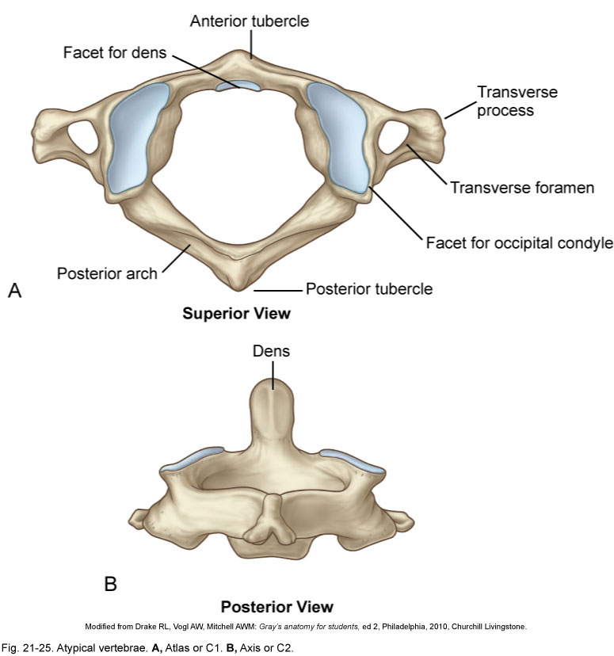
Types of Synovial Joints
Pivot Limited to rotation .

Slide 32
Types of Synovial Joints
Ellipsoidal / condyloid Limited to flexion, extension, abduction, and adduction.

Slide 33
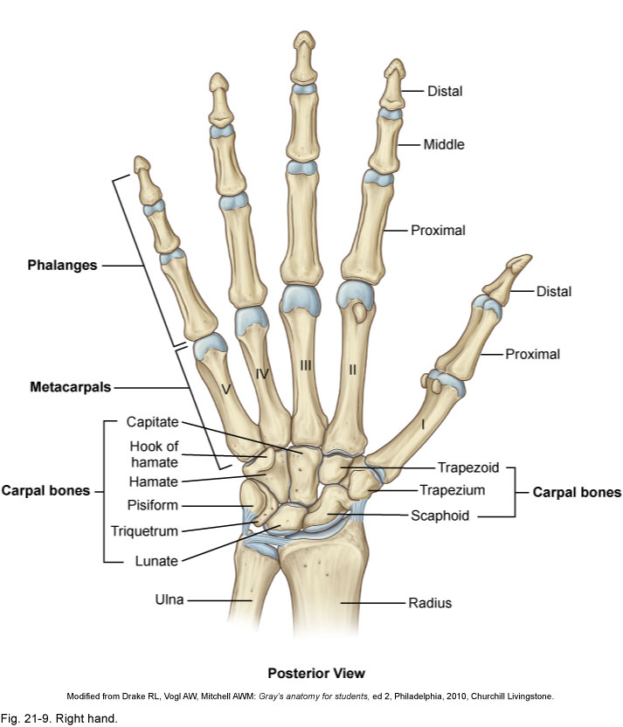
Types of Synovial Joints
Saddle Allowing flexion, extension, abduction, adduction, opposition, reposition, and circumduction, but not rotation.

Slide 34
Types of Synovial Joints
Ball and socket Allowing all movements except gliding . Offers the greatest range of motion.

Slide 35
Types of Synovial Joints
Gliding / planar Limited to planar movements but movement may be permitted in all planes .

Slide 36
Types of Synovial Joints
Flexion Bending or decreasing the
angle of a joint.
Extension Straightening or increasing the angle of a joint .

Slide 37
Types of Synovial Joints
Flexion Bending or decreasing the
angle of a joint.
Extension Straightening or increasing the angle of a joint .

Slide 38
Types of Synovial Joints
Flexion Bending or decreasing the
angle of a joint.
Extension Straightening or increasing the angle of a joint .

Slide 39
Types of Synovial Joints
Hyperextension A continuation of extension beyond anatomic position.

Slide 40
Types of Synovial Joints
Abduction Movement away , from the median plane.
Adduction Movement toward , the median plane.

Slide 41
Types of Synovial Joints
Abduction Movement away , from the median plane.
Adduction Movement toward , the median plane.

Slide 42
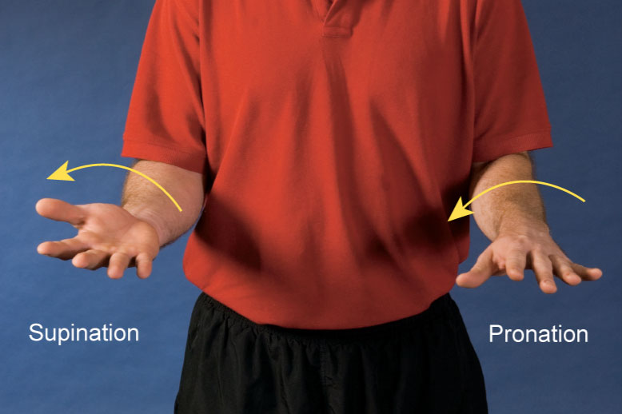
Types of Synovial Joints
Supination Lateral (outward) rotation of the forearm so that the palm is turned up .
Pronation Medial (inward) rotation of the forearm so that the palm is turned down .

Slide 43
Types of Synovial Joints
Plantarflexion Extension of the ankle such that the toes are pointing downward , increasing the ankle angle anteriorly.
Dorsiflexion Flexing the ankle dorsally so that the toes are moving toward the shin .

Slide 44
Types of Synovial Joints
Inversion Elevation of the medial , edge of the foot so that the sole is turned inward (or medially).
Eversion Elevation of the lateral , edge of the foot so that the sole is turned outward (or laterally).

Slide 45
Types of Synovial Joints
Circumduction Cone -shaped range of motion that occurs when the distal end moves in a circle and the proximal end is fixed.

Slide 46
Types of Synovial Joints
Rotation Circular movement when a bone moves around its own central axis .

Slide 47
Types of Synovial Joints
Right and left rotation Rotation for joints that lie within the median axis.

Slide 48
Types of Synovial Joints
Lateral and medial rotation Rotation for joints that lie outside of the median axis.

Slide 49
Types of Synovial Joints
Upward and downward rotation Rotation of the scapula so that the glenoid fossa faces either upward or downward.

Slide 50
Types of Synovial Joints
Elevation Raising or lifting a body part. Moving superiorly .
Depression Lowering or dropping a body part. Moving inferiorly .

Slide 51
Types of Synovial Joints
Protraction Movement forward or anteriorly .
Retraction Movement backward or posteriorly .

Slide 52
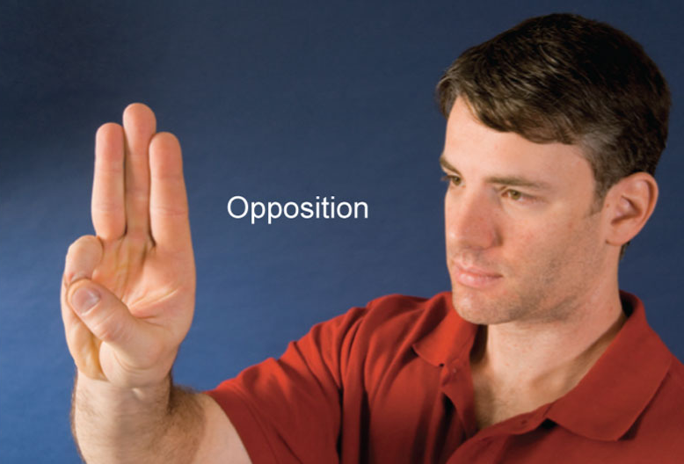
Types of Synovial Joints
Opposition Movement in which the tip of the thumb comes into contact with the tip of any other digit on the same hand.

Slide 53
Types of Synovial Joints
Lateral deviation Side to side movement in the transverse plane.

Slide 54
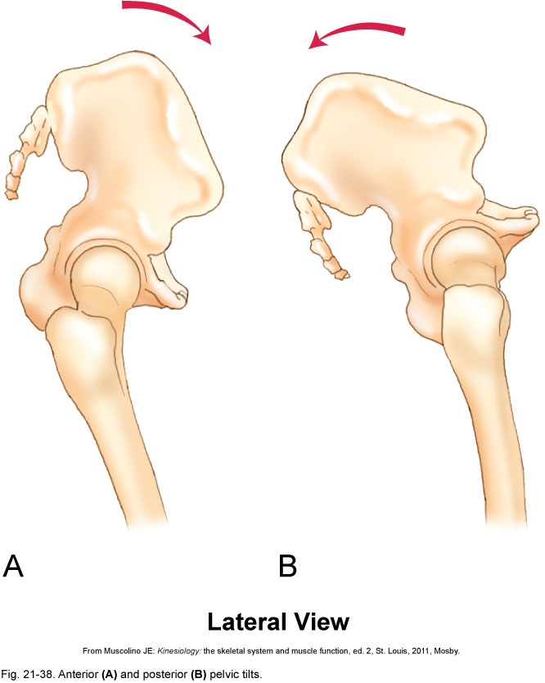
Types of Synovial Joints
Anterior pelvic tilt Entire pelvis tilted forward in the frontal plane.
Posterior pelvic tilt Entire pelvis tilted backward in the frontal plane.

Slide 55
Synovial Joints
Glenohumeral Glenoid fossa of the scapula – Humerus; AKA: shoulder joint.

Slide 56
Synovial Joints
Iliofemoral Ilium of the pelvic bone – Femur; AKA: hip joint.

Slide 57
Synovial Joints
Humeroulnar Humerus – Ulna; AKA: elbow joint.

Slide 58
Synovial Joints
Humeroradial Humerus – Radius; AKA: elbow joint.

Slide 59
Synovial Joints
Tibiofemoral Tibia – Femur; AKA: knee joint.

Slide 60
Synovial Joints
Talocrural Talus – Tibia; AKA: ankle joint.

Slide 61
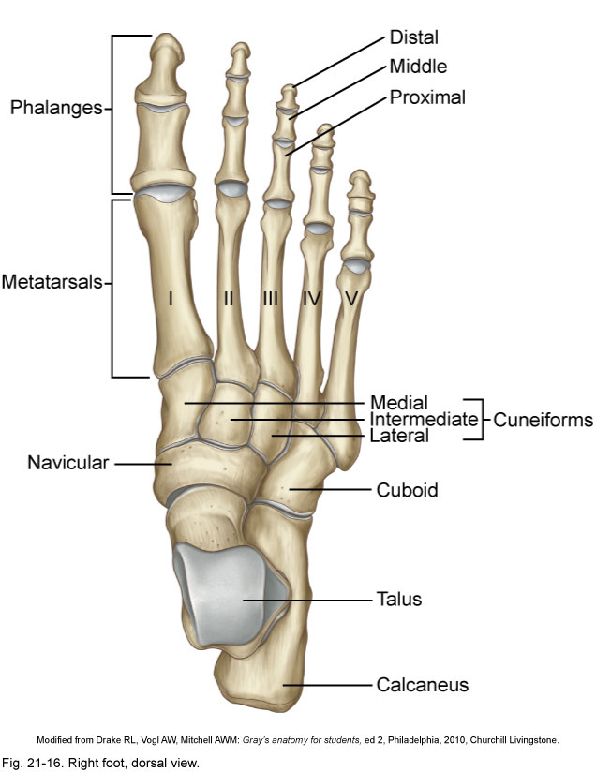
Synovial Joints
Interphalangeal Phalanx – Phalanx; AKA: IP joint.

Slide 62
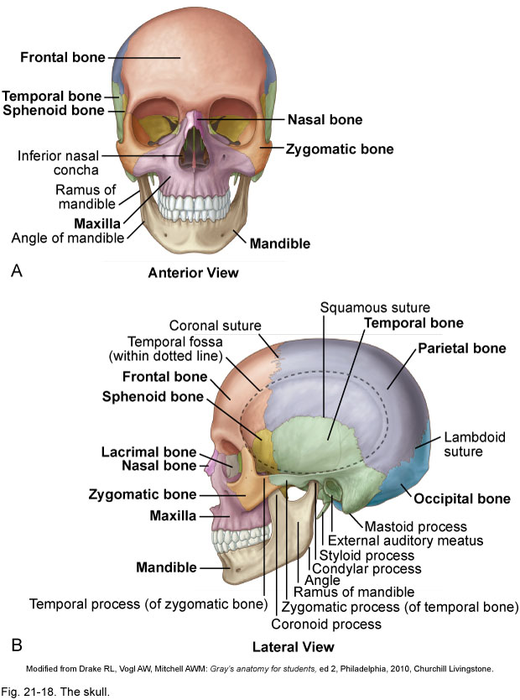
Synovial Joints
Temporomandibular Temporal bone – Mandible; AKA: TMJ, jaw joint.

Slide 63
Synovial Joints
Atlantoaxial Atlas (C1) – Axis (C2); “No-no” joint.

Slide 64
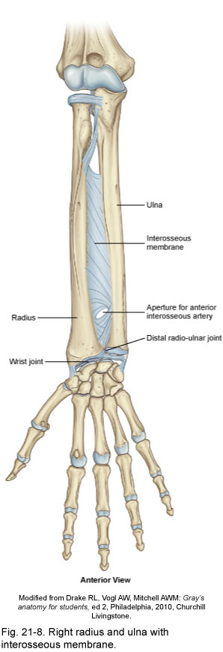
Synovial Joints
Radioulnar (proximal) Radius – Ulna.

Slide 65
Synovial Joints
Carpometacarpal of the thumb Carpal – Metacarpal; AKA: CM joint.

Slide 66
Synovial Joints
Radiocarpal Radius – Carpal; AKA: wrist joint.

Slide 67
Synovial Joints
Metacarpophalangeal Metacarpal – Phalanx; AKA: MCP joint.

Slide 68
Synovial Joints
Metatarsophalangeal Metatarsal – Phalanx; AKA: MTP joint.

Slide 69
Synovial Joints
Atlantooccipital Atlas (C1) – Occiput; “Yes-yes” joint.

Slide 70
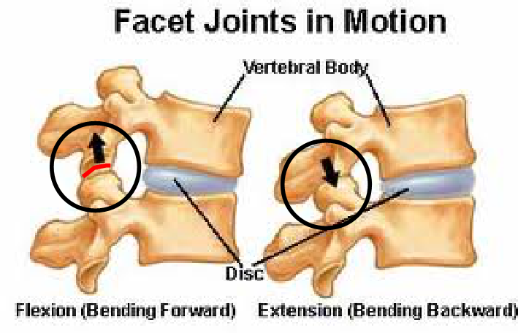
Synovial Joints
Intervertebral facet Between each vertebrae from C2-L5; AKA: facet joints.

Slide 71
Synovial Joints
Acromioclavicular Acromion process of the scapula – Clavicle; AKA: AC joint.

Slide 72
Synovial Joints
Sternoclavicular Sternum – Clavicle; AKA: SC joint.

Slide 73
Synovial Joints
Intercarpal Carpal – Carpal.

Slide 74
Synovial Joints
Carpometacarpal Carpal – Metacarpal; AKA: CM joint.

Slide 75
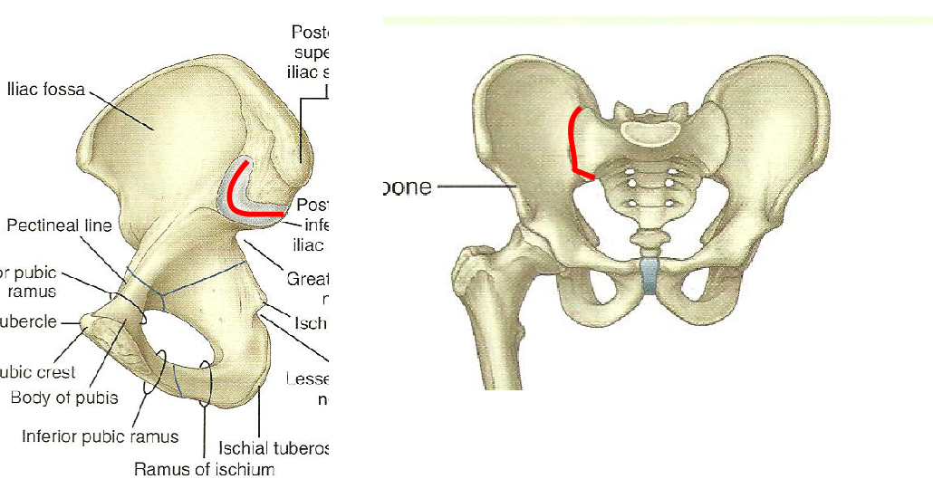
Synovial Joints
Lumbosacral facet L5 – S1.

Slide 76
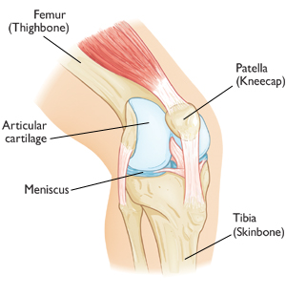
Synovial Joints
Patellofemoral Patella – Femur.

Slide 77
Synovial Joints
Tarsometatarsal Tarsal – Metatarsal; AKA: TM joint.

Slide 78
Synovial Joints
Intertarsal Tarsal – Tarsal.

