Slide 1
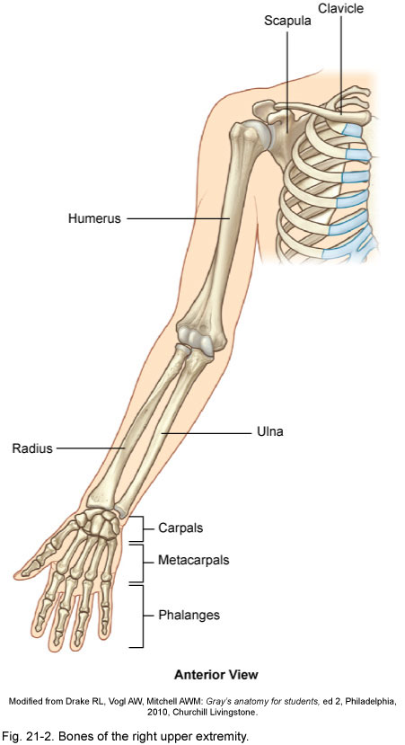
Anatomy and Kinesiology of the Shoulder Girdle

Slide 2
Lesson Plan:
40a Anatomy and Kinesiology of the Shoulder Girdle
5 minutes: Breath of Arrival and Attendance
20 minutes: New Muscles: rotator cuff muscles, pectoralis minor, and serratus anterior
15 minutes: Scapulothoracic Agonists
15 minutes: Glenohumeral Agonists

Slide 3
Classroom Rules
Punctuality- everybody's time is precious:
  Be ready to learn by the start of class, we'll have you out of here on time
  Tardiness: arriving late, late return after breaks, leaving early
The following are not allowed:
  Bare feet
  Side talking
  Lying down
  Inappropriate clothing
  Food or drink except water
  Phones in classrooms, clinic or bathrooms
You will receive one verbal warning, then you'll have to leave the room.

Slide 4
New Muscles
Rotator Cuff
Other Scapular Muscles
Supraspinatus
Infraspinatus
Teres Minor
Subscapularis
Know these OIA’s
Pectoralis Minor
Serratus Anterior
Don’t need to know these OIA’s yet
S
I
T
S

Slide 5
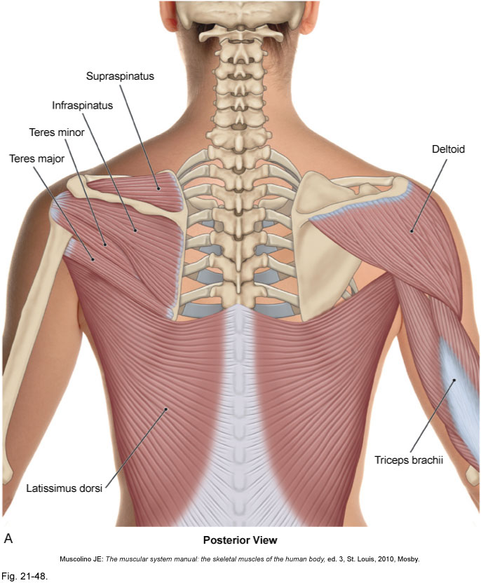
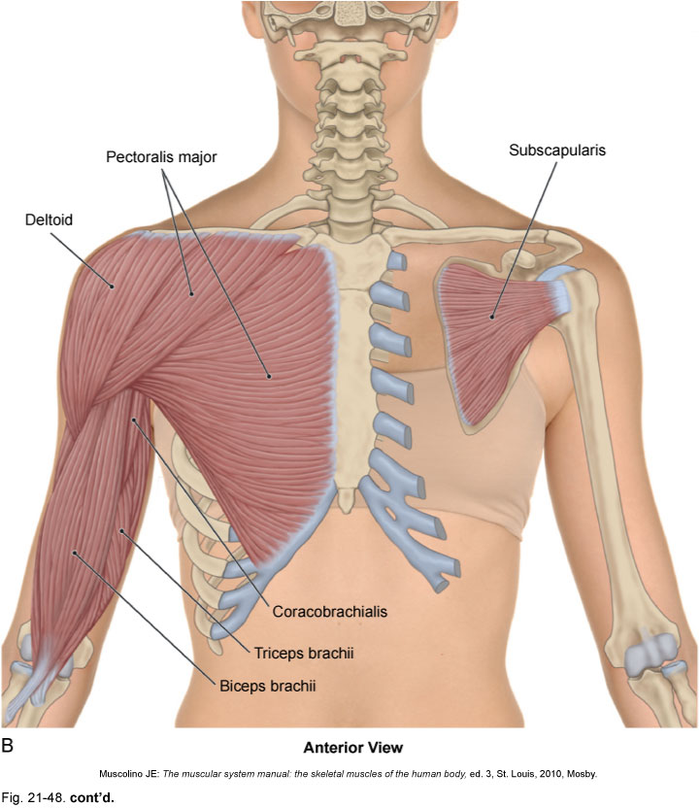
Rotator Cuff
Supraspinatus
Infraspinatus
Subscapularis
Teres Minor
(Teres Major)
(Latissimus Dorsi)
Posterior View
Anterior View

Slide 6
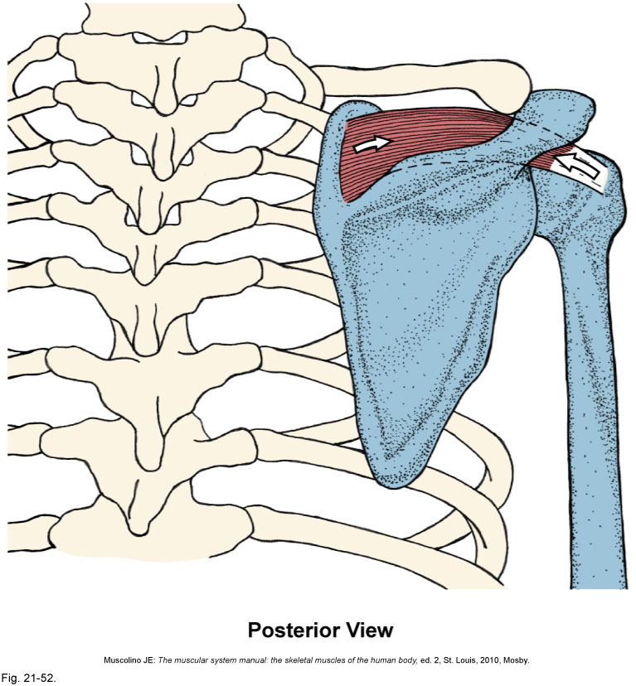
Supraspinatus
Origin:
  Supraspinous fossa of the scapula
Insertion:
  Greater tubercle of the humerus
(superior facet)
Actions:
  Shoulder AB duction

Slide 7
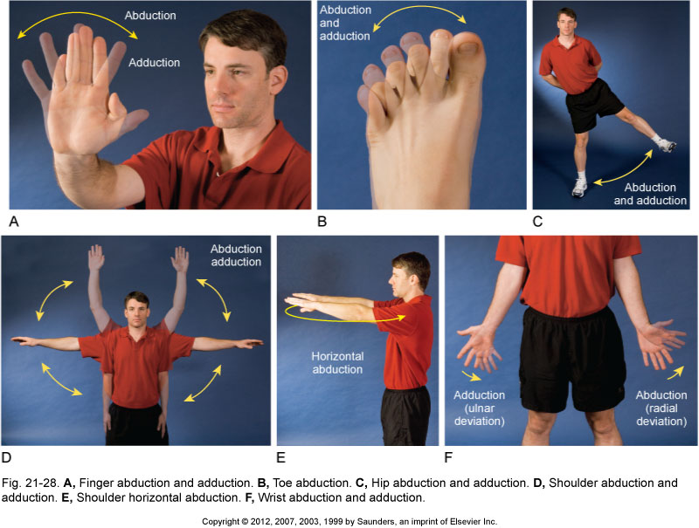
Supraspinatus
Origin:
  Supraspinous fossa of the scapula
Insertion:
  Greater tubercle of the humerus
(superior facet)
Actions:
  Shoulder AB duction
AB duction

Slide 8
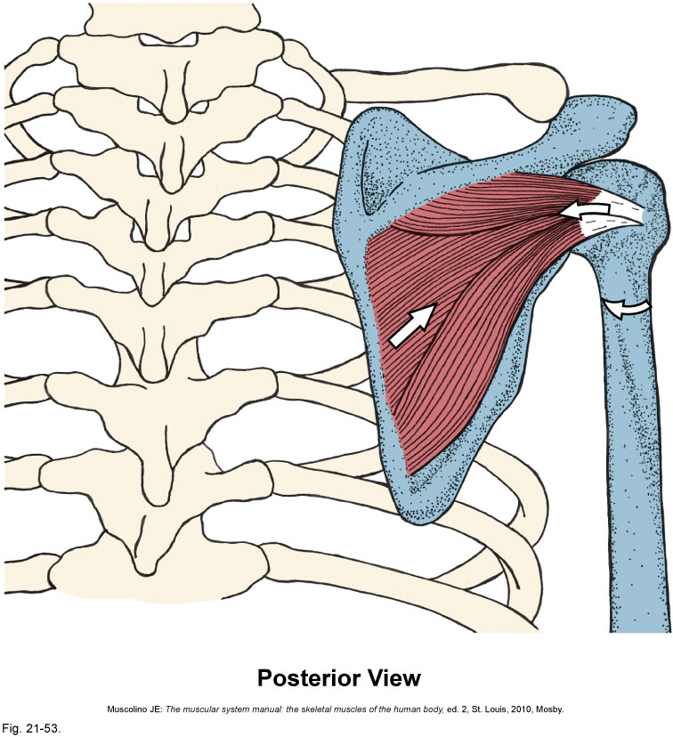
Infraspinatus
Origin:
  Infraspinous fossa of the scapula
Insertion:
  Greater tubercle of the humerus
(middle facet)
Actions:
  Shoulder lateral rotation

Slide 9
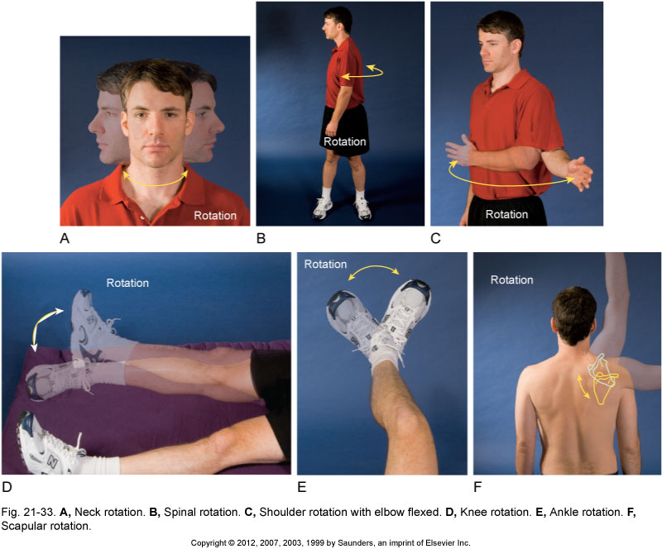
Infraspinatus
Origin:
  Infraspinous fossa of the scapula
Insertion:
  Greater tubercle of the humerus
(middle facet)
Actions:
  Shoulder lateral rotation
Lateral rotation

Slide 10
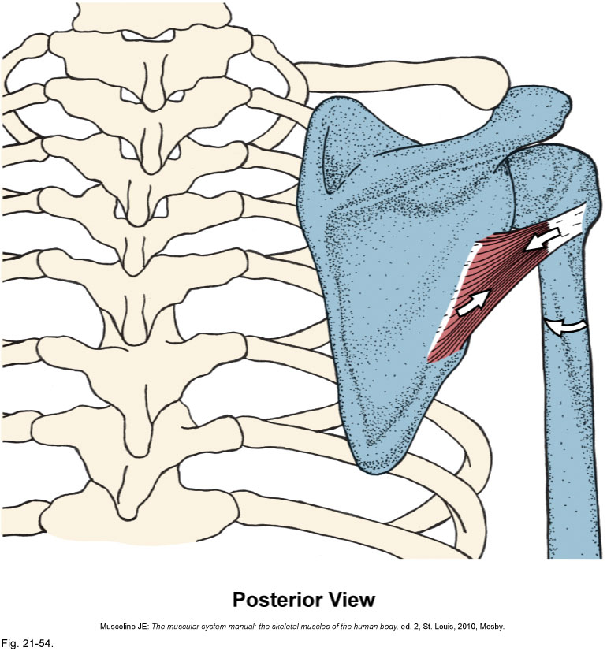
Teres Minor
Origin:
  Upper axillary border of the scapula
Insertion:
  Greater tubercle of the humerus
(inferior facet)
Actions:
  Shoulder lateral rotation

Slide 11
Teres Minor
Origin:
  Upper axillary border of the scapula
Insertion:
  Greater tubercle of the humerus
(inferior facet)
Actions:
  Shoulder lateral rotation
Lateral rotation

Slide 12
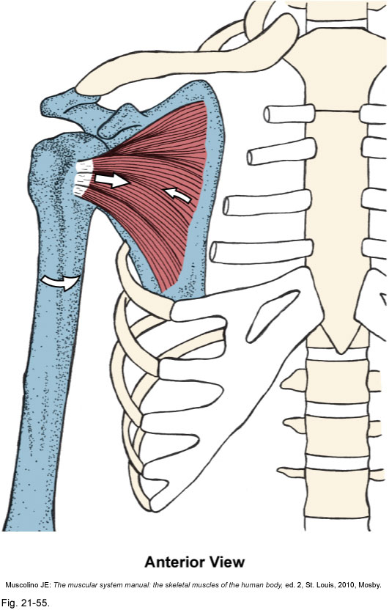
Subscapularis
Origin:
  Subscapular fossa of the scapula
Insertion:
  Lesser tubercle of the humerus
Actions:
  Shoulder medial rotation

Slide 13
Subscapularis
Origin:
  Subscapular fossa of the scapula
Insertion:
  Lesser tubercle of the humerus
Actions:
  Shoulder medial rotation
Medial rotation

Slide 14
Rotator Cuff
Supraspinatus
Infraspinatus
Subscapularis
Teres Minor
(Teres Major)
(Latissimus Dorsi)
Posterior View
Anterior View

Slide 15
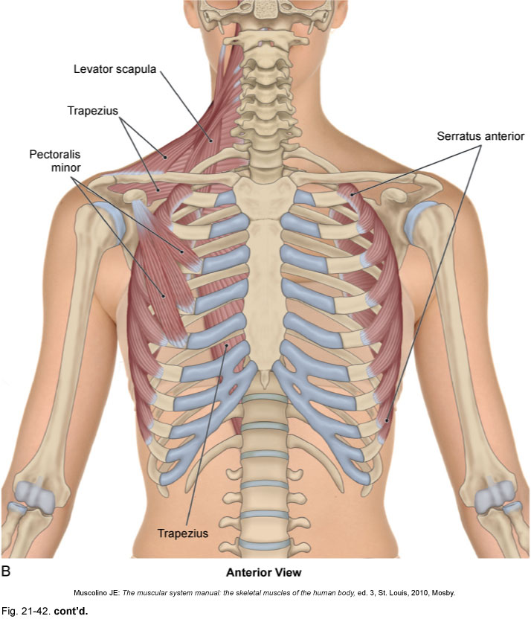
Two other new muscles
Serratus Anterior
Pectoralis Major

Slide 16
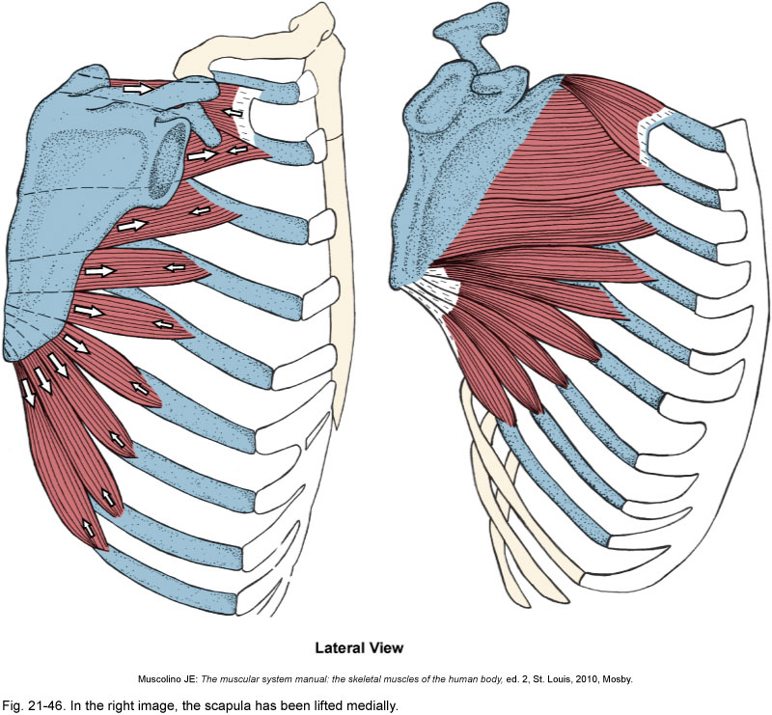
Serratus Anterior
Origin:
  Ribs 1-9, outer surfaces
Insertion:
  Vertebral border of the scapula
Actions:
  Scapular depression
  Scapular abduction/protraction
  Scapular upward rotation
  Holds the scapula to the thorax

Slide 17
Serratus Anterior
Origin:
  Ribs 1-9, outer surfaces
Insertion:
  Vertebral border of the scapula
Actions:
  Scapular depression
  Scapular abduction/protraction
  Scapular upward rotation
  Holds the scapula to the thorax

Slide 18
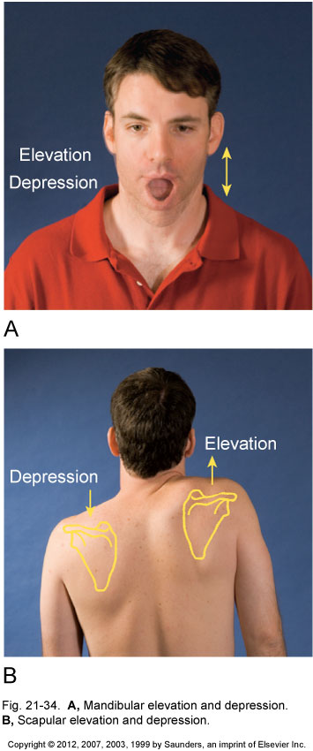
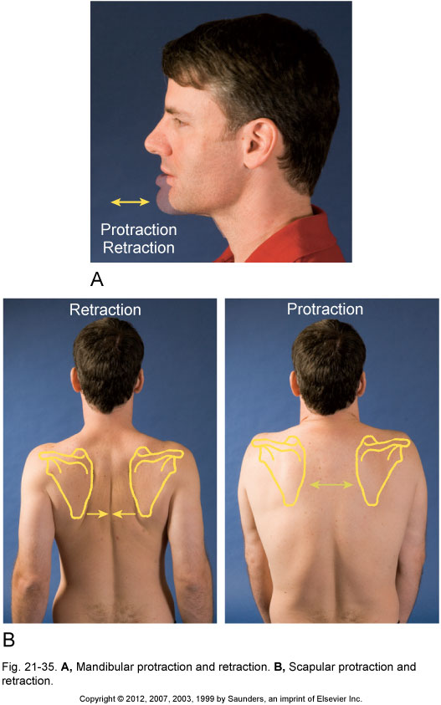
Serratus Anterior
Origin:
  Ribs 1-9, outer surfaces
Insertion:
  Vertebral border of the scapula
Actions:
  Scapular depression
  Scapular abduction/protraction
  Scapular upward rotation
  Holds the scapula to the thorax
Depression
Abduction / Protraction
Upward Rotation

Slide 19
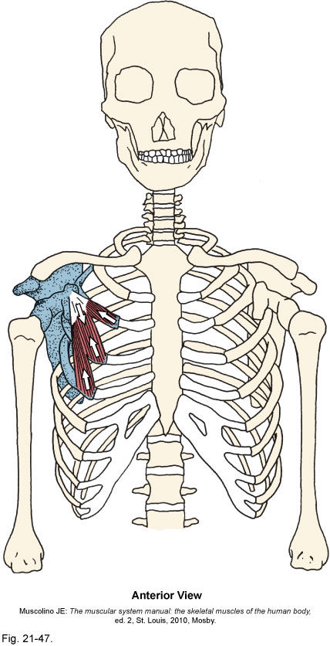
Pectoralis Minor
Origin:
  Ribs 3-5
Insertion:
  Coracoid process of the scapula
Actions:
  Scapular depression
  Scapular abduction/protraction
  Scapular downward rotation

Slide 20
Pectoralis Minor
Origin:
  Ribs 3-5
Insertion:
  Coracoid process of the scapula
Actions:
  Scapular depression
  Scapular abduction/protraction
  Scapular downward rotation
Depression
Abduction / Protraction
Downward Rotation

Slide 21
Scapulothoracic Joint Muscles
Trapezius
Levator Scapula
Rhomboids
Serratus Anterior
Pectoralis Minor

Slide 22
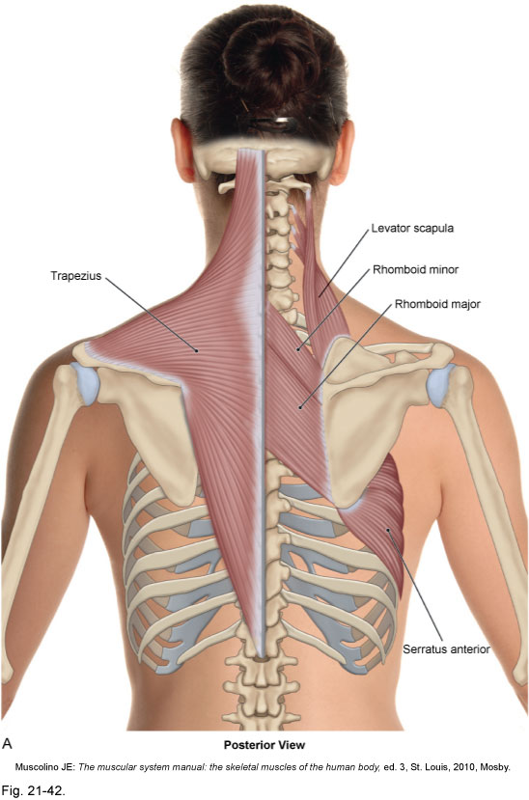
Scapulothoracic Joint Muscles
Levator Scapula
Trapezius
Rhomboids
Serratus Anterior
Posterior View

Slide 23
Scapulothoracic Joint Muscles
Levator Scapula
Trapezius
Serratus Anterior
Pectoralis Minor
Anterior View

Slide 24
Agonists of the Scapulothoracic Joint

Slide 25
Agonists of the Scapulothoracic Joint
Depression
Elevation
Lower Trapezius
Serratus Anterior
Pectoralis Minor
Upper Trapezius
Levator Scapula
Rhomboids

Slide 26
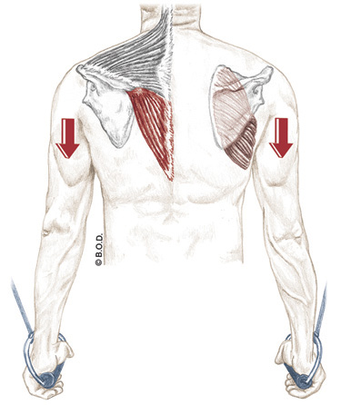
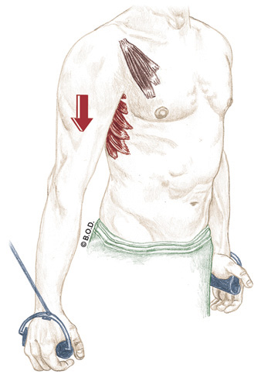
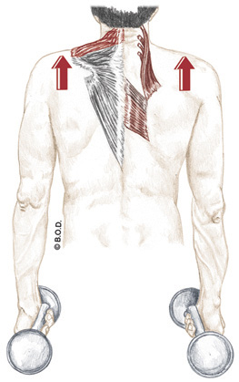
Agonists of the Scapulothoracic Joint
Depression
Elevation
Lower Trapezius
Serratus Anterior
Pectoralis Minor
Upper Trapezius
Levator Scapula
Rhomboids

Slide 27
Agonists of the Scapulothoracic Joint
Retraction/Adduction
Protraction/Abduction
Middle Trapezius
Rhomboids
Serratus Anterior
Pectoralis Minor

Slide 28
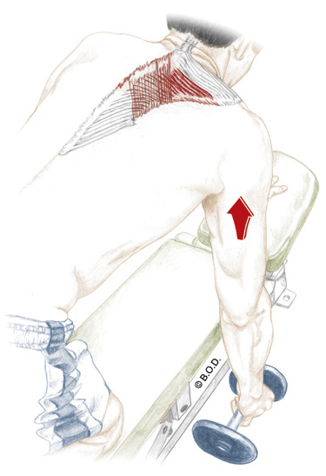
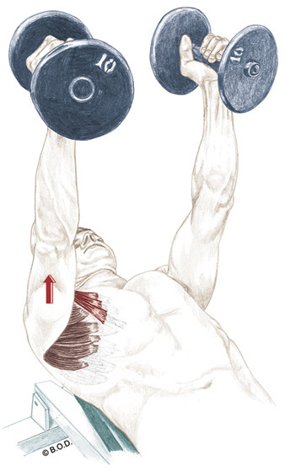
Agonists of the Scapulothoracic Joint
Retraction/Adduction
Protraction/Abduction
Middle Trapezius
Rhomboids
Serratus Anterior
Pectoralis Minor

Slide 29
Agonists of the Scapulothoracic Joint
Upward Rotation
Downward Rotation
Upper and Lower Trapezius
Serratus Anterior
Rhomboids
Levator Scapula
Pectoralis Minor

Slide 30
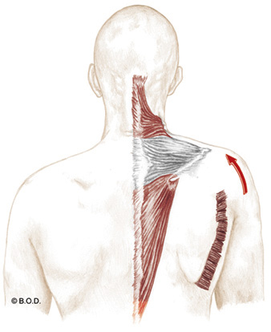
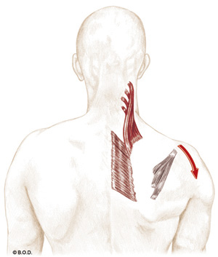
Agonists of the Scapulothoracic Joint
Upward Rotation
Downward Rotation
Upper and Lower Trapezius
Serratus Anterior
Rhomboids
Levator Scapula
Pectoralis Minor

Slide 31
Glenohumeral Joint Muscles
Deltoid
Pectoralis Major
Latissimus Dorsi
Teres Major
Triceps
Supraspinatus
Subscapularis
Infraspinatus
Teres Minor

Slide 32
Glenohumeral Joint Muscles
Supraspinatus
Infraspinatus
Teres Minor
Deltoid
Teres Major
Triceps Brachii
Latissimus Dorsi
Posterior View

Slide 33
Glenohumeral Joint Muscles
Pectoralis
Major
Deltoid
Triceps Brachii
Biceps Brachii
Anterior View

Slide 34
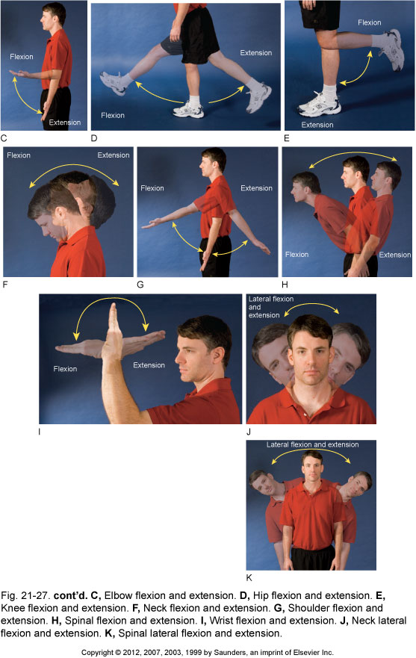
Agonists of the Glenohumeral Joint
Flexion
Extension
Anterior Deltoid
Pectoralis Major (clavicular head)
Posterior Deltoid
Latissimus Dorsi / Teres Major
Pectoralis Major (sternal head)
Triceps Brachii (long head)

Slide 35
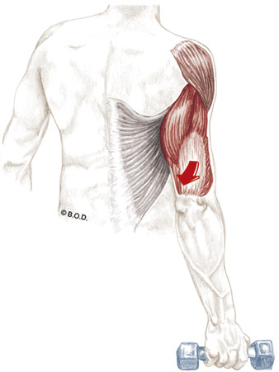
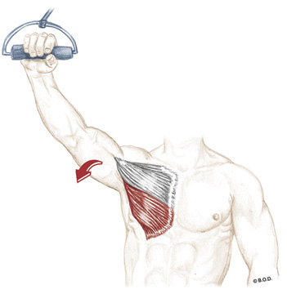
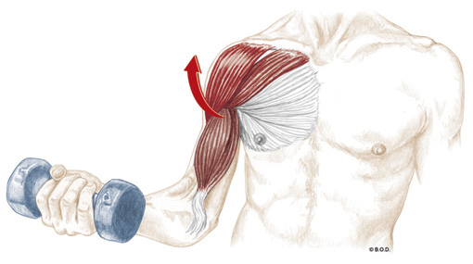
Agonists of the Glenohumeral Joint
Flexion
Extension
Anterior Deltoid
Pectoralis Major (clavicular head)
Posterior Deltoid
Latissimus Dorsi / Teres Major
Pectoralis Major (sternal head)
Triceps Brachii (long head)

Slide 36
Agonists of the Glenohumeral Joint
Abduction
Adduction
Deltoid (all fibers)
Supraspinatus
Pectoralis Major
Latissimus Dorsi / Teres Major
Triceps Brachii (long head)

Slide 37
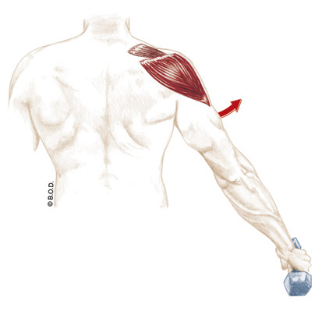
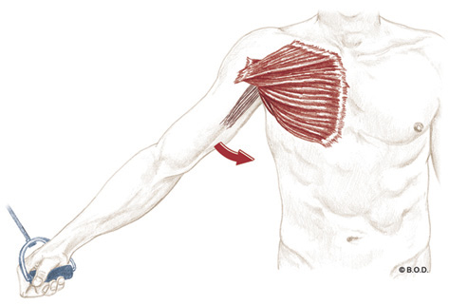
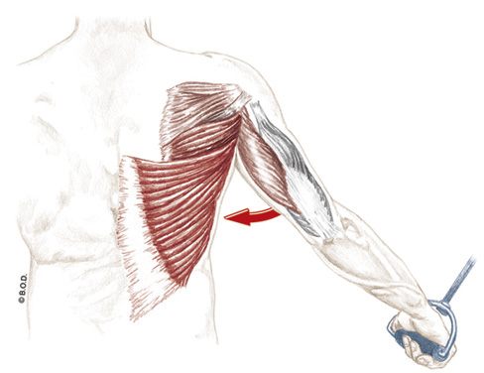
Agonists of the Glenohumeral Joint
Abduction
Adduction
Deltoid (all fibers)
Supraspinatus
Pectoralis Major
Latissimus Dorsi / Teres Major
Triceps Brachii (long head)

Slide 38
Agonists of the Glenohumeral Joint
Medial Rotation
Lateral Rotation
Anterior Deltoid
Subscapularis
Pectoralis Major
Posterior Deltoid
Infraspinatus / Teres Minor

Slide 39
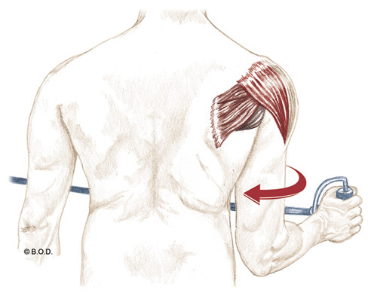
Agonists of the Glenohumeral Joint
Medial Rotation
Lateral Rotation
Anterior Deltoid
Subscapularis
Pectoralis Major
Posterior Deltoid
Infraspinatus / Teres Minor

Slide 40
Anatomy and Kinesiology of the Shoulder Girdle

Slide 41
Use the following slides if needed to review muscles

Slide 42
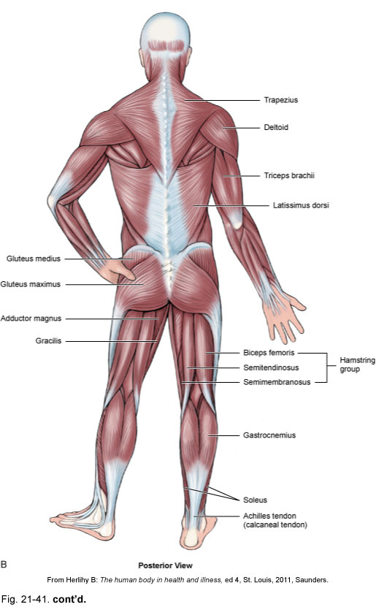
Trapezius in context

Slide 43
Trapezius in context

Slide 44
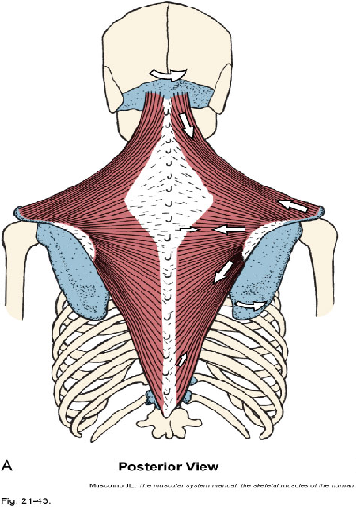
Trapezius
Origin:
Occiput
Ligamentum nuchae (nuchal ligament)
Spinous processes of C7-T12
Insertion:
Lateral one-third of clavicle
Acromion process
Spine of the scapula
Actions:
Upper:
  Elevate the scapula
  Upwardly rotate the scapula
  Laterally flex head and neck
  Rotate head and neck to opposite side
  Extend head and neck
Middle:
  Adduct the scapula
Lower:
  Depress the scapula
  Upwardly rotate the scapula

Slide 45
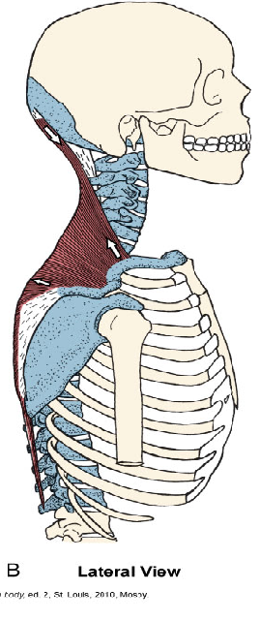
Trapezius
Origin:
Occiput
Ligamentum nuchae
Spinous processes of C7-T12
Insertion:
Lateral one-third of clavicle
Acromion process
Spine of the scapula
Actions:
Upper:
  Elevate the scapula
  Upwardly rotate the scapula
  Laterally flex head and neck
  Rotate head and neck to opposite side
  Extend head and neck
Middle:
  Adduct the scapula
Lower:
  Depress the scapula
  Upwardly rotate the scapula

Slide 46
Trapezius
Origin:
Occiput
Ligamentum nuchae
Spinous processes of C7-T12
Insertion:
Lateral one-third of clavicle
Acromion process
Spine of the scapula
Actions:
Upper:
  Elevate the scapula
  Upwardly rotate the scapula
  Laterally flex head and neck
  Rotate head and neck to opposite side
  Extend head and neck
Middle:
  Adduct the scapula (retraction)
Lower:
  Depress the scapula
  Upwardly rotate the scapula

Slide 47
Rhomboids in context

Slide 48
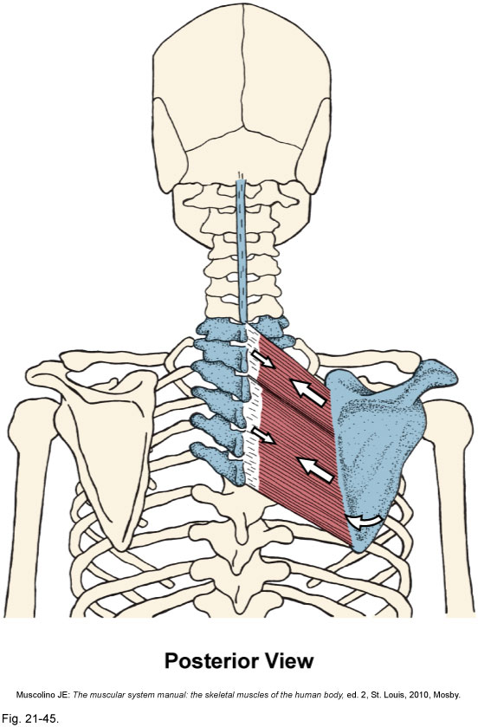
Rhomboids
Origin:
Major:
  Spinous processes of T2-T5
Minor:
  Spinous processes of C7-T1
Insertion:
Major:
  Medial border of scapula, between the spine and inferior angle
Minor:
  Upper portion of medial border of scapula, across from the spine
Actions:
Adduct the scapula
Downwardly rotate the scapula

Slide 49
Rhomboids
Origin:
Major:
  Spinous processes of T2-T5
Minor:
  Spinous processes of C7-T1
Insertion:
Major:
  Medial border of scapula, between the spine and inferior angle
Minor:
  Upper portion of medial border of scapula, across from the spine
Actions:
Adduct the scapula (retraction)
Downwardly rotate the scapula

Slide 50
Levator Scapula in context

Slide 51
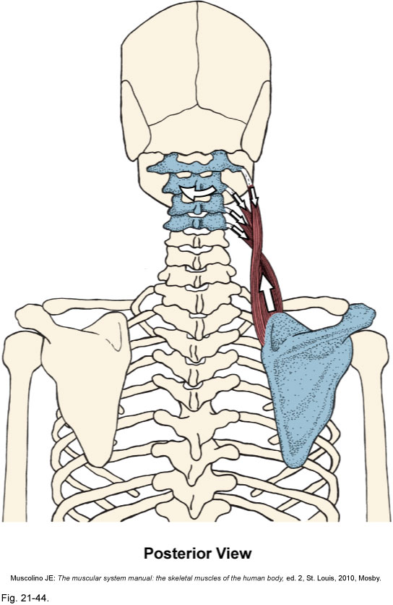
Levator Scapula
Origin:
Transverse processes of C1-4
Insertion:
Upper region of medial border of scapula
Superior angle of scapula
Actions:
Elevate the scapula
Downward rotation of the scapula

Slide 52
Levator Scapula
Origin:
Transverse processes of C1-4
Insertion:
Upper region of medial border of scapula
Superior angle of scapula
Actions:
Elevate the scapula
Downward rotation of the scapula

Slide 53
Teres major and Latissimus dorsi

Slide 54
Teres major and Latissimus dorsi

Slide 55
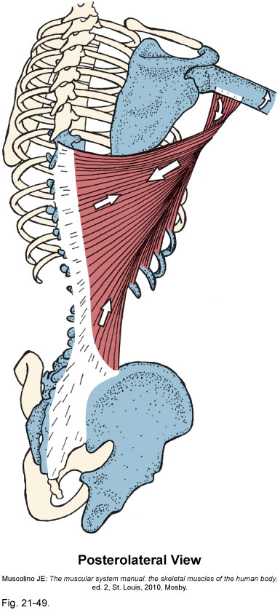
Latissimus dorsi
Origin:
  Spinous processes of last 6
  thoracic vertebrae
  Last 3-4 ribs
  Thoracolumbar aponeurosis
  Iliac crest
Insertion:
  Crest of the lesser tubercle
  of the humerus
Actions:
  Shoulder extension
  Shoulder medial rotation
  Shoulder adduction

Slide 56
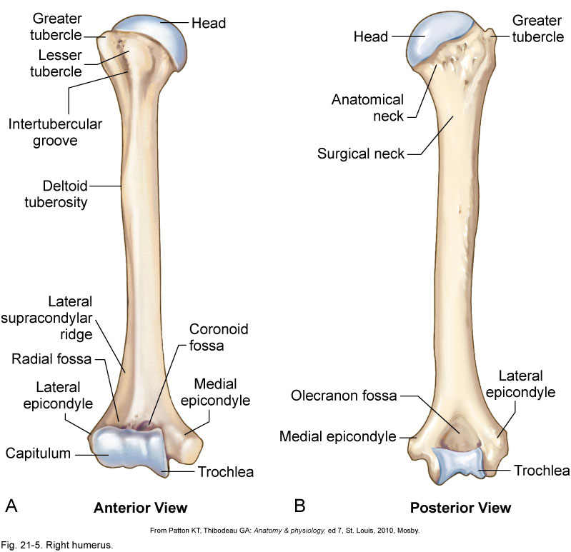
Latissimus dorsi
Origin:
  Spinous processes of last 6
  thoracic vertebrae
  Last 3-4 ribs
  Thoracolumbar aponeurosis
  Iliac crest
Insertion:
  Crest of the lesser tubercle
  of the humerus
Actions:
  Shoulder extension
  Shoulder medial rotation
  Shoulder adduction

Slide 57
Latissimus dorsi
Origin:
  Spinous processes of last 6
  thoracic vertebrae
  Last 3-4 ribs
  Thoracolumbar aponeurosis
  Iliac crest
Insertion:
  Crest of the lesser tubercle
  of the humerus
Actions:
  Shoulder extension
  Shoulder medial rotation
  Shoulder adduction

Slide 58
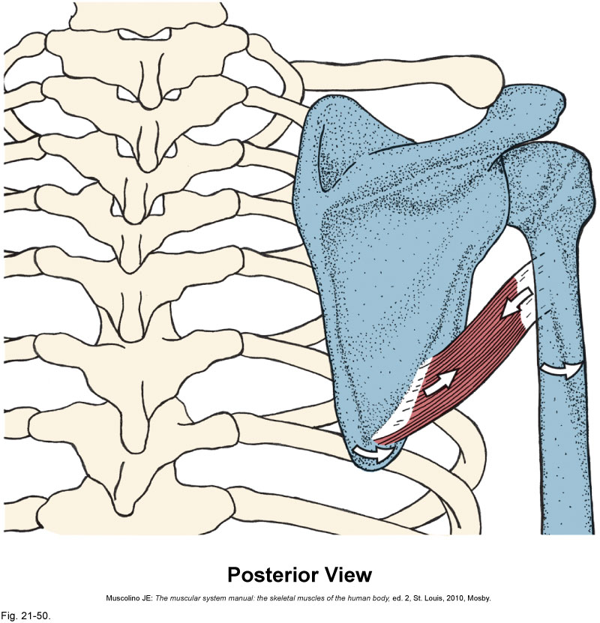
Teres Major
Origin:
    Lower axillary border and inferior angle of scapula
Insertion:
Medial lip of bicipital groove of humerus
Action:
Extension of humerus
Adduction of humerus
  Medial rotation of humerus
Notes:
I use this to remind them where the muscles are - relative to skin, superficial fascia, deep fascia, nerves, blood vessels and bone.

Slide 59
Teres Major
Origin:
    Lower axillary border and inferior angle of scapula
Insertion:
Medial lip of bicipital groove of humerus
Action:
Extension of humerus
Adduction of humerus
  Medial rotation of humerus
Notes:
I use this to remind them where the muscles are - relative to skin, superficial fascia, deep fascia, nerves, blood vessels and bone.

Slide 60
Teres Major
Origin:
    Lower axillary border and inferior angle of scapula
Insertion:
Medial lip of bicipital groove of humerus
Action:
Extension of humerus
Adduction of humerus
  Medial rotation of humerus
Notes:
I use this to remind them where the muscles are - relative to skin, superficial fascia, deep fascia, nerves, blood vessels and bone.

Slide 61
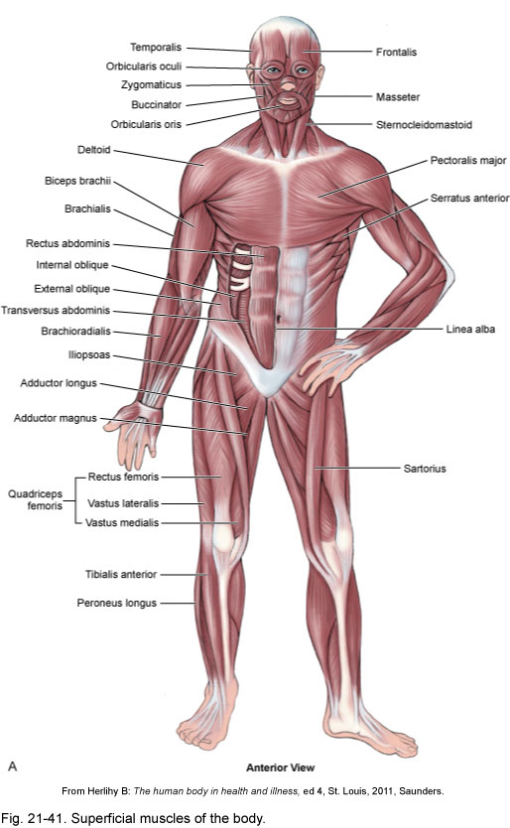
Deltoid and Pectoralis Major

Slide 62
Deltoid and Pectoralis Major

Slide 63
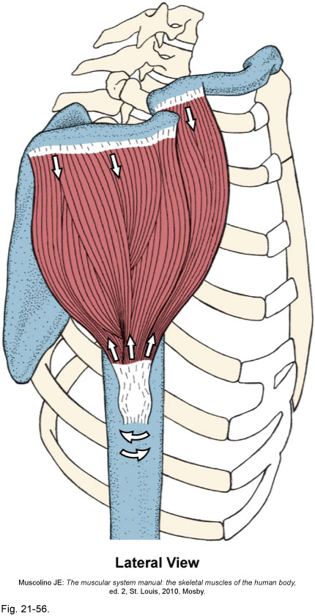
Deltoid
Origin:
Anterior: lateral third of clavicle
Middle: acromion process of scapula
Posterior: spine of scapula
Insertion:
Deltoid tuberosity of humerus
Actions:
All fibers: Shoulder abduction
Anterior:
  Shoulder horizontal adduction
  Shoulder flexion
  Shoulder medial rotation
Posterior:
  Shoulder horizontal abduction
  Shoulder extension
  Shoulder lateral rotation

Slide 64
Deltoid
Origin:
Anterior: lateral third of clavicle
Middle: acromion process of scapula
Posterior: spine of scapula
Insertion:
Deltoid tuberosity of humerus
Actions:
All fibers: Shoulder abduction
Anterior:
  Shoulder horizontal adduction
  Shoulder flexion
  Shoulder medial rotation
Posterior:
  Shoulder horizontal abduction
  Shoulder extension
  Shoulder lateral rotation
Abduction

Slide 65
Deltoid
Origin:
Anterior: lateral third of clavicle
Middle: acromion process of scapula
Posterior: spine of scapula
Insertion:
Deltoid tuberosity of humerus
Actions:
All fibers: Shoulder abduction
Anterior:
  Shoulder horizontal adduction
  Shoulder flexion
  Shoulder medial rotation
Posterior:
  Shoulder horizontal abduction
  Shoulder extension
  Shoulder lateral rotation
Horizontal
adduction
Flexion
Medial rotation

Slide 66
Deltoid
Origin:
Anterior: lateral third of clavicle
Middle: acromion process of scapula
Posterior: spine of scapula
Insertion:
Deltoid tuberosity of humerus
Actions:
All fibers: Shoulder abduction
Anterior:
  Shoulder horizontal adduction
  Shoulder flexion
  Shoulder medial rotation
Posterior:
  Shoulder horizontal abduction
  Shoulder extension
  Shoulder lateral rotation
Horizontal
abduction
Extension
Lateral rotation

Slide 67
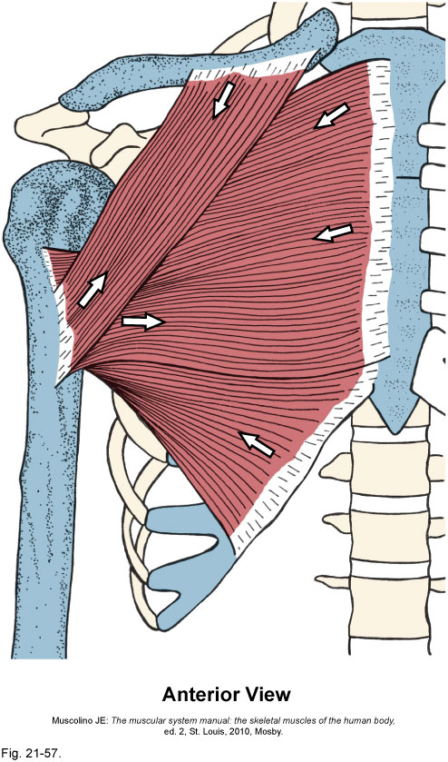
Pectoralis Major
Origin:
Clavicular head:
  Medial half of clavicle
Sternocostal head:
  Sternum and cartilages of 1-6 ribs
Insertion:
Crest of the greater tubercle of humerus
Actions:
All fibers:
  Shoulder adduction
  Shoulder medial rotation
Upper fibers:
  Shoulder horizontal adduction
  Shoulder flexion
Lower fibers:
  Shoulder extension

Slide 68
Pectoralis Major
Origin:
Clavicular head:
  Medial half of clavicle
Sternocostal head:
  Sternum and cartilages of 1-6 ribs
Insertion:
Crest of the greater tubercle of humerus
Actions:
All fibers:
  Shoulder adduction
  Shoulder medial rotation
Upper fibers:
  Shoulder horizontal adduction
  Shoulder flexion
Lower fibers:
  Shoulder extension
Adduction
Medial rotation

Slide 69
Pectoralis Major
Origin:
Clavicular head:
  Medial half of clavicle
Sternocostal head:
  Sternum and cartilages of 1-6 ribs
Insertion:
Crest of the greater tubercle of humerus
Actions:
All fibers:
  Shoulder adduction
  Shoulder medial rotation
Upper fibers:
  Shoulder horizontal adduction
  Shoulder flexion
Lower fibers:
  Shoulder extension
Horizontal
adduction
Flexion

Slide 70
Pectoralis Major
Origin:
Clavicular head:
  Medial half of clavicle
Sternocostal head:
  Sternum and cartilages of 1-6 ribs
Insertion:
Crest of the greater tubercle of humerus
Actions:
All fibers:
  Shoulder adduction
  Shoulder medial rotation
Upper fibers:
  Shoulder horizontal adduction
  Shoulder flexion
Lower fibers:
  Shoulder extension
Extension

Slide 71
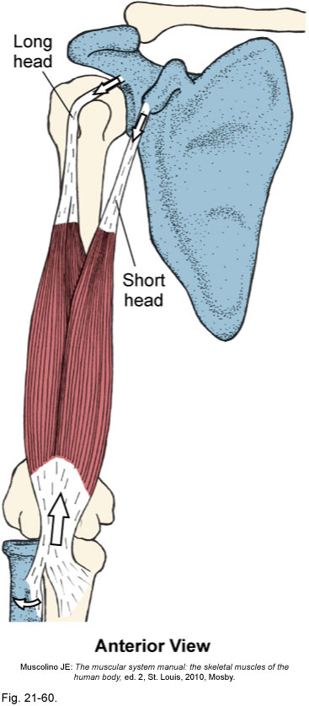
Biceps Brachii
Origin:
Short head: coracoid process of the scapula
Long head: supraglenoid tubercle of the scapula
Insertion:
Tuberosity of the radius
Aponeurosis of the biceps brachii
Actions:
Elbow flexion
Forearm supination
Shoulder flexion

Slide 72
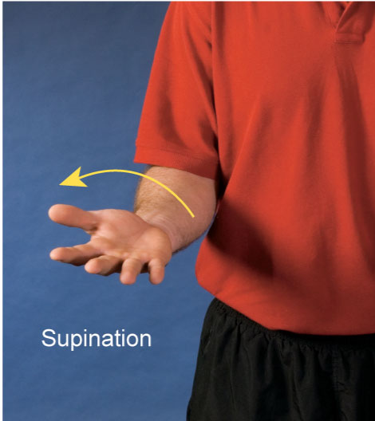
Biceps Brachii
Origin:
Short head: coracoid process of the scapula
Long head: supraglenoid tubercle of the scapula
Insertion:
Tuberosity of the radius
Aponeurosis of the biceps brachii
Actions:
Elbow flexion
Forearm supination
Shoulder flexion
Flexion
Supination
Flexion

Slide 73
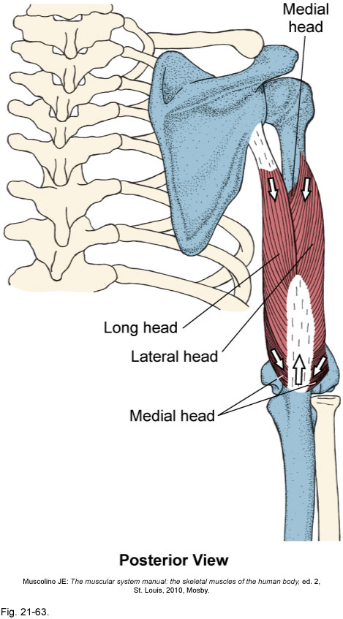
Triceps Brachii
Origin:
Long head: infraglenoid tubercle of the scapula
Lateral head: upper posterior humerus
Medial head: lower posterior humerus
Insertion:
Olecranon process of the scapula
Actions:
Elbow extension
Shoulder extension
Shoulder adduction

Slide 74
Triceps Brachii
Origin:
Long head: infraglenoid tubercle of the scapula
Lateral head: upper posterior humerus
Medial head: lower posterior humerus
Insertion:
Olecranon process of the scapula
Actions:
Elbow extension
Shoulder extension
Shoulder adduction
Extension
Extension
Adduction

