Slide 1
Welcome to The Lauterstein-Conway Massage School
Upcoming Class Schedules
April Evening Class: Mon – Thur 6:00pm – 10:30pm :
  Start Date: April 16, 2019 - 6 month program
May Morning Class: Mon - Thur 8:15am - 12:45pm
  Start Date: May 13, 2019 - 6 month program
July Evening Class: Mon & Wed 6:00pm – 10:30pm
  Start Date: July 17, 2019 - 12 month program

Slide 2
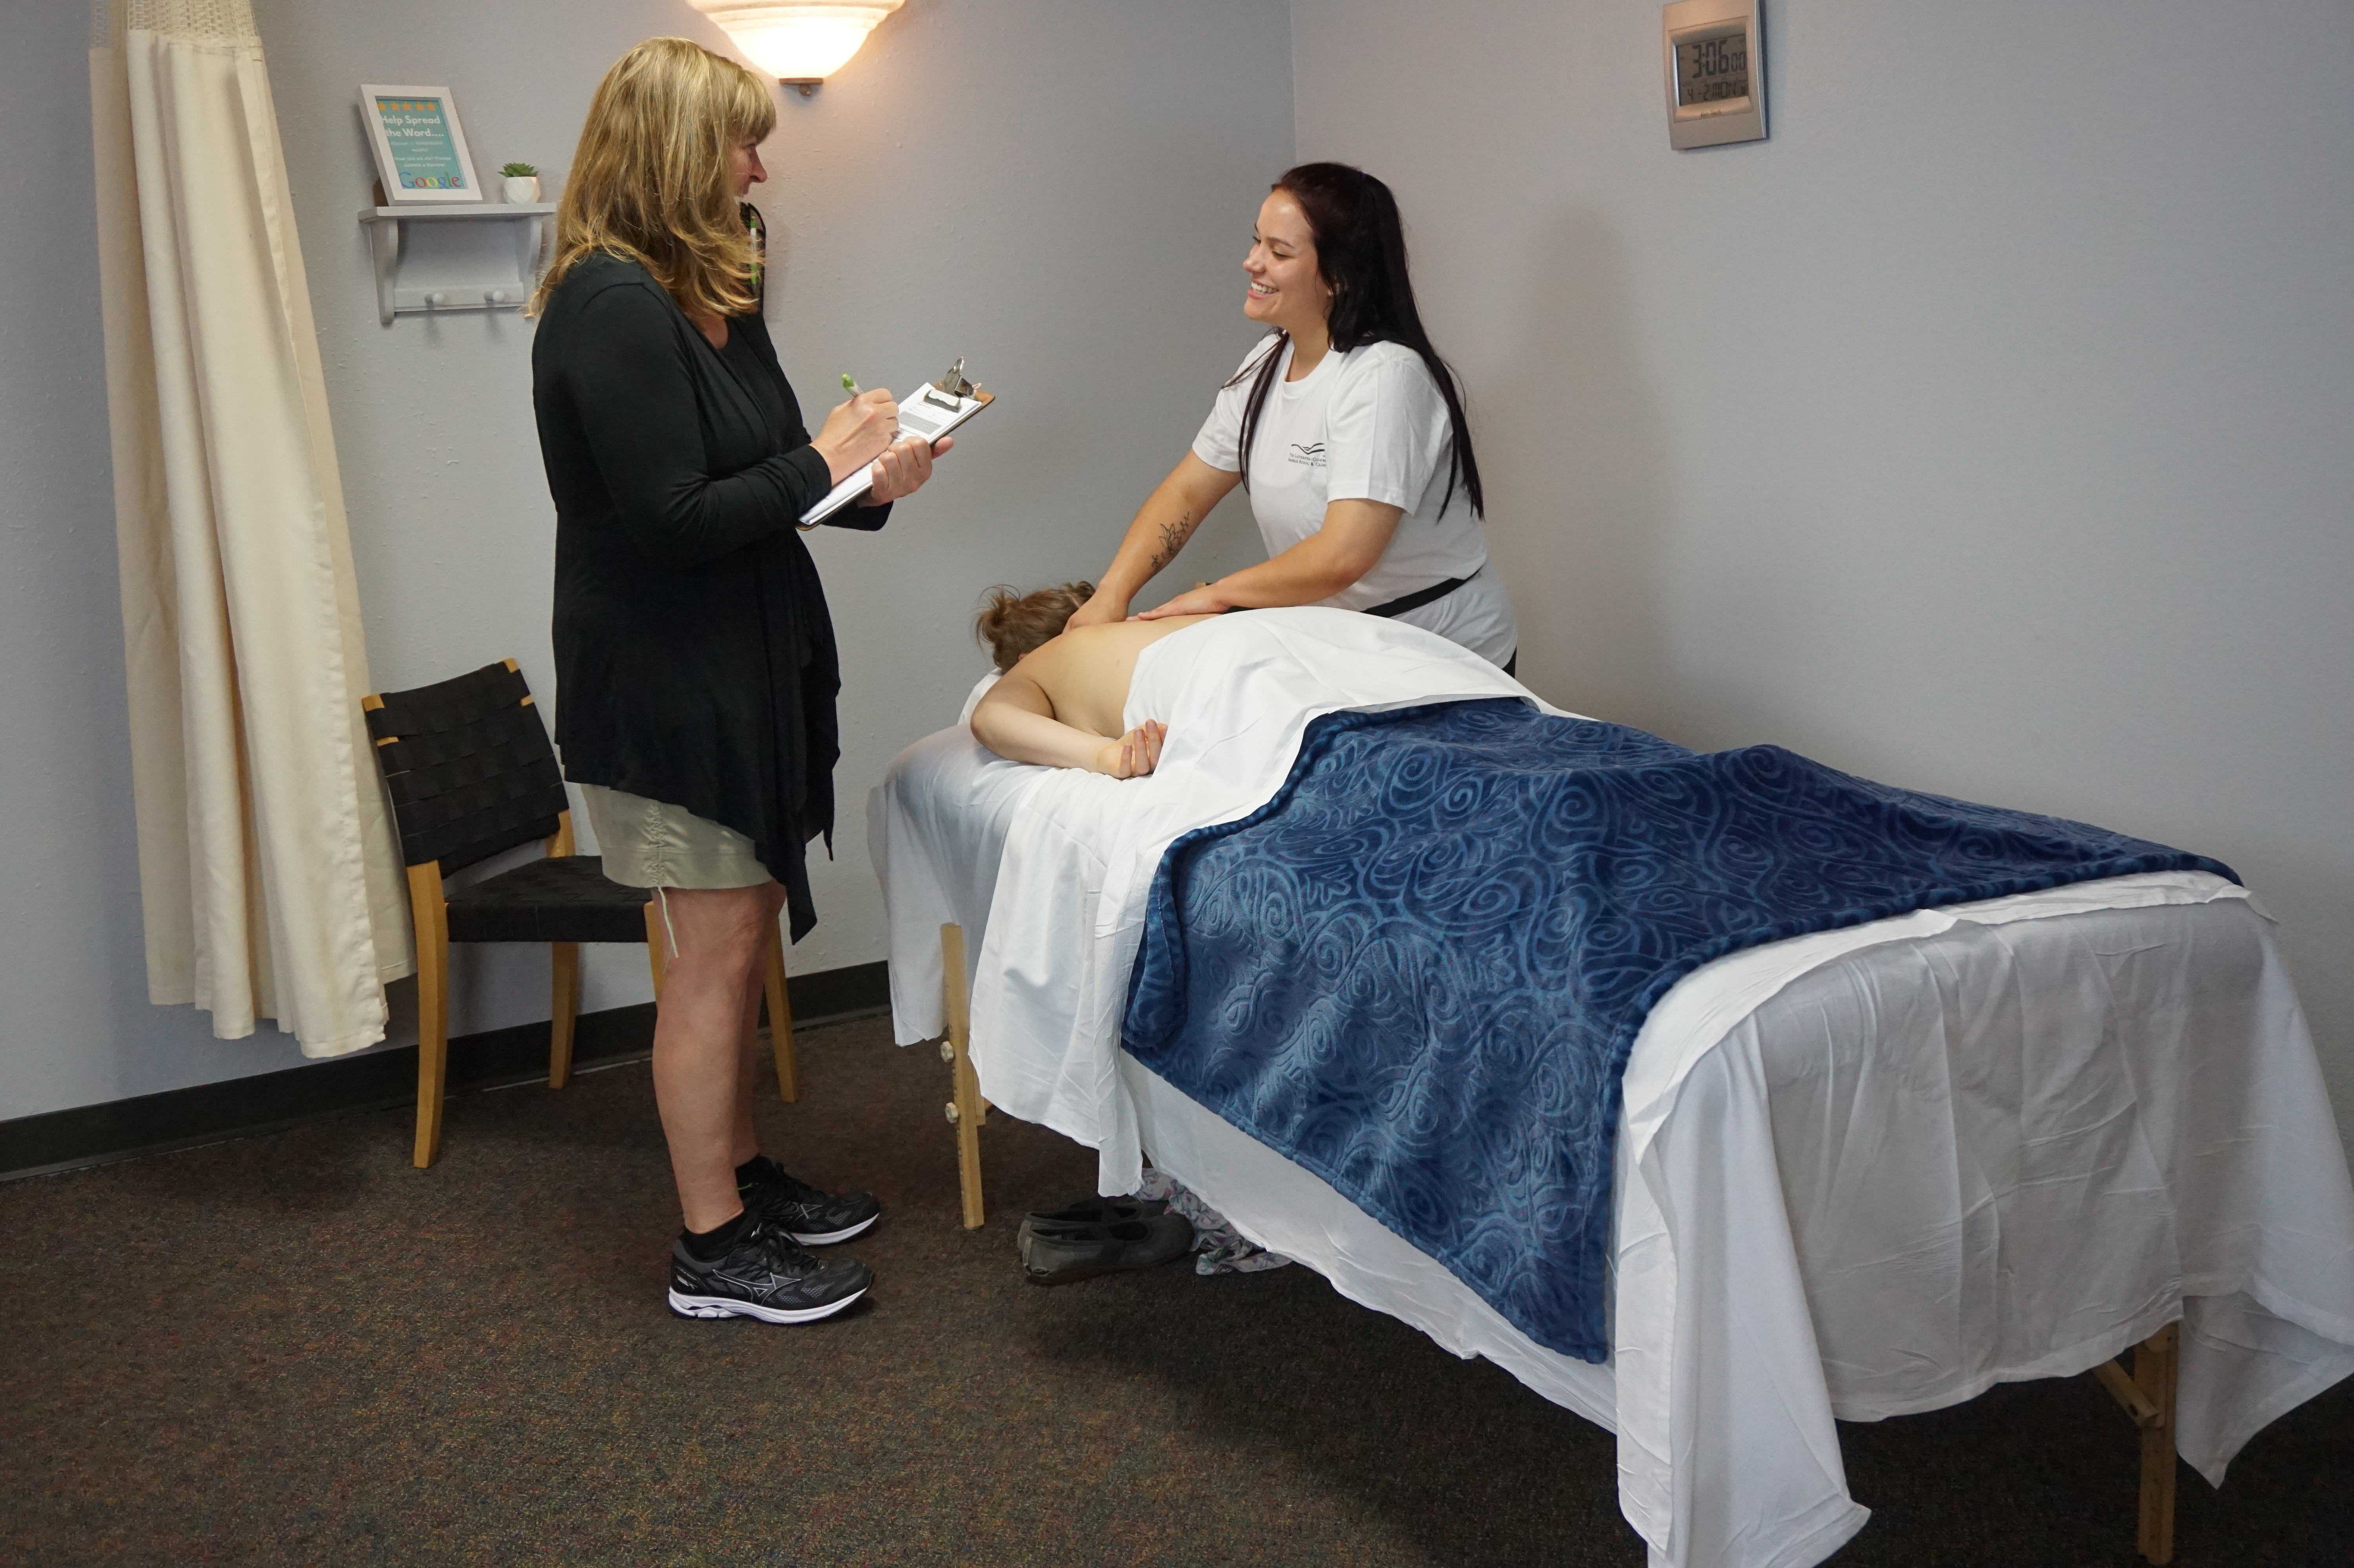
Learning About Massage Therapy

Slide 3
Massage Therapy
What is Massage Therapy?
Massage therapy is manual manipulation of soft body tissues (muscle, connective tissue, tendons and ligaments) to enhance a person’s health and well-being. There are dozens of types of massage therapy methods (also called modalities).
Notes:
Can anyone name a Massage Modality?

Slide 4
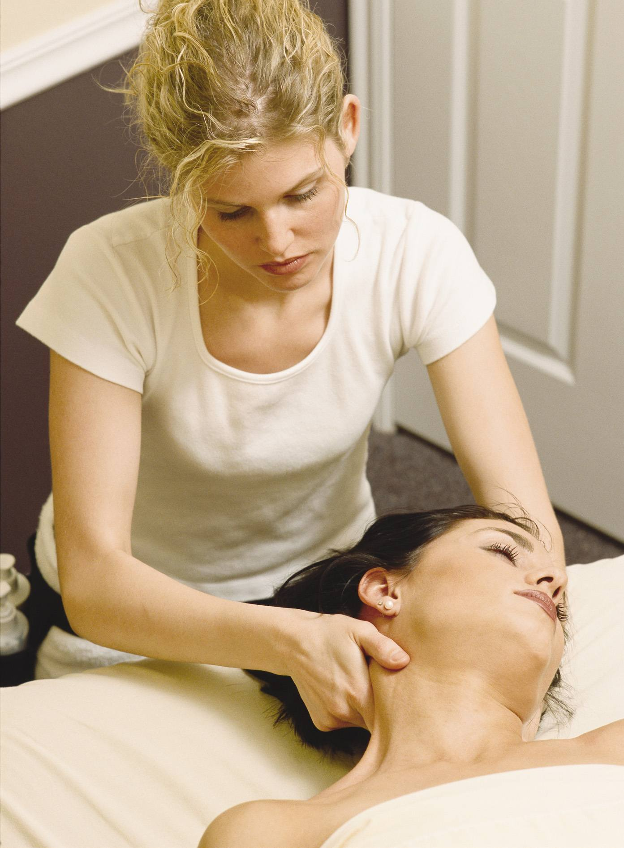
Careers
Austin and the Massage Industry are GROWING!
Opportunities in Massage and Bodywork
  Spas or Resorts
  Medical Settings
  Wellness Centers
  Fitness and Sports Massage
  Careers Within Franchises
  Self - Employed
Employee earning potential $17 - $40 / hour plus tips
Notes:
Ask where do LMTs work?
Tammie tells story about how she got started in Massage. Healing aspect!

Slide 5
Our Curriculum
Swedish Massage
Sports Massage
Deep Tissue
Deep Massage
Clinical Massage
Chair Massage
Hydrotherapy
Pregnancy massage
Human Anatomy & Physiology
Pathology
Kinesiology
Human Health & Hygeine
Business Practice & Ethics

Slide 6
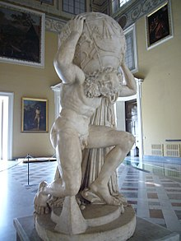
Massage for the Shoulders, Neck, and Arms
Notes:
Stress is a major factor in life these days; An estimated 75-90 percent of all doctor visits are for stress-related issues.
Massage therapy has been proven to significantly, quickly and thoroughly relieve stress
What are some ways that massage helps keep our body healthy?
Relaxes
Stimulates circulation
Relieves muscle tension
Improves muscular balance
Supports free movement
Relieves pain
Promotes wellness
So how do we accomplish this? First of all….
Do no harm – to yourself or your client. If it hurts, find another way. NEVER ASSUME THAT MORE PRESSURE IS BETTER.

Slide 7
Massage for the Shoulders, Neck, and Arms
LET’S GET STARTED!
Receiver: seated reverse on chair
Giver: First sanitize your hands
Then introduce yourselves and
giver stand behind the receiver.

Slide 8
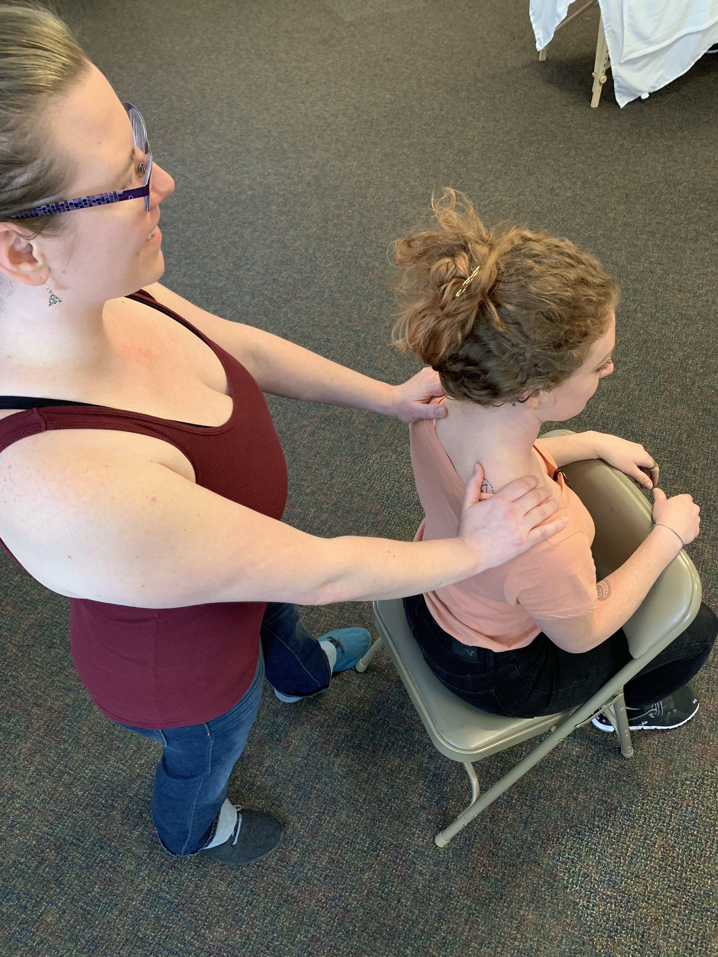
Massage for the Shoulders, Neck, and Arms
LET’S GET STARTED!
Receiver: seated reverse on chair
Giver: First use our Purell to clean your hands
Then introduce yourselves.
Stand behind the receiver
1. (Place hands on shoulders.) Place heels of hands on upper back, palms on top of shoulder, and fingers in front of shoulders.

Slide 9
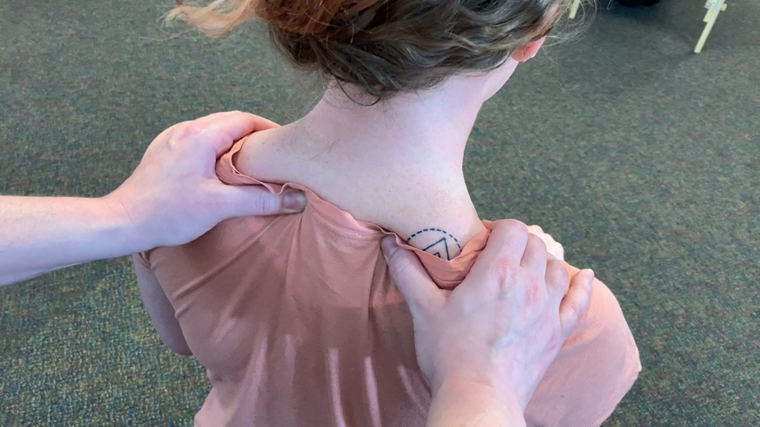
Massage for the Shoulders, Neck, and Arms
2. Begin kneading the trapezius muscle and upper shoulders – knead by bringing your thumbs and fingers toward each other. (like kneading bread dough)
Start gently – check in with receiver regarding pressure.

Slide 10
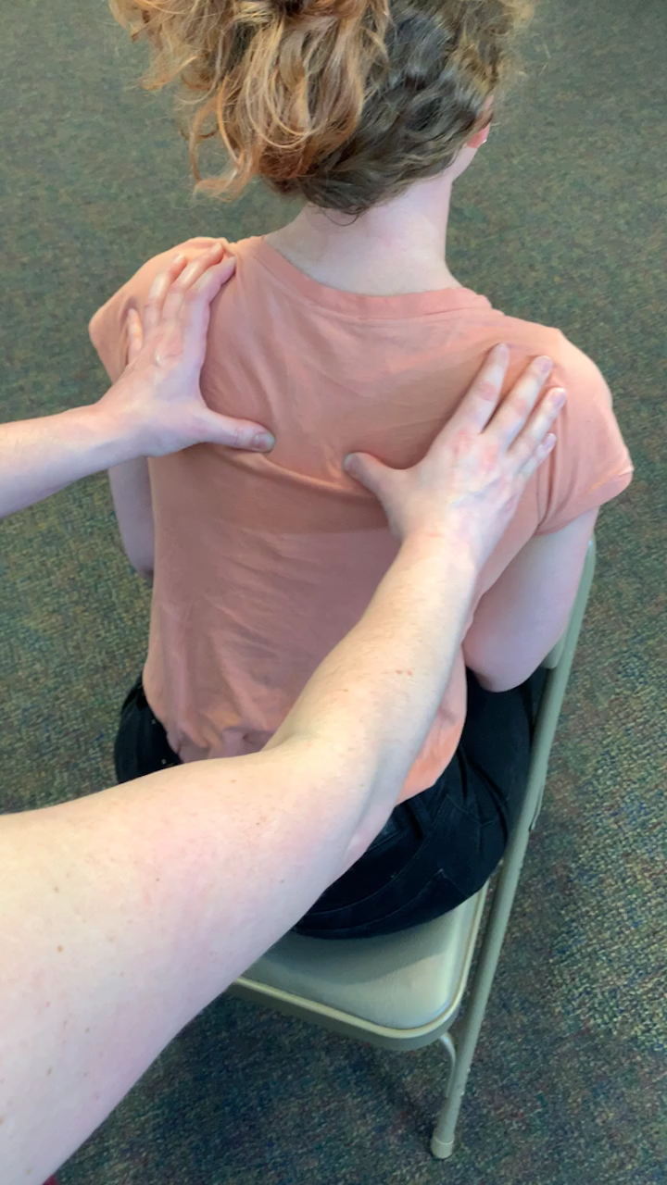
Massage for the shoulders, neck, and arms
4. Keeping your hands approximately in the same area, Now put some emphasis into the upper back.
Press with the thumbs into the upper ribs. Make small circles between shoulder blade and spine.

Slide 11
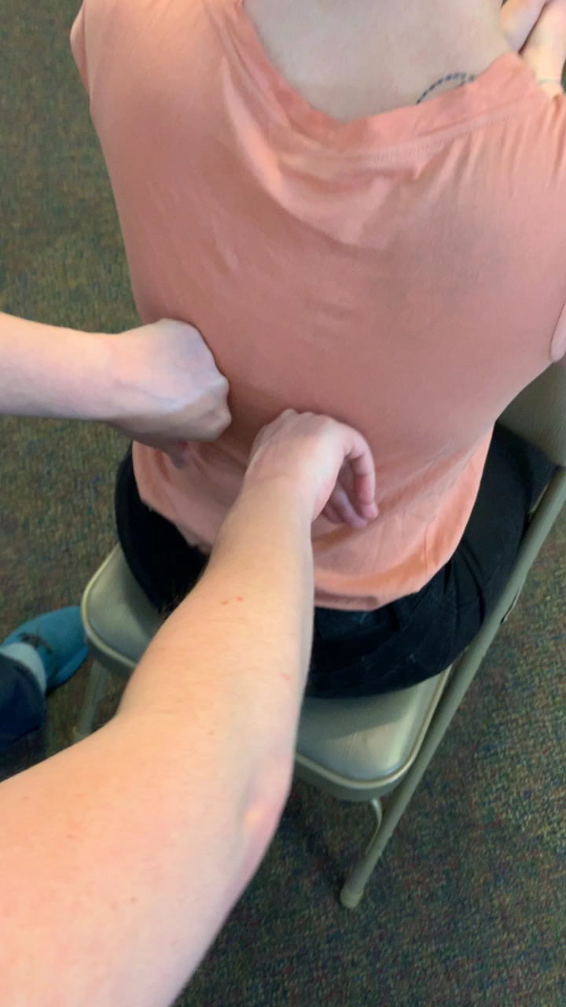
Massage for the shoulders, neck, and arms
Find the layer of tissue along the spine where it starts to feel firm. Lunge with loose fists on both sides of spine. Rotate wrists down the back to hips.
5. Go back up to shoulders. Repeat some kneading of the trapezius.

Slide 12
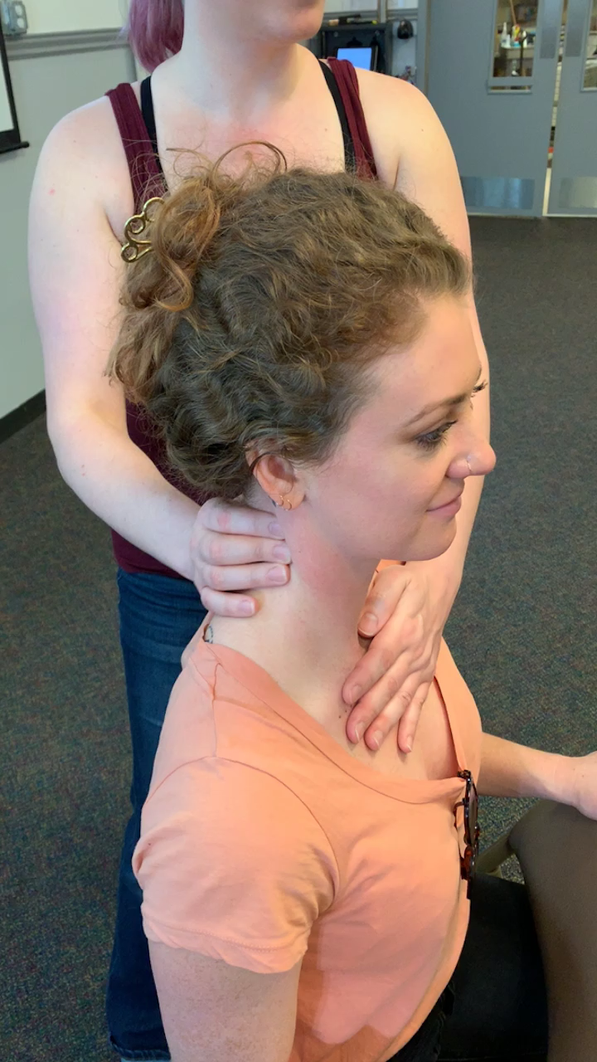
Massage for the shoulders, neck, and arms
6. Standing alongside the person, place your hand gently on the chest close to the clavicle. Supporting the chest, begin gently kneading the neck muscles near the tops of the shoulders – area of 7th cervical vertebra (the big bump).

Slide 13
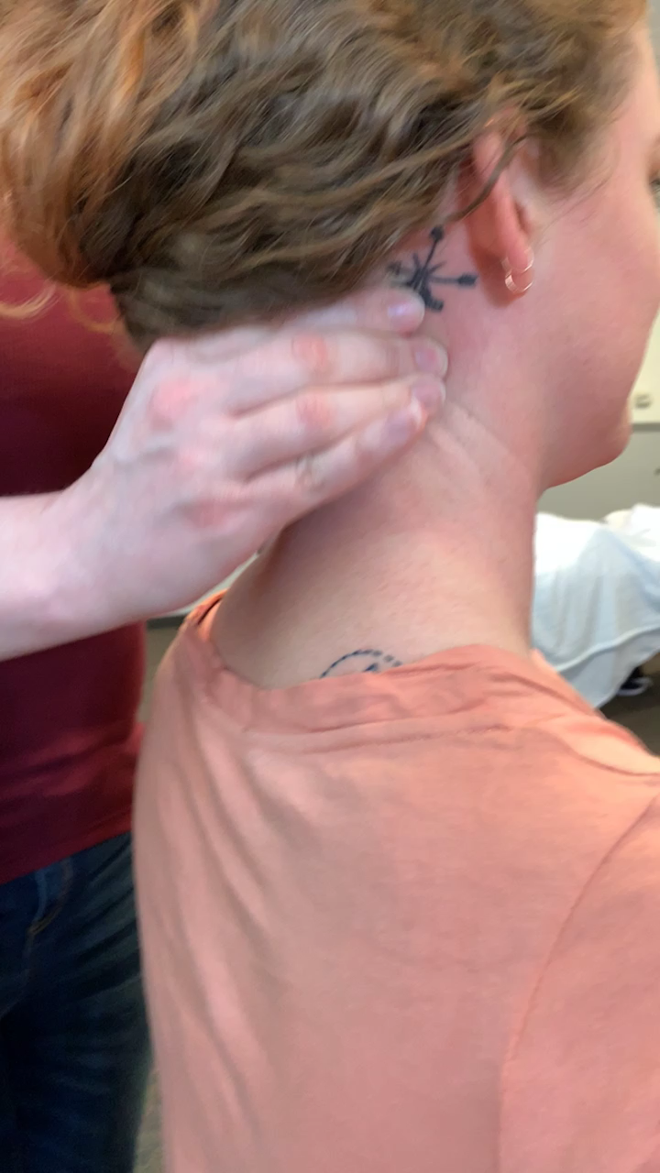
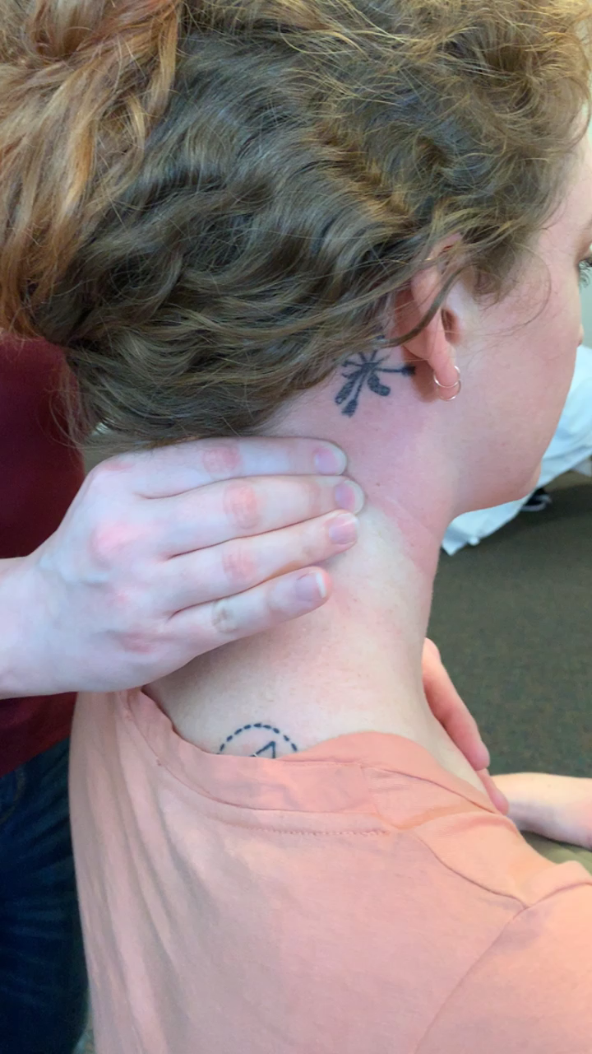
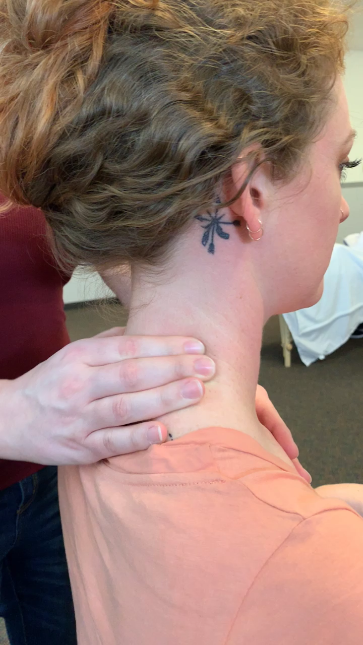
Massage for the shoulders, neck, and arms
7. Divide the length of neck into 3 sections knead them by section bottom to top.
8. Knead for 2-3 breaths at the level of bottom section. Then knead at the mid-level and repeat at the top level (the last vertebra before the bottom of the cranium.)

Slide 14
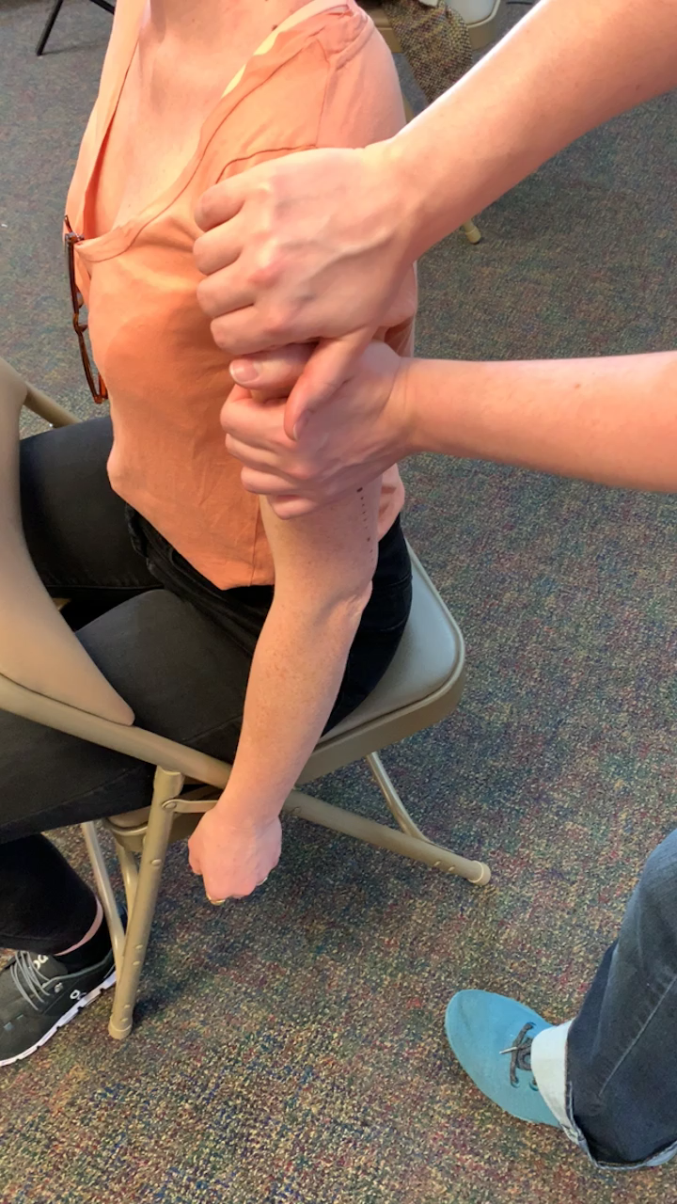
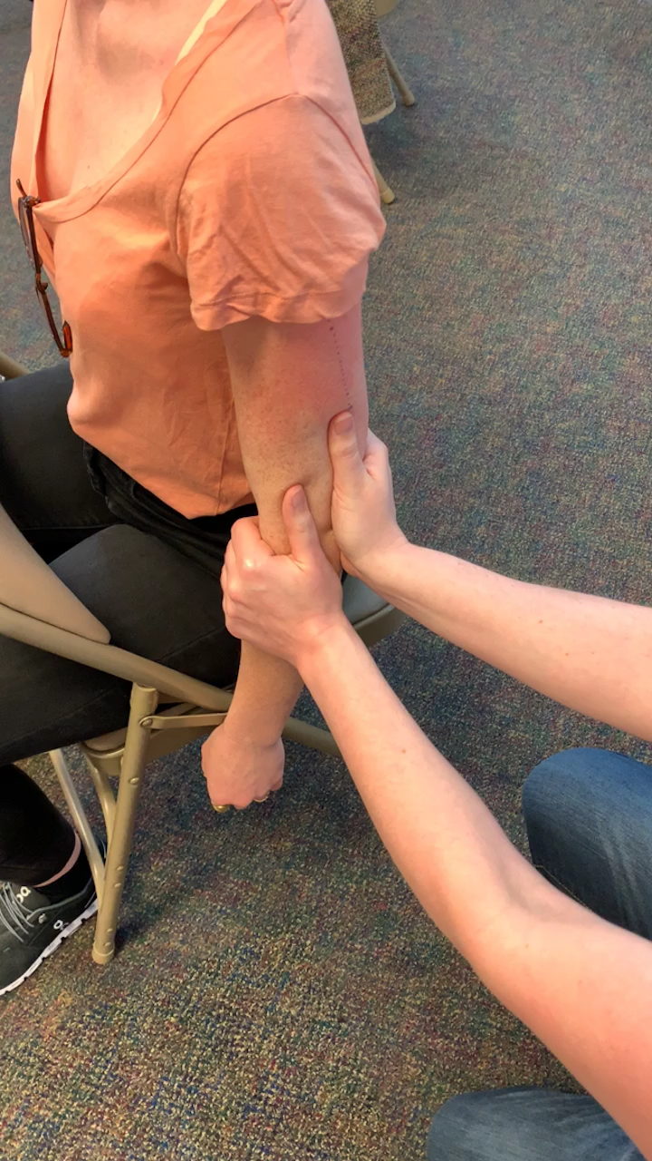
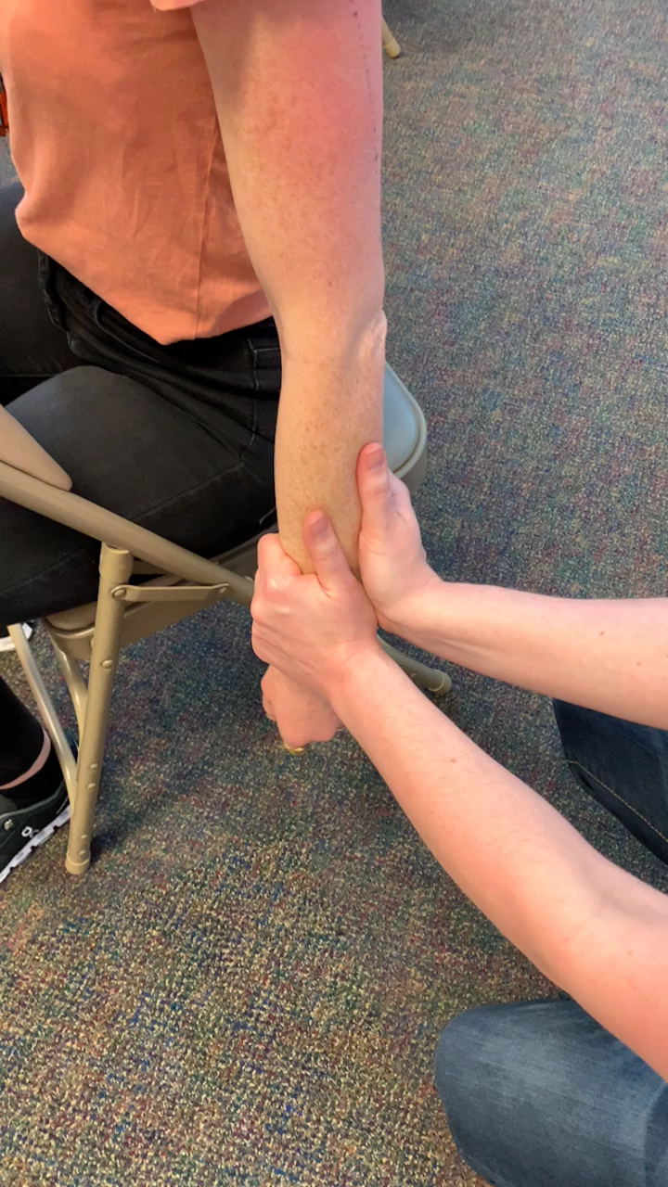
Massage for the shoulders, neck, and arms
9. On that same side, use both hands to gently squeeze down the arm to the hand.

Slide 15
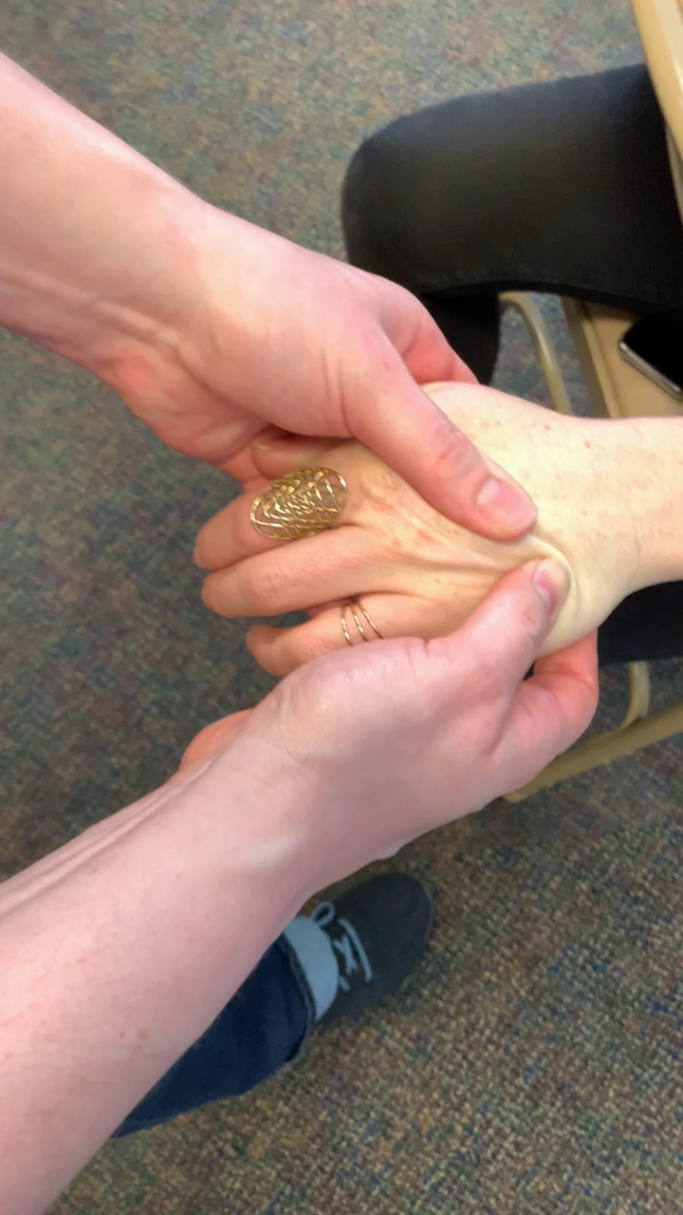
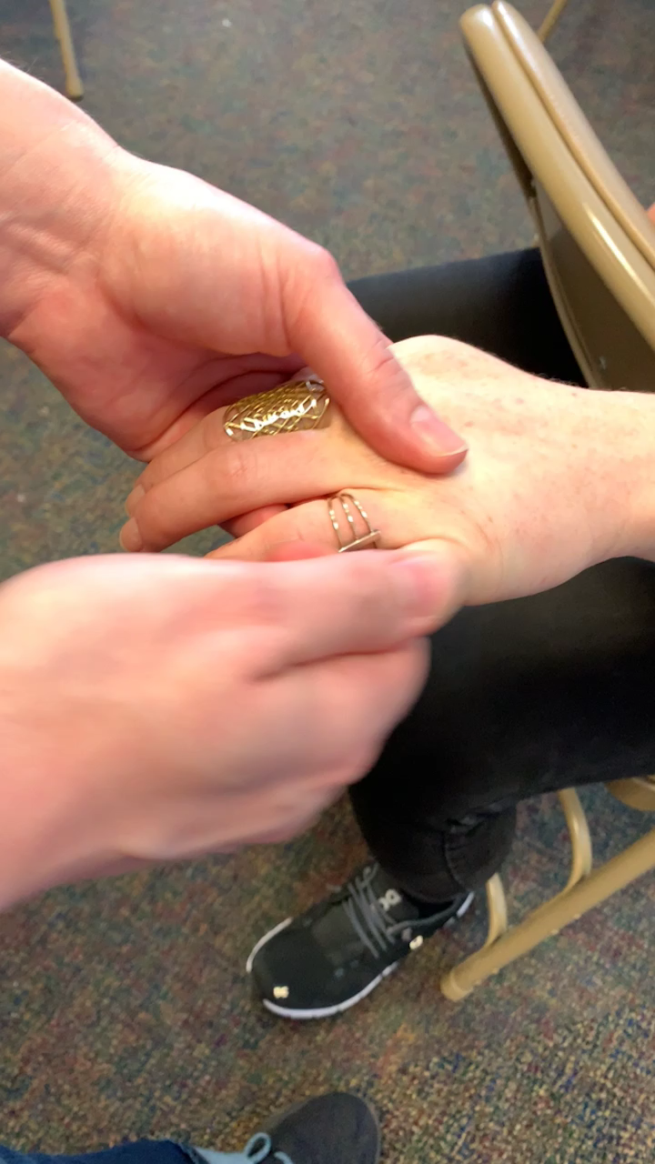
Massage for the shoulders, neck, and arms
10. Gently strip metacarpals. Squeeze each finger. Apply range of motion-extension, flexion, and traction. Up, down, rotate, pull.
11. Squeeze up arm from wrist to shoulder.

Slide 16
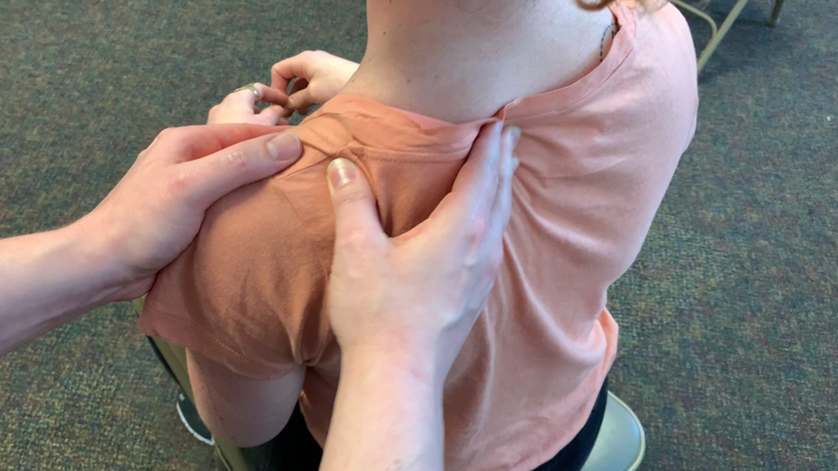
Massage for the shoulders, neck, and arms
12. Return to kneading the trapezius – 2-3 breaths.
13. Gently supporting front of shoulder – use fingers to make circles along the shoulder blade near the spine.

Slide 17
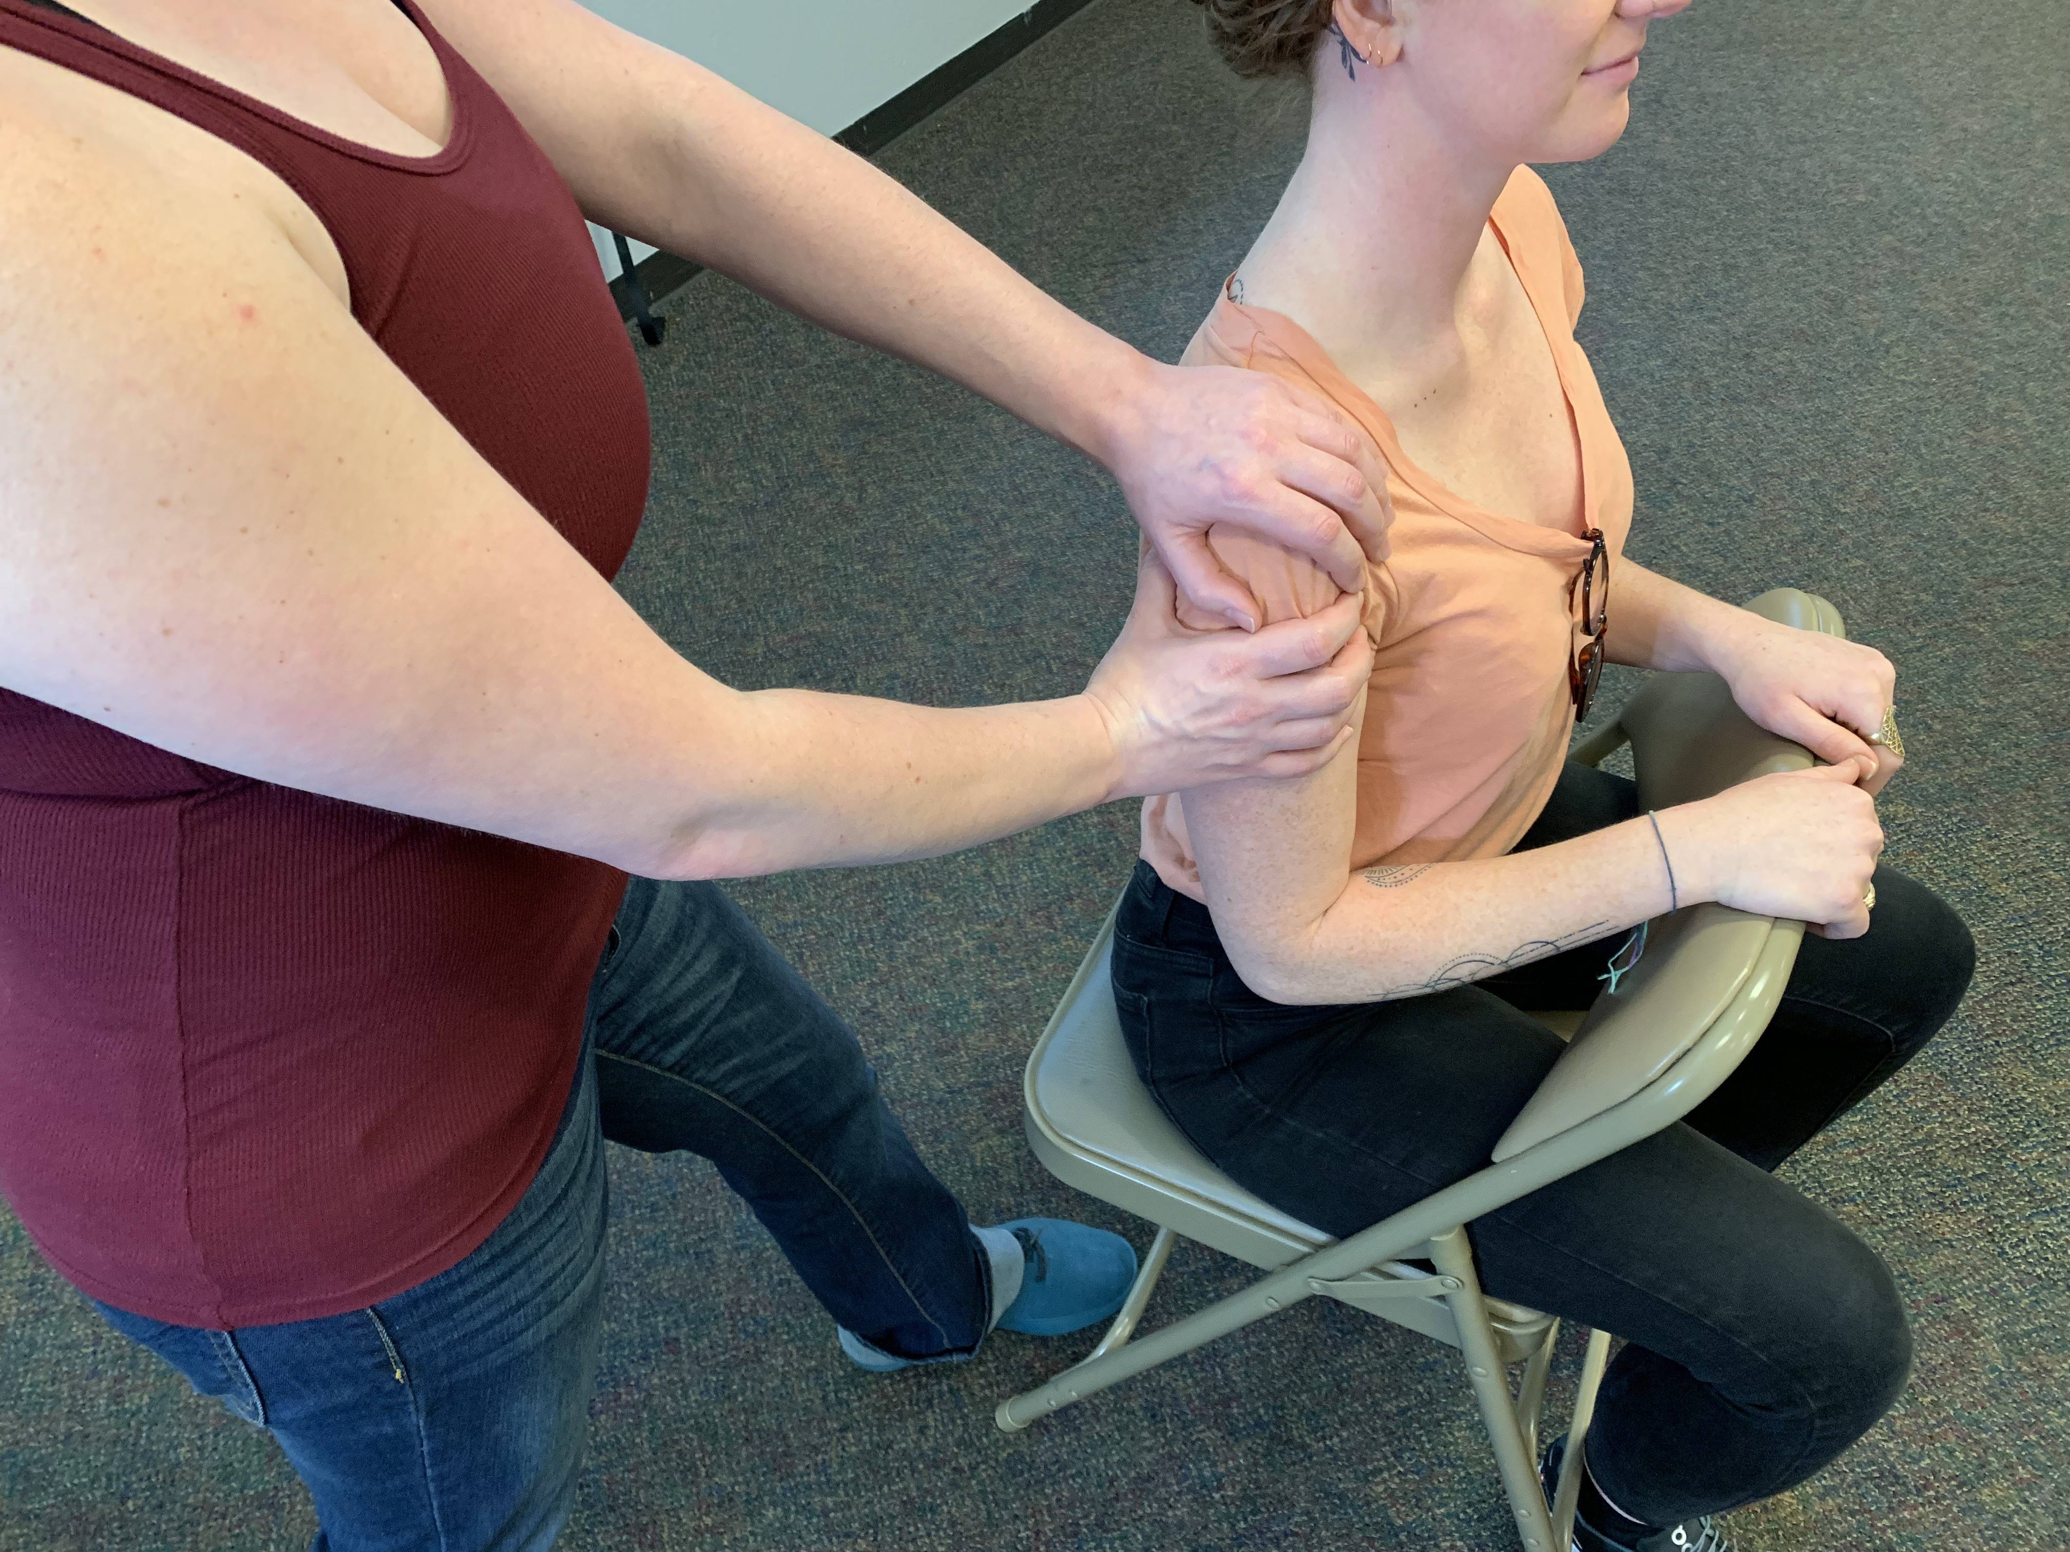
Massage for the shoulders, neck, and arms
14. Repeat on supporting other shoulder.
15. Return to Step #9

Slide 18
Massage for the shoulders, neck, and arms
9. On that same side, use both hands to gently squeeze down the arm to the hand.

Slide 19
Massage for the shoulders, neck, and arms
10. Gently strip metacarpals. Squeeze each finger. Apply range of motion-extension, flexion, and traction. Up, down, rotate, pull.
11. Squeeze up arm from wrist to shoulder.

Slide 20
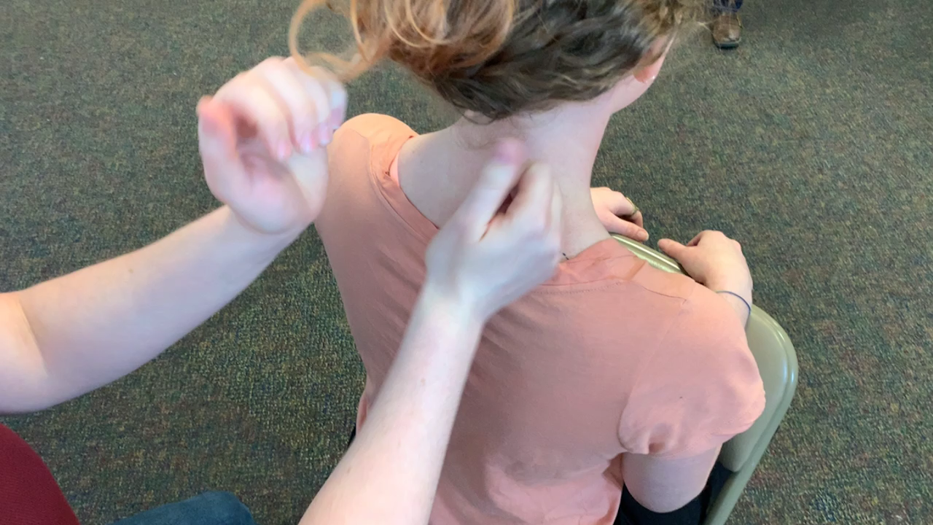
Massage for the shoulders, neck, and arms
15. Use pinkie-side of loose fist to gently add rhythmic percussion movements to the upper back to the soft tissues easing up on any bony surfaces.

Slide 21
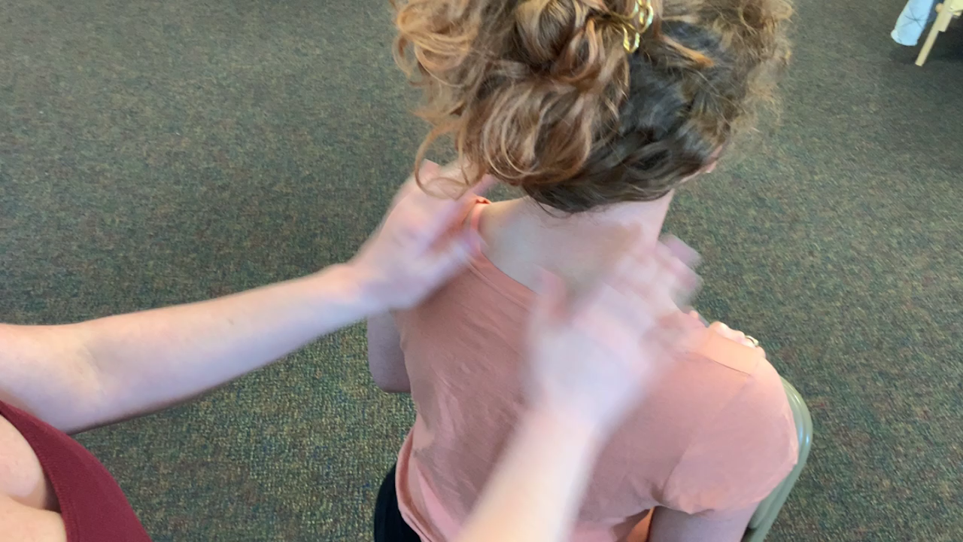
Massage for the shoulders, neck, and arms
16. Gently squeeze both shoulders from neck out to shoulder caps and brush off the shoulders.

Slide 22
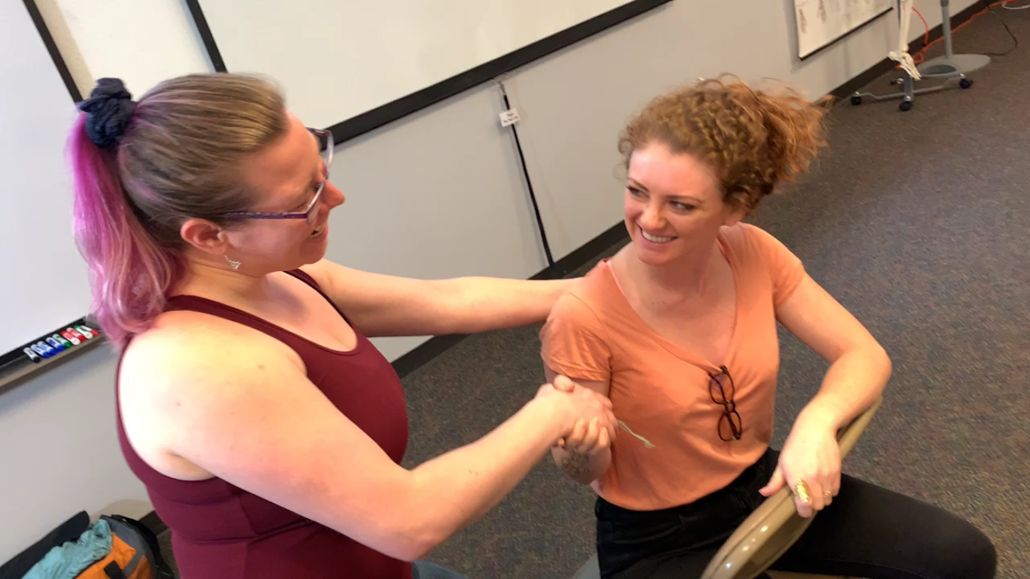
Massage for the shoulders, neck, and arms
17. Squeezing the the shoulder caps thank your partner by name.

Slide 23
Welcome to The Lauterstein-Conway Massage School
Upcoming Class Schedules
April Evening Class: Mon – Thur 6:00pm – 10:30pm :
  Start Date: April 16, 2019 - 6 month program
May Morning Class: Mon - Thur 8:15am - 12:45pm
  Start Date: May 13, 2019 - 6 month program
July Evening Class: Mon & Wed 6:00pm – 10:30pm
  Start Date: July 17, 2019 - 12 month program

