Slide 1
90a Kinesiology Quiz

Slide 2
90a Kinesiology: Palpation Posterior Back and Neck Class Outline
5 minutes Attendance, Breath of Arrival, and Reminders
40 minutes Kinesiology Quiz
15 minutes Review
60 minutes Total

Slide 3
90a Kinesiology Quiz Class Reminders
Assessments:
96b Deep Massage Touch Assessment Packet A:81-82; 89-90
Quizzes:
90a Kinesiology Quiz – NOW!!
(erectors, multifidi, rotatores, quadratus lumborum, levator scapula, trapezius, splenius capitis, splenius cervicis, and semispinalis capitis, gluteals, fibularis longus and brevis, tibialis anterior, soleus, gastrocnemius, TFL, and quads)
50 questions in 40 minutes
94a Kinesiology Quiz
See syllabus for list of muscles to review
75 questions in 60 minutes
Preparation for upcoming classes:
90b Deep Massage: Technique Demo and Practice – Posterior Back and Neck
Lauterstein: Chapter 7.
Lauterstein: Pages 140-142 and 166-171.
91a Kinesiology: Palpation – Anterior and Posterior Legs, Posterior Back, and Neck

Slide 4
Classroom Rules
Punctuality - everybody’s time is precious
Be ready to learn at the start of class; we’ll have you out of here on time
Tardiness: arriving late, returning late after breaks, leaving during class, leaving early
The following are not allowed:
Bare feet
Side talking
Lying down
Inappropriate clothing
Food or drink except water
Phones that are visible in the classroom, bathrooms, or internship
You will receive one verbal warning, then you’ll have to leave the room.

Slide 5
90a Kinesiology: Palpation Posterior Back and Neck

Slide 6
Palpation
Set Up by the Students
Students form groups of 3.
Each group sets up a table and gets 1 face cradle, 1 bolster, and 2 chairs.
Receivers must remain clothed.
There will be no need of sheets except for a face cradle cover.
Demo and Practice
All of the students come to a central table to watch a brief demonstration of how to palpate one of the focus muscles:
List and identify the bony landmarks, especially origins and insertions.
List and identify the muscle bellies and tendons.
List and explain the actions.
Demo how to palpate the muscle while simultaneously offer resistance to the action, “Contract, relax. Contract, relax.”
The students go back to their table to practice the palpation.
2 students palpate the third student collaboratively.
The instructor and assistant circulate to offer guidance and touch comparisons:
This process repeats for each muscle that will be palpated.
Once all the focus muscles have been palpated on the first student, repeat the process so that each student will palpate twice and be palpated once.

Slide 7
Study and Palpation
Use the remaining time for study and palpation of the following muscles:
Erector Spinae Group
Multifidi
Rotatores
Quadratus Lumborum
Levator Scapula
Trapezius
Splenius Capitis
Splenius Cervicis
Semispinalis Capitis

Slide 8
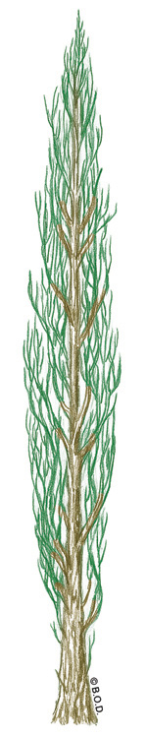
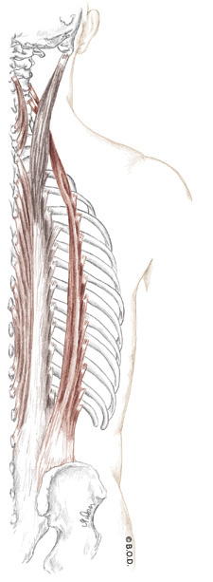
Erector Spinae Group Trail Guide, Page 196
The erector spinae group runs from the sacrum to the occiput.
Erectors have a dense, layered arrangement similar to that of a poplar tree.
The erector group consists of the:
Spinalis
Longissimus
Iliocostalis
When do you use your erectors?
Posterior View

Slide 9
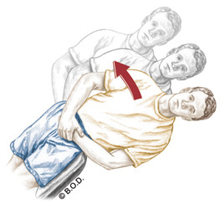
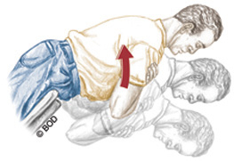
Actions of the erector spinae group
Lateral flexion of the vertebral column to the same side
Extension of the vertebral column
Erector spinae group
Posterior View

Slide 10
Spinalis, page 197 Unilaterally: Laterally flex vertebral column to the same side Bilaterally: Extend the vertebral column O Spinous processes of: C7 vertebrae Upper lumbar vertebrae Lower thoracic vertebrae Ligamentum nuchae Spinous processes of: Upper thoracic vertebrae Cervical vertebrae
A
O
I
Posterior View

Slide 11
Spinalis, page 197 Unilaterally: Laterally flex vertebral column to the same side Bilaterally: Extend the vertebral column O Spinous processes of: C7 vertebrae Upper lumbar vertebrae Lower thoracic vertebrae Ligamentum nuchae Spinous processes of: Upper thoracic vertebrae Cervical vertebrae
A
O
I
Posterior View

Slide 12
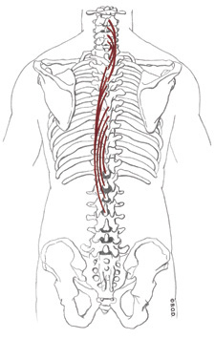
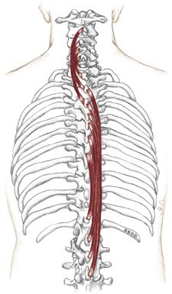
Spinalis, page 197 Unilaterally: Laterally flex vertebral column to the same side Bilaterally: Extend the vertebral column O Spinous processes of: C7 vertebrae Upper lumbar vertebrae Lower thoracic vertebrae Ligamentum nuchae Spinous processes of: Upper thoracic vertebrae Cervical vertebrae
A
O
I
Posterior View

Slide 13
Spinalis, page 197 Unilaterally: Laterally flex vertebral column to the same side Bilaterally: Extend the vertebral column O Spinous processes of: C7 vertebrae Upper lumbar vertebrae Lower thoracic vertebrae Ligamentum nuchae Spinous processes of: Upper thoracic vertebrae Cervical vertebrae
A
O
I
Posterior View

Slide 14
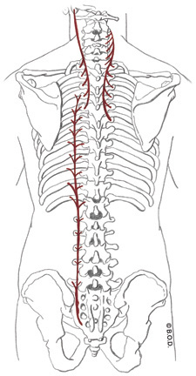
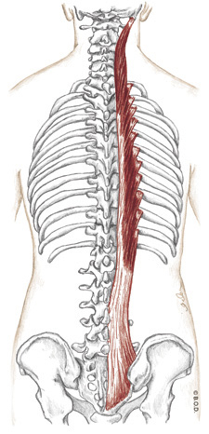
Longissimus, page 198 Unilaterally: Laterally flex vertebral column to the same side Bilaterally: Extend the vertebral column O Common tendon (thoracis) Transverse processes of upper five thoracic vertebrae (cervicis and capitis) Lower nine thoracic ribs (thoracis) Lower nine thoracic transverse processes (thoracis) Cervical transverse processes (cervicis) Mastoid process of temporal bone (capitis)
A
O
I
Posterior View

Slide 15
Longissimus, page 198 Unilaterally: Laterally flex vertebral column to the same side Bilaterally: Extend the vertebral column O Common tendon (thoracis) Transverse processes of upper five thoracic vertebrae (cervicis and capitis) Lower nine thoracic ribs (thoracis) Lower nine thoracic transverse processes (thoracis) Cervical transverse processes (cervicis) Mastoid process of temporal bone (capitis)
A
O
I
Posterior View

Slide 16
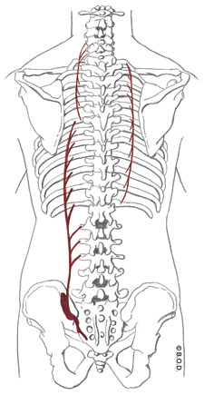
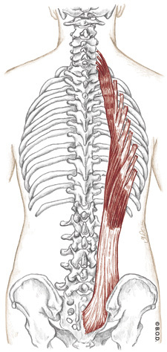
Iliocostalis, page 198 Unilaterally: Laterally flex vertebral column to the same side Bilaterally: Extend the vertebral column O Common tendon (lumborum) Posterior surface of ribs 1-12 (thoracis and cervicis) Transverse processes of lumbar vertebrae 1-3 (thoracis) Posterior surface of ribs 6-12 (lumborum) Posterior surface of ribs 1-6 (thoracis) Transverse processes of lower cervicals (cervicis)
A
O
I
Posterior View

Slide 17
Iliocostalis, page 198 Unilaterally: Laterally flex vertebral column to the same side Bilaterally: Extend the vertebral column O Common tendon (lumborum) Posterior surface of ribs 1-12 (thoracis and cervicis) Transverse processes of lumbar vertebrae 1-3 (thoracis) Posterior surface of ribs 6-12 (lumborum) Posterior surface of ribs 1-6 (thoracis) Transverse processes of lower cervicals (cervicis)
A
O
I
Posterior View

Slide 18
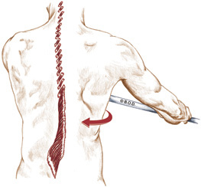
Multifidi, Trail Guide Page 201 Unilaterally: Rotate the vertebral column to the opposite side Bilaterally:
Extend the vertebral column Sacrum
Transverse processes of lumbar vertebrae through
cervical vertebrae Spinous processes of lumbar vertebrae through
2nd cervical vertebrae spanning 2 to 4 vertebrae
A
O
I
Posterior View

Slide 19
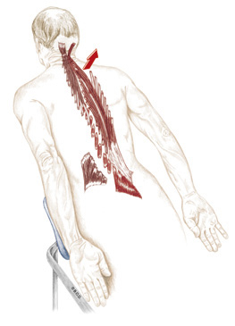
Multifidi, Trail Guide Page 201 Unilaterally: Rotate the vertebral column to the opposite side Bilaterally:
Extend the vertebral column Sacrum
Transverse processes of lumbar vertebrae through
cervical vertebrae Spinous processes of lumbar vertebrae through
2nd cervical vertebrae spanning 2 to 4 vertebrae
A
O
I
Posterolateral View

Slide 20
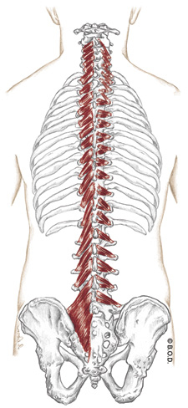
Multifidi, Trail Guide Page 201 Unilaterally: Rotate the vertebral column to the opposite side Bilaterally:
Extend the vertebral column Sacrum
Transverse processes of lumbar vertebrae through
cervical vertebrae Spinous processes of lumbar vertebrae through
2nd cervical vertebrae spanning 2 to 4 vertebrae
A
O
I
Multifidi
Rotatores

Slide 21
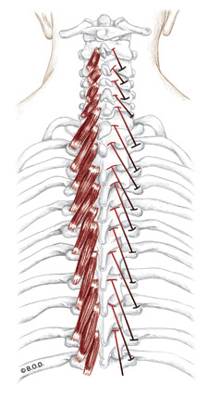
Multifidi, Trail Guide Page 201 Unilaterally: Rotate the vertebral column to the opposite side Bilaterally:
Extend the vertebral column Sacrum
Transverse processes of lumbar vertebrae through
cervical vertebrae Spinous processes of lumbar vertebrae through
2nd cervical vertebrae spanning 2 to 4 vertebrae
A
O
I
Multifidi
Posterior view

Slide 22
Multifidi, Trail Guide Page 201 Unilaterally: Rotate the vertebral column to the opposite side Bilaterally:
Extend the vertebral column Sacrum
Transverse processes of lumbar vertebrae through
cervical vertebrae
Spinous processes of lumbar vertebrae through
2nd cervical vertebrae spanning 2 to 4 vertebrae
A
O
I
Multifidi
Posterior view

Slide 23
Rotatores, Trail Guide Page 201 Unilaterally: Rotate the vertebral column to the opposite side Bilaterally:
Extend the vertebral column Transverse processes of lumbar vertebrae through
cervical vertebrae Spinous processes of lumbar vertebrae through
2nd cervical vertebrae spanning 1 to 2 vertebrae
A
O
I
Posterior View

Slide 24
Rotatores, Trail Guide Page 201 Unilaterally: Rotate the vertebral column to the opposite side Bilaterally:
Extend the vertebral column Transverse processes of lumbar vertebrae through
cervical vertebrae Spinous processes of lumbar vertebrae through
2nd cervical vertebrae spanning 1 to 2 vertebrae
A
O
I
Posterolateral View

Slide 25
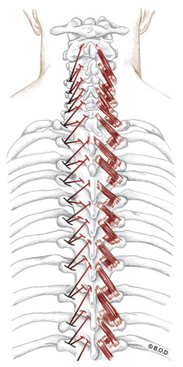
Rotatores, Trail Guide Page 201 Unilaterally: Rotate the vertebral column to the opposite side Bilaterally:
Extend the vertebral column Transverse processes of lumbar vertebrae through
cervical vertebrae Spinous processes of lumbar vertebrae through
2nd cervical vertebrae spanning 1 to 2 vertebrae
A
O
I
Posterior View

Slide 26
Rotatores, Trail Guide Page 201 Unilaterally: Rotate the vertebral column to the opposite side Bilaterally:
Extend the vertebral column Transverse processes of lumbar vertebrae through
cervical vertebrae Spinous processes of lumbar vertebrae through
2nd cervical vertebrae spanning 1 to 2 vertebrae
A
O
I
Posterior View

Slide 27
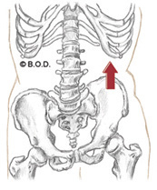
Quadratus Lumborum, Trail Guide Page 207 Unilaterally: Laterally tilt (elevate) the pelvis Laterally flex the vertebral column to the same side Assist to extend vertebral column Bilaterally: Fix the last rib during forced inhalation and exhalation Posterior iliac crest Last rib Transverse processes of 1st-4th lumbar vertebrae
A
O
I
Anterior View

Slide 28
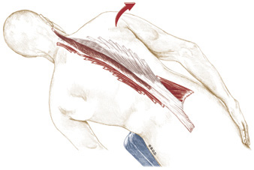
Quadratus Lumborum, Trail Guide Page 207 Unilaterally: Laterally tilt (elevate) the pelvis Laterally flex the vertebral column to the same side Assist to the extend vertebral column Bilaterally: Fix the last rib during forced inhalation and exhalation Posterior iliac crest Last rib Transverse processes of 1st-4th lumbar vertebrae
A
O
I
Posterior View

Slide 29
Quadratus Lumborum, Trail Guide Page 207 Unilaterally: Laterally tilt (elevate) the pelvis Laterally flex the vertebral column to the same side Assist to extend vertebral column Bilaterally: Fix the last rib during forced inhalation and exhalation Posterior iliac crest Last rib Transverse processes of 1st-4th lumbar vertebrae
A
O
I
Posterolateral View

Slide 30
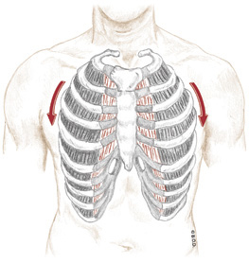
Quadratus Lumborum, Trail Guide Page 207 Unilaterally: Laterally tilt (elevate) the pelvis Laterally flex the vertebral column to the same side Assist to the extend vertebral column Bilaterally: Fix the last rib during forced inhalation and exhalation Posterior iliac crest Last rib Transverse processes of 1st-4th lumbar vertebrae
A
O
I
Anterior View

Slide 31
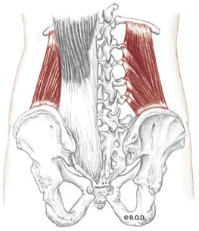
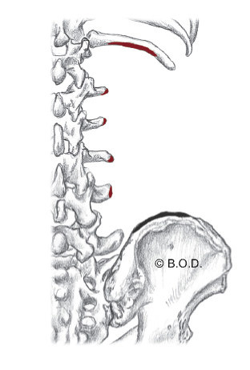
Quadratus Lumborum, Trail Guide Page 207 Unilaterally: Laterally tilt (elevate) the pelvis Laterally flex the vertebral column to the same side Assist to the extend vertebral column Bilaterally: Fix the last rib during forced inhalation and exhalation Posterior iliac crest Last rib Transverse processes of 1st-4th lumbar vertebrae
A
O
I

Slide 32
Quadratus Lumborum, Trail Guide Page 207 Unilaterally: Laterally tilt (elevate) the pelvis Laterally flex the vertebral column to the same side Assist to the extend vertebral column Bilaterally: Fix the last rib during forced inhalation and exhalation Posterior iliac crest Last rib Transverse processes of 1st-4th lumbar vertebrae
A
O
I

Slide 33
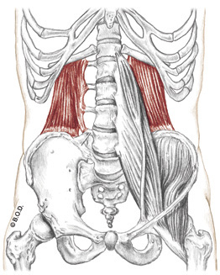
Quadratus Lumborum, Trail Guide Page 207
NOTE: the three lines of QL fibers correspond to the deep longitudinal stripping used in the orthopedic protocol for Low Back Pain.
Posterior View
Posterior View
Anterior View

Slide 34
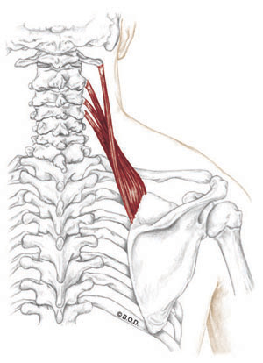
Levator Scapula Trail Guide, Page 83
Levator Scapula is located on the lateral and posterior sides of the neck.
The inferior portion is deep to trapezius, but the superior portion is superficial on the lateral side of the neck.
Its belly is approximately two fingers wide with fibers that naturally twist around themselves.
What actions does the levator scapula perform?
Posterior View

Slide 35
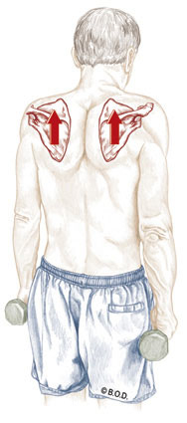
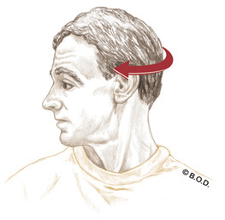
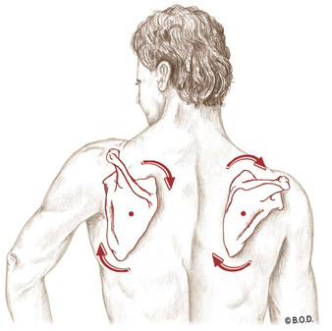
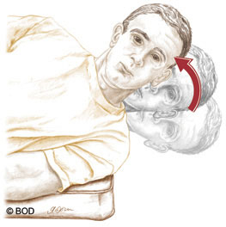
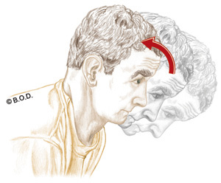
Actions of Levator Scapula
Lateral flexion of the head and neck
Rotation of the head and neck to the same side
Scapulothoracic elevation
Scapulothoracic downward rotation
Extension of the head and neck

Slide 36
Levator Scapula, page 84 A Unilaterally: Elevate the scapula, AKA: scapulothoracic joint Downwardly rotate the scapula, AKA: S/T joint Laterally flex the head and neck Rotate the head and neck to the same side Bilaterally: Extend the head and neck O Transverse processes of first through fourth cervical vertebrae Medial border of scapula, between superior angle and superior portion of spine of scapula
A
O
Posterior View
I

Slide 37
Levator Scapula, page 84 A Unilaterally: Elevate the scapula, AKA: scapulothoracic joint Downwardly rotate the scapula, AKA: S/T joint Laterally flex the head and neck Rotate the head and neck to the same side Bilaterally: Extend the head and neck O Transverse processes of first through fourth cervical vertebrae Medial border of scapula, between superior angle and superior portion of spine of scapula
A
O
Posterior View
I

Slide 38
Levator Scapula, page 84 A Unilaterally: Elevate the scapula, AKA: scapulothoracic joint Downwardly rotate the scapula, AKA: S/T joint Laterally flex the head and neck Rotate the head and neck to the same side Bilaterally: Extend the head and neck O Transverse processes of first through fourth cervical vertebrae Medial border of scapula, between superior angle and superior portion of spine of scapula
A
O
Posterior View
I

Slide 39
Levator Scapula, page 84 A Unilaterally: Elevate the scapula, AKA: scapulothoracic joint Downwardly rotate the scapula, AKA: S/T joint Laterally flex the head and neck Rotate the head and neck to the same side Bilaterally: Extend the head and neck O Transverse processes of first through fourth cervical vertebrae Medial border of scapula, between superior angle and superior portion of spine of scapula
A
O
Posterior View
I

Slide 40
Levator Scapula, page 84 A Unilaterally: Elevate the scapula, AKA: scapulothoracic joint Downwardly rotate the scapula, AKA: S/T joint Laterally flex the head and neck Rotate the head and neck to the same side Bilaterally: Extend the head and neck O Transverse processes of first through fourth cervical vertebrae Medial border of scapula, between superior angle and superior portion of spine of scapula
A
O
Posterior View
I

Slide 41
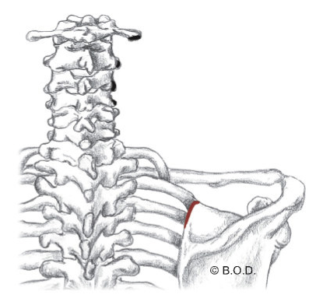
Levator Scapula, page 84 A Unilaterally: Elevate the scapula, AKA: scapulothoracic joint Downwardly rotate the scapula, AKA: S/T joint Laterally flex the head and neck Rotate the head and neck to the same side Bilaterally: Extend the head and neck O Transverse processes of first through fourth cervical vertebrae Medial border of scapula, between superior angle and superior portion of spine of scapula
A
O
Posterior View
I

Slide 42
Levator Scapula, page 84 A Unilaterally: Elevate the scapula, AKA: scapulothoracic joint Downwardly rotate the scapula, AKA: S/T joint Laterally flex the head and neck Rotate the head and neck to the same side Bilaterally: Extend the head and neck O Transverse processes of first through fourth cervical vertebrae Medial border of scapula, between superior angle and superior portion of spine of scapula
A
O
Posterior View
I

Slide 43
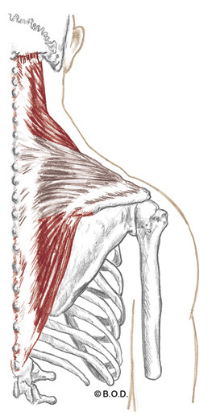
Trapezius Trail Guide, Page 68
Trapezius is a superficial muscle of the upper back and neck.
It comes from a Greek word meaning “little table” or “trapezoid shape”.
When do you use trapezius?
Posterior View

Slide 44
Trapezius Trail Guide, Page 68
Trapezius is used to:
Extend your neck over the handlebars of a bicycle
Hold a phone between your ear and shoulder
Carry articles strapped over your shoulder
Pull your shoulders back in a military fashion
What actions are performed by the upper fibers of trapezius?
Posterior View

Slide 45
Actions of trapezius upper fibers
Extension of the head and neck
Elevation of the scapula
Lateral flexion of the head and neck
Upward rotation of the scapula
Rotation of the head and neck to the opposite side

Slide 46
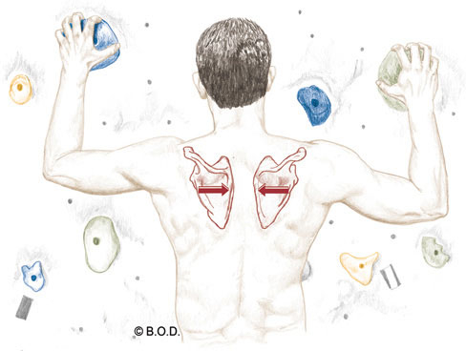
Actions of trapezius middle fibers
Adduction of the scapula.
Also called retraction of the scapula!
Middle fibers of trapezius are also responsible for stabilizing the scapula so that it remains in a fixed position.

Slide 47
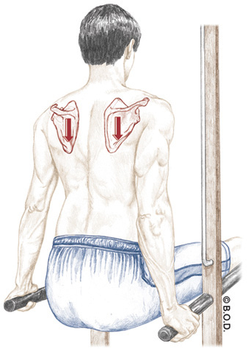
Actions of trapezius lower fibers
Upward rotation of the scapula
Depression of the scapula

Slide 48
Trapezius A Upper fibers: Bilaterally Extend the head and neck Unilaterally Laterally flex the head and neck to the same side Rotate the head and neck to the opposite side Elevate the scapula (scapulothoracic joint) Upwardly rotate the scapula (S/T joint) Middle fibers: Adduct the scapula (S/T joint) Stabilize the scapula (S/T joint) Lower fibers: Depress the scapula (S/T joint) Upwardly rotate the scapula (S/T joint) O External occipital protuberance Medial portion of superior nuchal line Ligamentum nuchae Spinous processes of C-7 through T-12 I Lateral one-third of clavicle Acromion Spine of scapula
A
O
I

Slide 49
Trapezius A Upper fibers: Bilaterally Extend the head and neck Unilaterally Laterally flex the head and neck to the same side Rotate the head and neck to the opposite side Elevate the scapula (scapulothoracic joint) Upwardly rotate the scapula (S/T joint) Middle fibers: Adduct the scapula (S/T joint) Stabilize the scapula (S/T joint) Lower fibers: Depress the scapula (S/T joint) Upwardly rotate the scapula (S/T joint) O External occipital protuberance Medial portion of superior nuchal line Ligamentum nuchae Spinous processes of C-7 through T-12 I Lateral one-third of clavicle Acromion Spine of scapula
A
O
I

Slide 50
Trapezius A Upper fibers: Bilaterally Extend the head and neck Unilaterally Laterally flex the head and neck to the same side Rotate the head and neck to the opposite side Elevate the scapula (scapulothoracic joint) Upwardly rotate the scapula (S/T joint) Middle fibers: Adduct the scapula (S/T joint) Stabilize the scapula (S/T joint) Lower fibers: Depress the scapula (S/T joint) Upwardly rotate the scapula (S/T joint) O External occipital protuberance Medial portion of superior nuchal line Ligamentum nuchae Spinous processes of C-7 through T-12 I Lateral one-third of clavicle Acromion Spine of scapula
A
O
I

Slide 51
Trapezius A Upper fibers: Bilaterally Extend the head and neck Unilaterally Laterally flex the head and neck to the same side Rotate the head and neck to the opposite side Elevate the scapula (scapulothoracic joint) Upwardly rotate the scapula (S/T joint) Middle fibers: Adduct the scapula (S/T joint) Stabilize the scapula (S/T joint) Lower fibers: Depress the scapula (S/T joint) Upwardly rotate the scapula (S/T joint) O External occipital protuberance Medial portion of superior nuchal line Ligamentum nuchae Spinous processes of C-7 through T-12 I Lateral one-third of clavicle Acromion Spine of scapula
A
O
I

Slide 52
Trapezius A Upper fibers: Bilaterally Extend the head and neck Unilaterally Laterally flex the head and neck to the same side Rotate the head and neck to the opposite side Elevate the scapula (scapulothoracic joint) Upwardly rotate the scapula (S/T joint) Middle fibers: Adduct the scapula (S/T joint) Stabilize the scapula (S/T joint) Lower fibers: Depress the scapula (S/T joint) Upwardly rotate the scapula (S/T joint) O External occipital protuberance Medial portion of superior nuchal line Ligamentum nuchae Spinous processes of C-7 through T-12 I Lateral one-third of clavicle Acromion Spine of scapula
A
O
I

Slide 53
Trapezius A Upper fibers: Bilaterally Extend the head and neck Unilaterally Laterally flex the head and neck to the same side Rotate the head and neck to the opposite side Elevate the scapula (scapulothoracic joint) Upwardly rotate the scapula (S/T joint) Middle fibers: Adduct the scapula (S/T joint) Stabilize the scapula (S/T joint) Lower fibers: Depress the scapula (S/T joint) Upwardly rotate the scapula (S/T joint) O External occipital protuberance Medial portion of superior nuchal line Ligamentum nuchae Spinous processes of C-7 through T-12 I Lateral one-third of clavicle Acromion Spine of scapula
A
O
I

Slide 54
Trapezius A Upper fibers: Bilaterally Extend the head and neck Unilaterally Laterally flex the head and neck to the same side Rotate the head and neck to the opposite side Elevate the scapula (scapulothoracic joint) Upwardly rotate the scapula (S/T joint) Middle fibers: Adduct the scapula (S/T joint) Stabilize the scapula (S/T joint) Lower fibers: Depress the scapula (S/T joint) Upwardly rotate the scapula (S/T joint) O External occipital protuberance Medial portion of superior nuchal line Ligamentum nuchae Spinous processes of C-7 through T-12 I Lateral one-third of clavicle Acromion Spine of scapula
A
O
I

Slide 55
Trapezius A Upper fibers: Bilaterally Extend the head and neck Unilaterally Laterally flex the head and neck to the same side Rotate the head and neck to the opposite side Elevate the scapula (scapulothoracic joint) Upwardly rotate the scapula (S/T joint) Middle fibers: Adduct the scapula (S/T joint) Stabilize the scapula (S/T joint) Lower fibers: Depress the scapula (S/T joint) Upwardly rotate the scapula (S/T joint) O External occipital protuberance Medial portion of superior nuchal line Ligamentum nuchae Spinous processes of C-7 through T-12 I Lateral one-third of clavicle Acromion Spine of scapula
A
O
I

Slide 56
Trapezius A Upper fibers: Bilaterally Extend the head and neck Unilaterally Laterally flex the head and neck to the same side Rotate the head and neck to the opposite side Elevate the scapula (scapulothoracic joint) Upwardly rotate the scapula (S/T joint) Middle fibers: Adduct the scapula (S/T joint) Stabilize the scapula (S/T joint) Lower fibers: Depress the scapula (S/T joint) Upwardly rotate the scapula (S/T joint) O External occipital protuberance Medial portion of superior nuchal line Ligamentum nuchae Spinous processes of C-7 through T-12 I Lateral one-third of clavicle Acromion Spine of scapula
A
O
I

Slide 57
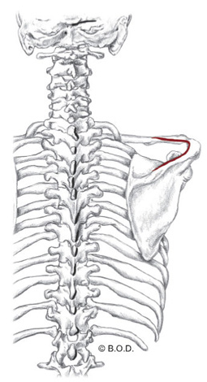
Trapezius A Upper fibers: Bilaterally Extend the head and neck Unilaterally Laterally flex the head and neck to the same side Rotate the head and neck to the opposite side Elevate the scapula (scapulothoracic joint) Upwardly rotate the scapula (S/T joint) Middle fibers: Adduct the scapula (S/T joint) Stabilize the scapula (S/T joint) Lower fibers: Depress the scapula (S/T joint) Upwardly rotate the scapula (S/T joint) O External occipital protuberance Medial portion of superior nuchal line Ligamentum nuchae Spinous processes of C-7 through T-12 I Lateral one-third of clavicle Acromion Spine of scapula
A
O
I
O
O
I

Slide 58
Trapezius A Upper fibers: Bilaterally Extend the head and neck Unilaterally Laterally flex the head and neck to the same side Rotate the head and neck to the opposite side Elevate the scapula (scapulothoracic joint) Upwardly rotate the scapula (S/T joint) Middle fibers: Adduct the scapula (S/T joint) Stabilize the scapula (S/T joint) Lower fibers: Depress the scapula (S/T joint) Upwardly rotate the scapula (S/T joint) O External occipital protuberance Medial portion of superior nuchal line Ligamentum nuchae Spinous processes of C-7 through T-12 I Lateral one-third of clavicle Acromion Spine of scapula
A
O
I
O
O
I

Slide 59
Trapezius A Upper fibers: Bilaterally Extend the head and neck Unilaterally Laterally flex the head and neck to the same side Rotate the head and neck to the opposite side Elevate the scapula (scapulothoracic joint) Upwardly rotate the scapula (S/T joint) Middle fibers: Adduct the scapula (S/T joint) Stabilize the scapula (S/T joint) Lower fibers: Depress the scapula (S/T joint) Upwardly rotate the scapula (S/T joint) O External occipital protuberance Medial portion of superior nuchal line Ligamentum nuchae Spinous processes of C-7 through T-12 I Lateral one-third of clavicle Acromion Spine of scapula
A
O
I
O
O
I

Slide 60
Trapezius A Upper fibers: Bilaterally Extend the head and neck Unilaterally Laterally flex the head and neck to the same side Rotate the head and neck to the opposite side Elevate the scapula (scapulothoracic joint) Upwardly rotate the scapula (S/T joint) Middle fibers: Adduct the scapula (S/T joint) Stabilize the scapula (S/T joint) Lower fibers: Depress the scapula (S/T joint) Upwardly rotate the scapula (S/T joint) O External occipital protuberance Medial portion of superior nuchal line Ligamentum nuchae Spinous processes of C-7 through T-12 I Lateral one-third of clavicle Acromion Spine of scapula
A
O
I
O
O
I

Slide 61
Trapezius A Upper fibers: Bilaterally Extend the head and neck Unilaterally Laterally flex the head and neck to the same side Rotate the head and neck to the opposite side Elevate the scapula (scapulothoracic joint) Upwardly rotate the scapula (S/T joint) Middle fibers: Adduct the scapula (S/T joint) Stabilize the scapula (S/T joint) Lower fibers: Depress the scapula (S/T joint) Upwardly rotate the scapula (S/T joint) O External occipital protuberance Medial portion of superior nuchal line Ligamentum nuchae Spinous processes of C-7 through T-12 I Lateral one-third of clavicle Acromion Spine of scapula
A
O
I
O
O
I

Slide 62
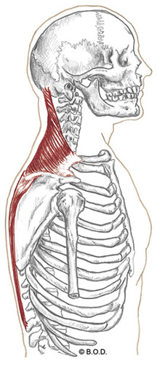
Trapezius A Upper fibers: Bilaterally Extend the head and neck Unilaterally Laterally flex the head and neck to the same side Rotate the head and neck to the opposite side Elevate the scapula (scapulothoracic joint) Upwardly rotate the scapula (S/T joint) Middle fibers: Adduct the scapula (S/T joint) Stabilize the scapula (S/T joint) Lower fibers: Depress the scapula (S/T joint) Upwardly rotate the scapula (S/T joint) O External occipital protuberance Medial portion of superior nuchal line Ligamentum nuchae Spinous processes of C-7 through T-12 I Lateral one-third of clavicle Acromion Spine of scapula
A
O
I
O
I

Slide 63
Trapezius A Upper fibers: Bilaterally Extend the head and neck Unilaterally Laterally flex the head and neck to the same side Rotate the head and neck to the opposite side Elevate the scapula (scapulothoracic joint) Upwardly rotate the scapula (S/T joint) Middle fibers: Adduct the scapula (S/T joint) Stabilize the scapula (S/T joint) Lower fibers: Depress the scapula (S/T joint) Upwardly rotate the scapula (S/T joint) O External occipital protuberance Medial portion of superior nuchal line Ligamentum nuchae Spinous processes of C-7 through T-12 I Lateral one-third of clavicle Acromion Spine of scapula
A
O
I
O
O
I

Slide 64
Trapezius A Upper fibers: Bilaterally Extend the head and neck Unilaterally Laterally flex the head and neck to the same side Rotate the head and neck to the opposite side Elevate the scapula (scapulothoracic joint) Upwardly rotate the scapula (S/T joint) Middle fibers: Adduct the scapula (S/T joint) Stabilize the scapula (S/T joint) Lower fibers: Depress the scapula (S/T joint) Upwardly rotate the scapula (S/T joint) O External occipital protuberance Medial portion of superior nuchal line Ligamentum nuchae Spinous processes of C-7 through T-12 I Lateral one-third of clavicle Acromion Spine of scapula
A
O
I
O
O
I

Slide 65
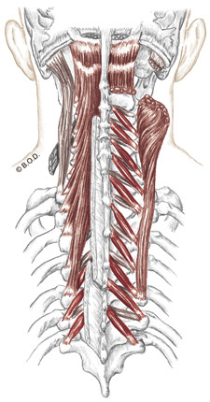
Transversospinalis Group Trail Guide, Page 200
Transversospinalis group:
Multifidi
Rotatores
Semispinalis capitis
These 3 muscles are deep to the erectors.
New to us, the semispinalis capitis muscle can be seen as the “twin speed bumps” on the posterior neck.
Posterior View

Slide 66
Semispinalis Capitis, page 201 Extend the vertebral column and head O Transverse processes of C4-T5 Between the superior and inferior nuchal lines of the occiput
A
O
I
Posterolateral View

Slide 67
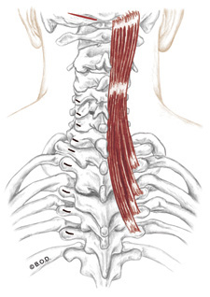
Semispinalis Capitis, page 201 Extend the vertebral column and head O Transverse processes of C4-T5 Between the superior and inferior nuchal lines of the occiput
A
O
I
Posterior View

Slide 68
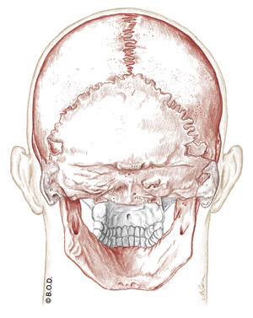
Semispinalis Capitis, page 201 Extend the vertebral column and head O Transverse processes of C4-T5 Between the superior and inferior nuchal lines of the occiput
A
O
I
Posterior View
Posterior View

Slide 69
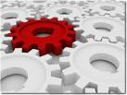

Slide 70
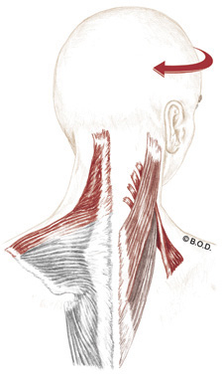
Splenius Capitis, page 203 Unilaterally: Rotate the head and neck to the same side Laterally flex the head and neck Bilaterally: Extend the head and neck Inferior 1/2 of ligamentum nuchae Spinous processes of C7 to T4 Mastoid process Lateral portion of superior nuchal line
A
O
I
Posterior View

Slide 71
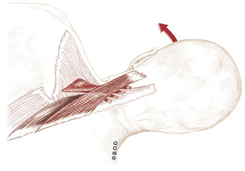
Splenius Capitis, page 203 Unilaterally: Rotate the head and neck to the same side Laterally flex the head and neck Bilaterally: Extend the head and neck Inferior 1/2 of ligamentum nuchae Spinous processes of C7 to T4 Mastoid process Lateral portion of superior nuchal line
A
O
I
Posterior View

Slide 72
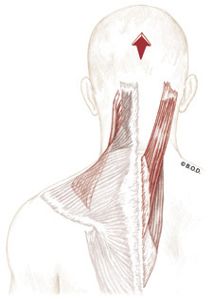
Splenius Capitis, page 203 Unilaterally: Rotate the head and neck to the same side Laterally flex the head and neck Bilaterally: Extend the head and neck Inferior 1/2 of ligamentum nuchae Spinous processes of C7 to T4 Mastoid process Lateral portion of superior nuchal line
A
O
I
Posterior View

Slide 73
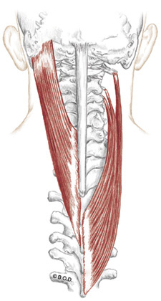
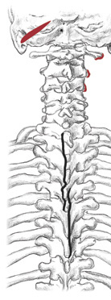
Splenius Capitis, page 203 Unilaterally: Rotate the head and neck to the same side Laterally flex the head and neck Bilaterally: Extend the head and neck Inferior 1/2 of ligamentum nuchae Spinous processes of C7 to T4 Mastoid process Lateral portion of superior nuchal line
A
C1/Axis
C2/Atlas
C3
O
C4
C5
C6
C7
T1
I
T2
T3
T4
Posterior View

Slide 74
Splenius Capitis, page 203 Unilaterally: Rotate the head and neck to the same side Laterally flex the head and neck Bilaterally: Extend the head and neck Inferior 1/2 of ligamentum nuchae Spinous processes of C7 to T4 Mastoid process Lateral portion of superior nuchal line
A
O
I
Posterior View

Slide 76
Splenius Cervicis, page 203 Unilaterally: Rotate the head and neck to the same side Laterally flex the head and neck Bilaterally: Extend the head and neck Spinous processes of T3 to T6 Transverse processes of C1 to C3
A
O
I
Posterior View

Slide 77
Splenius Cervicis, page 203 Unilaterally: Rotate the head and neck to the same side Laterally flex the head and neck Bilaterally: Extend the head and neck Spinous processes of T3 to T6 Transverse processes of C1 to C3
A
O
I
Posterior View

Slide 78
Splenius Cervicis, page 203 Unilaterally: Rotate the head and neck to the same side Laterally flex the head and neck Bilaterally: Extend the head and neck Spinous processes of T3 to T6 Transverse processes of C1 to C3
A
O
I
Posterior View

Slide 79
Splenius Cervicis, page 203 Unilaterally: Rotate the head and neck to the same side Laterally flex the head and neck Bilaterally: Extend the head and neck Spinous processes of T3 to T6 Transverse processes of C1 to C3
A
O
I
Posterior View

Slide 80
Splenius Cervicis, page 203 Unilaterally: Rotate the head and neck to the same side Laterally flex the head and neck Bilaterally: Extend the head and neck Spinous processes of T3 to T6 Transverse processes of C1 to C3
A
O
I
Posterior View

Slide 81
90a Kinesiology: Palpation Posterior Back and Neck

